Slide 1


Solutions by stc
Business Continuity Management System for stc | Technical Proposal
31st December 2023
Deloitte Reference: JO-7252586

Slide 2
Deloitte & Touche Advisory Saudi Ltd.
Prince Turki Bin Abdullah Al-Saud Street, Sulaimania Area
P.O. Box: 213, Riyadh – 11411, Kingdom of Saudi Arabia
Tel:+966 (0)11 2828 500
Fax:+966 (0)11 4761 350
www.deloitte.com
Private & Confidential
Deloitte Ref.: JO-7252586
December 31, 2023
On behalf of Deloitte & Touche Advisory Saudi Limited, hereinafter referred to as “Deloitte” and the members of our service team, we thank you for giving Deloitte the opportunity to submit our proposal for “Business Continuity Management System for stc” to your esteemed organization. It is an opportunity to develop our relationship with ‘stc’ and support you to obtain the desired outcomes. This proposal includes all the pertinent information required to address your needs and contains details of our people, credentials, tools and technology that differentiate Deloitte from the competition. Deloitte is the most qualified firm to meet your objectives, and this is based on the following: Our Relationship with stc – Deloitte has previously worked with stc on multiple projects including successful delivery of BCM and RM Maturity Assessment for subsidiaries, BCM Implementation for solutions, BCM Implementation for Channels, BCM Program Development for stc Pay, Compliance Management Maturity Assessment, Regulatory IA Review, 5G Readiness Review, Technology Strategy & Architecture Audit, Risk Management Program 2021, projects in the recent years. Our past experience with you has given us an insight into stc’s organization and its subsidiaries, processes, existing risks and systems which we can leverage in this project. Our Approach – We have developed our approach based on our extensive experience in establishing and implementing Business Continuity Management (BCM), Crisis Management and Disaster Recovery programs across the region, combined with our knowledge from delivering several end-to-end BCM programs in the Kingdom based on standards like ISO 22301:2019, ISO 22361:2022 and relevant international best practices. In our proposed approach we have considered and provided activities to ensure that maximum benefit is delivered through the journey of this project. Our Relevant Experience – Our proposed team has delivered various resilience programs within the Middle East. We have significant experience in establishing and implementing operational resilience, developing business continuity and crisis management capabilities and establishing the governance for effective resilience implementations. We have extensive experience in national and international standards (e.g., National Risk Council Resilience Guidelines, NCA ECC, DGA BCM Standard, ISO 22301, ISO 22361 etc.) and have delivered numerous engagements for clients in the Oil and Gas industries. Our Engagement Team – Our diverse, multicultural and multilingual team has outstanding BCM experience with over 35 dedicated, BCM trained and certified professionals in the region, supported by 250 risk consultants. Our team received recognition by the Business Continuity Institute (BCI) as the 2016 Continuity & Resilience Provider and the 2014 Business Continuity Provider and GCC Security Symposium & CISO Awards 7th Edition in Riyadh and UAE in the Year 2023. Our proposed team for this project consists of local and regional resources that have prior experience with several other organizations and will bring their experience directly to you. We look forward to extend our working relationship and are excited about the opportunity to serve stc on this important project. If you have any questions regarding the content of this proposal, please do not hesitate to contact our Cyber Partner, Tariq Ajmal at +971506522859, tajmal@deloitte.com or our Crisis & Resilience Leader for KSA & UAE, Arsalan Yousuf at aryousuf@deloitte.com or +966595615678. Yours sincerely, Khaled Al Sagga Partner Deloitte & Touche Advisory Saudi Limited
solutions by stc
Hamad m. Al Qahtani
Sell To Sales
solutions by stc
T: 0115251653
M: +966554437029
haqahtani@solutions.com.sa

Slide 3

Executive Summary
Our mission in Risk Advisory (RA) in Deloitte is to protect and create value for organizations by taking a risk intelligent approach towards managing financial, regulatory, technology, and business risks.
We strive to provide global, end-to-end, innovative, and risk-intelligent solutions tailored to priority industries and segments.

Slide 4
Executive Summary
Why Business Continuity Management?
Importance of Business Continuity
Business Continuity Management (BCM) is increasingly becoming a strategic imperative, forming part of Boardroom and C-suite conversations as a proven method to maintain reliable, continuous, and resilient operations. In addition to the requirements being enforced by regulators and the shareholders, BCM is the need of the hour especially due to the recent pandemic situation and supply chain issues.
Effective planning and implementation of BCM allows an organization to achieve the below key objectives:
Health and Safety - Protect health and safety of employees, contractors, customers and vendors in the location.
Viability
Financial Protection
Viability - Keeping the organization in the business, continuing to provide quality of products and services to customers.
Attract New Customers
Financial Protection - Protecting the organizations financial commitments.
Health and Safety
Brand Protection
Attract New Customers - Maintaining the ability to attract new customers and partners with the confidence of having a comprehensive BCMS.
Brand Protection - Avoiding embarrassment in the industry and loss of credibility.
Business Continuity Objectives

Slide 5
Executive Summary
Understanding Your Requirements
Project Objectives
Project Scope
Align stc with world-class corporate Business Continuity Management standards, best practices and benchmarks.
Take all reasonable steps to comply with the local statutory and regulatory requirements.
Ensure BCM activities are aligned to achieve strategic and operational objectives.
Boost maturity & resiliency of stc to effectively respond to any incident
Take all reasonable steps to safeguard the interests of key stakeholders, stc’s image and reputation, brand and value creating activities.
Ensure corporate readiness.
Improve competitive advantage, customer loyalty and satisfaction by ensuring the continuation of critical services.
Reduce the operational and financial impact of any disruption(s), and period of disruptions.
Enhance organizational resilience by managing continuity risks and continually improving disaster/emergency preparedness, response and recovery capabilities.
Continue providing vital services in post disaster scenarios;
Fully integrate BCM into stc’s culture and business processes by establishing and implementing a governance and control framework for BCM.
Perform BCM Risk Assessment
BCM Activities for stc
Review BCM Strategy and develop 3 years roadmap
Review and update BCM / CM DR / ER/ IM Plans
Develop BCM Test Plan Scenario Testing

Slide 6









Executive Summary
We Know You
Our experience with the stc Group
Deloitte understands the stc Group and its subsidiaries, working with your organization across multiple engagements. We believe our insight gained from these past engagements can be leveraged to ensure successful project delivery. A selection of these engagements is set out below:
Order to Cash
Record to Report
Procurement
Human Resources
Procurement Focused Contract (Forensic)
Lead to Market Review
Cyber Security Review
IT Governance
Internal Controls Review 2021 (Ongoing)
Risk Assessment & IA Plan Development
Internal Controls Review 2020
Enterprise Risk Management Roll-Out / Implementation
Strategic KRIs & KRI Framework
Cybersecurity Review
Services Development Review
Internal Controls Review 2021
Enterprise Risk Management
Internal Controls Review
TAWAL
stc Parent
Solutions by stc
Channels by stc
stc pay
CCC
AQALAT
Specialized by stc
STC Kuwait
Intigral
Site Lease & Acquisition IA Review
Operations IA Review
IA Secondments 2022 (Ongoing)
Risk Assessment & IA Plan Development
Internal Controls Review 2021 (Ongoing)
Internal Controls Review 2020
Internal Audit Services 2022
RM & BCM Subsidiaries maturity assessment
Cybersecurity Resilience Program
Internal Controls Review 2022 (Ongoing)
Risk Management Program 2021-2022 (Ongoing).
Internal Controls Review 2021
Compliance Management Maturity Assessment & IA Review.
Technology Strategy & Architecture Audit
5G Readiness Review
Enterprise Architecture Audit (Ongoing)
Enterprise Risk Assessment & Compliance Management
Business Continuity Management
Risk Appetite Development
Risk Assessment & IA Plan
Revenue & Cost of Revenue
Connectivity Services & Telecom Technical
GRC Function Assessment including Cyber Security
Product Development Life Cycle
Alliances and Partnership
Business Continuity Management
Governance, Risk & Compliance Engagements (Ongoing)
Quality, Risk & Compliance Consultancy Program
Risk Assessment & Development of IA Plan
Internal Controls Review
Governance, Risk and Compliance Secondment (ongoing)
BCM & DRP Development & Enhancement
Third Party Assessment (Ongoing)
Setup of Enterprise Risk Framework
Development & Enhancement of Policies

Slide 7
Executive Summary
Deloitte’s Proposition to stc
Below provides a phased approach mapped to the project requirements, to deliver the desired outcomes for BCMS at stc.
Review existing BCM Strategy and existing BCM roadmap, refine BCM Strategy in alignment with BIA and RA performed to address gaps in stc’ existing recovery strategy; identify and document list of activities/gap required to refine Recovery Strategy
Develop BCM exercising program and exercise plans, develop different test scenarios, conduct tabletop exercises and crisis simulations with different teams and stakeholders.
Project Initiation Activities
Phase 1:
BCM Risk Assessment
Phase 2:
BCM Strategy and Roadmap
Phase 3:
Plans Review and Enhancement
Phase 4:
BCM Exercising
Identify threats and risks to stc processes, services and products, perform risk assessment, identify existing controls and propose mitigations. Update risk registers and develop risk assessment report
Review the existing BCP template and identify gaps in existing BCP plan in alignment with ISO 22301. Review plans including ER, CM, DR, IM etc., provide recommendations and update the plans. Align IT DR and Telecom DR along with incident management

Slide 8
Executive Summary
Delivery Model Proposition
Based on our understanding of the scope and efforts required to achieve the desired objectives yet keeping the proposition cost-effective and value-add for stc, we are proposing two different delivery models. While the overall project approach remains the same for all phases, each model has different effort and number of deliverables, as described below:
Option 1 – Value-based, Cost-effective Scope Delivery
Phase 1 – BCM Risk Assessment For stc Head Office and other locations within Riyadh: Perform onsite risk identification, risk assessment, verification of existing controls and development of risk mitigation plans. For all stc locations outside Riyadh: Perform risk identification and risk assessment workshops remotely. The assessment will be limited to interviews and review of documentations. However, no control verification will be performed, and risk mitigation plan will be proposed based on the design of control provided during workshops.
Phase 2 – BCM Strategy and Roadmap Perform a current maturity assessment of stc’s BCMS against international standards and best practices. Develop a 3-year BCM Strategy and roadmap to achieve the target BCMS maturity. Also review and enhance the BCM recovery strategies based on the BIA performed by stc and risk assessment performed in Phase 1.
Phase 3 - Plans Review and Enhancement Review and enhance business continuity plan (BCP) template and update BCPs Review and enhance incident management plans (maximum 10 plans), centralized crisis management plan and centralized crisis communication plan Review and update centralized IT disaster recovery plan and a maximum of 20 selected technical recovery plans Develop emergency response plan (ERP) template to be used by stc departments
Phase 4 – BCM Exercising Develop BCM Exercising Program Identify ten (10) different test scenarios Conduct seven (07) tabletop exercises covering IMPs, BCPs, IT DRP, TRP, CMP and CCP Conduct three (03) crisis simulations covering CMP and CCP Develop post-exercise reports

Slide 9
Executive Summary
Delivery Model Proposition
Based on our understanding of the scope and efforts required to achieve the desired objectives yet keeping the proposition cost-effective and value-add for stc, we are proposing two different delivery models. While the overall project approach remains the same for all phases, each model has different effort and number of deliverables, as described below:
Option 2 – Full-scope Delivery
Phase 1 – BCM Risk Assessment For all stc locations across KSA: Perform onsite risk identification, risk assessment, verification of existing controls and development of risk mitigation plans.
Phase 2 – BCM Strategy and Roadmap Perform a current maturity assessment of stc’s BCMS against international standards and best practices. Develop a 3-year BCM Strategy and roadmap to achieve the target BCMS maturity. Also review and enhance the BCM recovery strategies based on the BIA performed by stc and risk assessment performed in Phase 1.
Phase 3 - Plans Review and Enhancement Review and enhance business continuity plan (BCP) template and update BCPs Review and enhance all incident management plans across stc Review and enhance centralized crisis management plan and centralized crisis communication plan Review and update centralized IT disaster recovery plan and all technical recovery plans (approx. 300) Develop emergency response plan (ERP) template and document ERPs for a maximum of 10 different emergency scenarios for stc Head Office
Phase 4 – BCM Exercising Develop BCM Exercising Program Identify ten (10) different test scenarios Conduct seven (07) tabletop exercises covering IMPs, BCPs, IT DRP, TRP, CMP and CCP Conduct two (02) crisis simulations covering CMP and CCP Conduct one (01) crisis simulation covering selected IMPs, BCPs, IT DRP, TRPs, CMP and CCP Develop post-exercise reports

Slide 10

Our Capabilities
As your provider for Cyber and Technology Risk services, we will bring an outstanding capabilities of Deloitte that are tailored to your needs.

Slide 11
Our Capabilities
Our BCM Profile
Why Deloitte?
Deloitte - an award-winning service provider for Crisis & Resilience (C&R) and global C&R thought leader - can help public and private entities successfully implement the requirements in the ISO 22301:2019 - Business Continuity Management Systems – standard, ISO 22361:2022 – Crisis Management – Guidelines and ISO 22316:2017 – Security and Resilience.
Extensive Experience
We have delivered full BCM implementations, IT Disaster Recovery Management programs, assessed organizational readiness and maturity and advised on best BCM practices for government, semi-government and private sector organizations in multiple industries.
A World-class Team
Our diverse, multicultural and multilingual team has outstanding Crisis & Resilience experience in Middle East with over 35 dedicated, locally-based, BCM trained and certified professionals, supported by 250 risk consultants. Our team was twice recognized by the Business Continuity Institute (BCI) as the Continuity & Resilience Provider and the Business Continuity Provider. Our teams were recently awarded by the CISO Global Forum for BCM Services in both KSA and UAE.
Our Robust & Agile BCM Methodology
We provide customizable solutions to meet your BCM objectives. Our methodology is adaptive to the needs of every organization and addresses complex processes and drivers in order to ensure effective implementation.
35+
250+
40+
Trained and dedicated BCM Professionals
Technology Risk Consultants
End-to-end BCM implementations in the ME Region
25+
15+
Certified ISO 22301 LI, CBCI, MBCI Professionals
Industry sectors for which BCM services have been provided

Slide 12

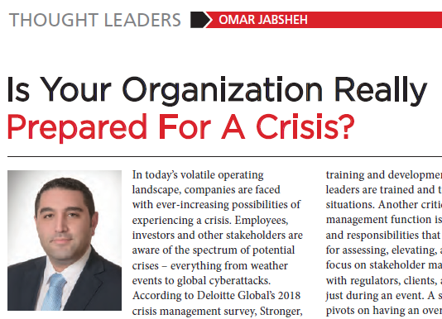

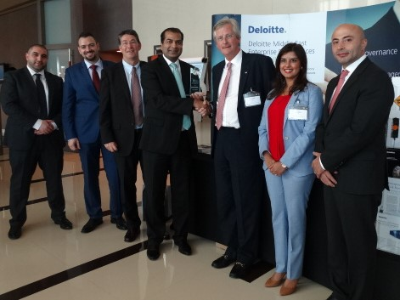

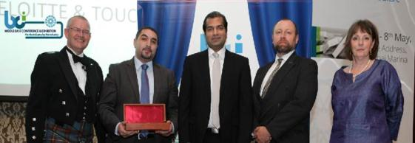
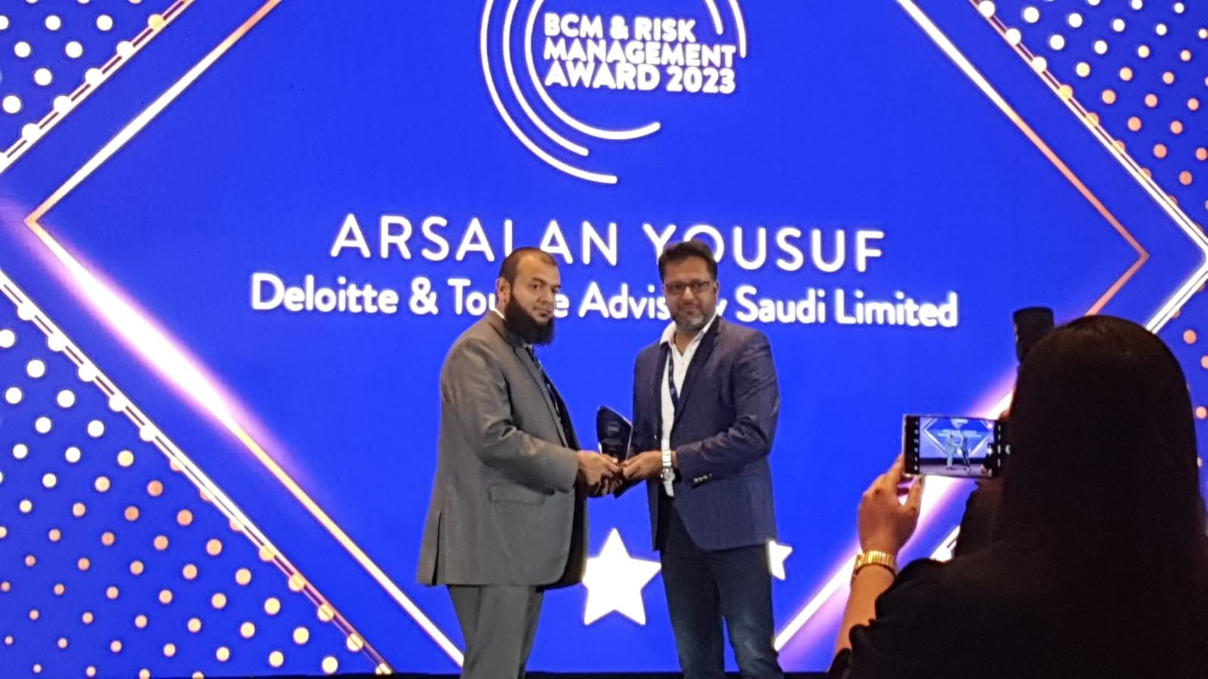


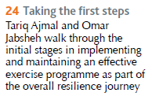
Our Capabilities
Leaders in Resilience
Award Winning Performance
Thought Leadership
Forums & Community Partners
“The winning organization of this award (Deloitte) offers a comprehensive array of solutions designed to help their clients evaluate their risks, determine acceptable levels of exposure and monitor the applications of these controls. Throughout 2013, they excelled in delivering business continuity, resilience and operational risk management solutions to a number of clients and redefined the standard of excellence in the BCM domain for the region.” - Business Continuity Provider of the Year 2014 (Service) Award.
Also, our team of Professionals have been honored with the prestigious BCM & Risk Management award for their exceptional contribution at the GCC Security Symposium & CISO Awards 7th Edition in Riyadh and UAE in the Year 2023.
Our team of resilience professionals are well regarded in the business community, as evident in some prominent publications such as Forbes Magazine.
Our resilience team members are members of professional communities such as the Business Continuity Institute’s (BCI) chapters and forums across the region, and regularly contribute to thought leadership across those platforms.
Forbes Magazine – April 2019
Thought Leaders Section
Conferences & Seminars
Our professionals have also made an impact in terms of thought leadership at a global scale, such as publishing articles in the BCI’s Continuity Magazine published globally.
Our resilience leadership team are regularly invited to speak at conferences and seminars on areas in resilience and crisis management.
2014
2023
BCI’s Continuity Magazine – Q3 2015
Continuity & Resilience Provider
(Service / Product) 2016
Business Continuity Provider
of the Year 2014 (Service)

Slide 13
































Our Capabilities
Our BCM Credentials
Our Middle East BCM practice has experienced practitioners and consultants certified in the business continuity field. We have successfully developed and evolved BCMS, implemented end-to-end projects, assessed readiness and maturity, and advised on BCM best practices.

Slide 14



Our Capabilities
BCM Credentials within stc Group
Client
solutions by stc
Deloitte was engaged by STC Solutions to implement a holistic BCM Program and integrating it with the existing Enterprise Risk Management framework..
Services Provided
Establishing BCM governance policy and procedures
Performing Threat Risk Assessment and Business Impact Analysis for the entire organization identifying the time-critical services, business processes and their respective recovery requirements
Developed Business Continuity Plans and Recovery Strategies that will support solutions in recovering their time critical services and operations in a timely manner.
Developed Crisis Management and Crisis Communication Plans to assist the Senior Management address any adverse situation
Impact Delivered
Conducted several trainings and tabletop exercises for BCPs and Crisis Management Plan
Based on the BCMS developed and implemented by Deloitte, STC Solutions obtained ISO 22301 Certification in 2020.
Client
channels by stc
Deloitte was engaged by STC Channels to review and update channels‘ existing BCM program.
Services Provided
Review and enhance the overall BCM Program governance and framework
Conduct Business Impact Analysis and Threat Risk Assessment for the organization’s departments and services, identifying critical services and products, associated processes and their recovery requirements
Develop recovery strategies to support recovering critical services and the associated processes within the recovery timeframes, and documented the continuity plans
Developed Crisis Management and Crisis Communication Plans to assist the Senior Management address any adverse situation .
Impact Delivered
Conducted several trainings and tabletop exercises for BCPs and Crisis Management Plan, enabling Channels enhance its preparedness for disruptive incidents.
Client
stc Pay
Deloitte was engaged by stc Pay to establish develop its business continuity and disaster recovery capabilities in line with ISO 22301 and SAMA BCM Framework requirements.
Services Provided
Develop BCM Policy, Governance and manual setting establishing the base for BCMS.
Conduct Business Impact Analysis and Threat Risk Assessment for all in-scope departments and locations
Identify suitable recovery strategies, develop business continuity and disaster recovery plans
Develop incident and crisis management framework, crisis management plan and crisis communication plan.
Impact Delivered
Conducted trainings and tabletop exercises for BCPs and CMP.
Enabled stc Pay to achieve compliance against ISO 22301 and SAMA BCM Framework requirements.

Slide 15



Our Capabilities
Selected BCM Credentials
Royal Commission for Al Ula
Uptown Jeddah Company
ROSHN Real Estate Company
Ministry of Commerce
Ministry of Transport and Logistical Services
Project Details
Project Details
Project Details
Project Details
Project Details
Establishment and operation of Governance, Risk and Compliance (GRC). Due to its vast experience in GRC, its qualified team and strong relationships, Deloitte has recently completed a mega project for the Royal Commission for AlUla (RCU). Deloitte is responsible for the establishment of the GRC function based on the build-operate-transfer model over an 18-month period. The scope of work covered the development of the enterprise risk, enterprise resilience, governance, ethics and compliance departments part of the GRC division.
Uptown Jeddah Company engaged Deloitte & Touche Advisory Saudi Limited to Establish the Business Continuity Management Function and implement an end-to-end Business Continuity Management System for the Company. The project had a timeline of 10 Months.
The scope of work covered the establishment of the function develop the policy and operating model, in addition to BCM Framework and manual procedures. Also as part of the scope performing Threat Risk Assessment and Business Impact Analysis for the whole entity. As a result of this analysis, Deloitte has delivered an updated Business Continuity Plans and Recovery Strategies that are will support Uptown Jeddah Company in recovering their time critical services and operations in a timely manner.
As part of the scope Deloitte developed the Incident Response and Crisis Management framework and related plans.
ROSHN is a real estate entity established under the Public Investment Fund (PIF).
ROSH partnered with Deloitte to implement a robust BCMS in light of ROSHN’s mission and vision to make long term investments in the future of cities across Saudi Arabia by developing great communities with best-in-class homes and to be the most trusted community developer in Saudi Arabia. The engagement was completed over a period of 8 months, with below key outcomes:
A Business Continuity Management System which is aligned with the ISO 22301:2019 standards and is reflective of ROSHN’s culture and operations.
Trained, skilled professionals who understand the importance of resilience, and are confident and competent to complete their assigned roles in the BCMS.
Deloitte & Touche Advisory Saudi Limited led the development and implementation efforts for a comprehensive Business Continuity Management program for MC for a period of 10 Months. The project comprised of establishing BCM Governance Policies and Procedures as well as conducting organization-wide Business Impact Analysis, IT Disaster Recovery Assessment and Threat Risk Assessment outlining the recovery time and recovery point objectives for the MCs critical services and processes. Moreover, a number of exercises (Tabletop and Simulation) have been conducted to evaluate MC’s crisis preparedness.
Establishment of the Risk Management (RM) and Business Continuity Management (BCM) functions. The project comprised of establishing BCM Governance via the development of Policies, Frameworks, Structures, and Procedures. Deloitte is also responsible of conducting organization-wide Business Impact Analysis and Threat Risk Assessment outlining the recovery time and recovery point objectives for critical services and processes. Moreover, the project scope also includes the identification of best-fit of recovery strategies / solutions, development of Business Continuity Plans (BCPs) including Crisis Management, conducting exercises, and spreading awareness / conducting training workshops. Last but not least, throughout this journey Deloitte supported the establishment of Guidelines dedicated for RM and BCM which are planned to be utilized throughout the sector in-order to support the increase in maturity.

Slide 16




Our Capabilities
Selected BCM Credentials
Saudi Arabian Monetary Authority (SAMA)
Saudi Payments (SADAD)
Ma’aden
Al Rajhi Bank
Tadawul
Project Details
Project Details
Project Details
Project Details
Project Details
Deloitte was engaged to develop Business Continuity Development Program for SAMA Head Office, all branches and Committees across the Kingdom. In line with the understanding of the vision and requirements of SAMA, Deloitte built on its realization of the scale and criticality of such an important initiative by investing 24 months of extensive efforts of hands-on involvement to develop an end-to-end BCMS. The dedicated team steered the development of the program in its initial stages by assessing and understanding existing resilience capabilities of the organization, only to be followed with a multi-month in-depth BIA of the entire organization (including the Headquarters in Riyadh as well as the authority’s ten branches across the kingdom) to derive the authority’s time-critical processes and identify recovery requirements needed to support the recovery of such processes.
Saudi Payments was established by the Saudi Central Bank (SAMA) to be the national Payment Infrastructure provider for the Kingdom of Saudi Arabia (KSA), with the mandate to operate and manage all payment systems in KSA (i.e. mada, SARIE, IPS, SADAD and Esal).
Deloitte was appointed by SAMA to establish, manage and operate the Governance, Risk and Compliance function of Saudi Payments for 2 years. This included management and maintenance of Business Continuity Management, Enterprise Risk Management, Information Security Governance, Fraud Risk Management and Compliance Management.
As part of the BCM Department, Deloitte successfully achieved Maturity Level 4 against SAMA BCM Framework and was able to maintain ISO 22301 certification through 2 successful surveillance audits.
Deloitte & Touche M.E. is currently working with Ma’aden to assess and revamp its crisis management capabilities. The project requires updating the relevant plans and procedures and conducting trainings and exercises for middle management and senior management.
Deloitte was also involved in implementation of end-to-end Business Continuity Management System for Ma’aden Corporate and all of its business units and affiliate companies including a review of its emergency response procedures for its mines and sites. MA’ADEN engaged Deloitte to assist in the development of the enterprise wide Enterprise Risk Management (ERM) Program and the BCM Program concurrently. The Project lasted 2 years and covered the entire units and sites in scope.
Deloitte & Touche Advisory Saudi Limited led the update and enhancements efforts for a comprehensive Business Continuity Management program for ARB for a period of 9 Months. The project comprised of establishing BCM Governance Policies and Procedures as well as conducting organization-wide Business Impact Analysis, Threat Risk Assessment outlining the recovery time and recovery point objectives for ARB’s critical services and processes. Moreover, a number of exercises have been conducted to evaluate ARB’s crisis preparedness.
Furthermore, Deloitte conducted an organizational resilience maturity assessment for ARB and developed a road map entailing the initiatives to be undertaken by the various ARB stakeholders to optimize their resilience capabilities.
Tadawul has Business Continuity (BC) arrangements in place and was striving to ensure its BC program is enhanced and up to date.
To achieve this, Tadawul sought the services of Deloitte to provide expert advice and assistance to enable the Risk Management Division (RMD) undertake an update cycle of Tadawul’s BC program with the aim of raising the quality and maturity to the program further (including initiation of expanding the scope of the program to the Subsidiary), and also focusing on building exercising and testing capability.

Slide 17







Our Capabilities
Relevant Publications
Building Supply Chain Resilience beyond COVID-19
A three-dimensional tech strategy, enabled by cloud, can drive market value
Communicating the Value of Cybersecurity to Boards and Leadership
Deloitte’s Global Resilience Report
Building Operational Resilience and Agility
Preparing for a sustainable future
Capital Allocation and Resilient Portfolios

Slide 18

Approach & Methodology
We believe in a service delivery approach that is driven by the client vision and expectation. We strive to provide global, end-to-end, innovative, and intelligent solutions tailored to priority industries and segments.
Subsequent section summarizes the approach performed by Deloitte to meet your expectation and objective.

Slide 19
Approach & Methodology
Deloitte’s BCM Methodology
The below is a high-level representation of Deloitte’s BCM methodology, which is a mature method for establishing and operating a BCMS and is aligned with leading industry standards such as: NCA, ISO 22301 and industry best practices. Based on the project requirements, specific activities of the methodology will be applied in this project to achieve the desired outcomes.
Program Governance
Change Management and Awareness
Analyze
Design
Roll Out
Evaluate
Current State Assessment
Recovery Strategies
Internal Audit
Plan Development
Awareness & Training
BCMS Governance Framework
Incident and Crisis Management
Operational Continuity (BETH3V™)
Management Review
Business Impact Analysis
Building (Facilities)
Equipment
Technology (Disaster)
HR Workforce
3rd Party (Supply Chain)
Vital Records
Testing & Exercising
Certification Support
Threat Risk Assessment
Plan Validation
Improve and Maintain

Slide 20
Approach & Methodology
Proposed BCM Approach
Below provides a phased approach mapped to the project requirements, to deliver the desired outcomes for BCMS at stc.
Review existing BCM Strategy and existing BCM roadmap, refine BCM Strategy in alignment with BIA and RA performed to address gaps in stc’ existing recovery strategy; identify and document list of activities/gap required to refine Recovery Strategy
Develop BCM exercising program and exercise plans, develop different test scenarios, conduct tabletop exercises and crisis simulations with different teams and stakeholders.
Project Initiation Activities
Phase 1:
BCM Risk Assessment
Phase 2:
BCM Strategy and Roadmap
Phase 3:
Plans Review and Enhancement
Phase 4:
BCM Exercising
Identify threats and risks to stc processes, services and products, perform risk assessment, identify existing controls and propose mitigations. Update risk registers and develop risk assessment report
Review the existing BCP template and identify gaps in existing BCP plan in alignment with ISO 22301. Review plans including ER, CM, DR, IM etc., provide recommendations and update the plans. Align IT DR and Telecom DR along with incident management

Slide 21
Approach & Methodology
Project Initiation Activities
Key Activities
Project Management Approach
Our Project Methodology encompasses the following activities divided into five steps:
Step I – Project Initiation: Develop and sign-off an engagement letter to establish an agreement on the scope of work, approach and methodologies to be used. Furthermore, conduct a kick-off meeting with key stakeholders of the project and establish a project steering committee.
Step II – Project Planning: Develop a detailed project plan with timelines, resource allocation, deliverables, milestones and dependencies
Step III – Execution: Project activities will be performed according to project plan
Step IV – Monitoring and Quality Assurance: Reporting will be agreed as part of the planning phase whereby a status meeting will occur regularly with the project steering committee to outline the performance of the agreed program and achievement of key deliverables.
Step V – Project Closing: A closing meeting will be conducted with the project steering committee followed by a final sign-off and formal hand-over of all deliverables
Engagement Letter / Contract
Phase I - Initiation
Client Assistance Letter
Phase II - Planning
Project Plan
Kick-Off Meeting
Request for Information
Engagement Activities
Phase III - Execution
Meetings & Workshops
Status Reports
Phase IV - Monitoring
Internal Quality Assurance
Exit Meeting
Phase V - Closing
Deliverables
Management Sign-Off
Project Charter
Project Plan (MS Project)
Kick-off Presentation
Deliverables
Project Management
Meetings / Workshops
Fieldwork
Quality Assurance

Slide 22
Approach & Methodology
Project and Quality Management
We recognize that the quality service and advice we deliver enables our clients to make good decisions and protects their businesses and reputations. Quality is our passion - engrained in our culture and reinforced by our processes and systems. The cornerstone of quality in Deloitte is the caliber of our people and the consultative environment in which they work.
Although an iterative process, there are three distinct phases to our Quality Program: Planning, Assurance and Control.
Quality Planning
Quality Assurance
Quality Control
Establish Templates and Procedures
Stakeholder Feedback
Accurate Deliverables
Meeting Expectations
Communicate Quality Standards
Quality Reporting
Document Quality Issues
Define Client Expectations
Deliverable Review Process
Deloitte Quality Control Lead
This process identifies the quality standards that are expected by and relevant to stc and determines how to fulfil them.
This process focuses on each deliverable meeting relevant quality standards; and is accomplished through peer reviews, client reviews, and product reviews.
This process monitors and manages quality issues so that compliance is maintained, including objective reports of quality issues to Deloitte leadership and stc.
The Quality Control Plan depicted above has been designed to manage the quality of work through-out the duration of the engagement. The Quality Control Plan is based on a Quality Control framework that has been established by DTT member firms, refined through years of implementation, and has been successfully used by Deloitte professionals on large public and private sector engagements. This Quality Control Plan includes items specific to the needs with the goal of producing uniform, clear, concise, deliverables and work products of the highest possible quality throughout our length of service to stc.

Slide 23
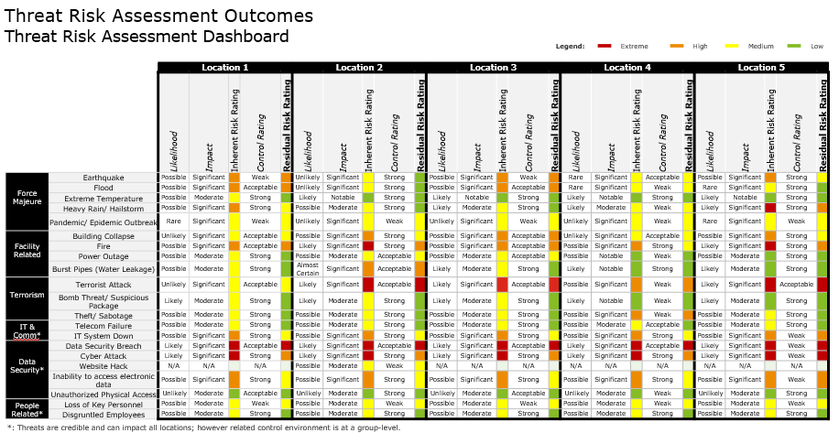
Approach & Methodology
Phase 1: BCM Risk Assessment (1/2)
Key Activities
Methodologies / Sample Deliverables
Risk Assessment
Understand and document the significant threats and hazards that could adversely impact stc products, services and processes. This involves facilitating workshops with relevant stakeholders to understand and document the probability, severity, and impact of these threats and hazards.
We will do the following activities:
Develop a customized TRA template tailored to stc need, utilizing the existing risk management framework.
Identify the threats for the in-scope location (i.e. stc Head office in Riyadh and other locations across the Kingdom), possible likelihood, probability of occurrence and the potential impact of the threats.
Identify inherent risks associated with various asset categories defined in BETH3V: Buildings, Equipment (hardware), Technology (software), Human Resources, 3rd parties (stakeholders), and Vital Records.
Identify the existing physical and environmental mitigating controls / measures.
Measure the risk exposure level after evaluating the identified mitigating measures implemented in stc, using the existing risk management approach.
Develop a consolidated TRA report outlining all the results captured throughout the TRA exercise.
Develop a risk assessment presentation for the Senior Management outlining all the key results captured throughout the analysis and assessment exercises.
For Illustration Purposes Only
Deliverables
Risk Assessment methodology and template
BC Risk Register
Consolidated BC Risk Assessment Report
Presentation to Senior Management

Slide 24
Approach & Methodology
Phase 1: BCM Risk Assessment (2/2)
Threat Risk Assessment (TRA) methodology will be tailored / customized in alignment with the currently adopted Risk Management to meet stc needs and requirements. The TRA targets the understanding and documentation of significant threats and hazards which could adversely impact stc operations and services; a sample of key threats and risks are outlined in the diagram below:
Reference | Threat / Risk Category | Threat / Risk Description | Impacted Resource Types | Likelihood | Impact | Inherent Risk | Exciting Controls | Control Effectiveness | Residual Risk
1 | - | Safety hazards | - | - | - | - | - | - | -
2 | - | Health hazards | - | - | - | - | - | - | -
3 | - | Environmental hazards | - | - | - | - | - | - | -
4 | - | Property Damage | - | - | - | - | - | - | -
5 | - | Fire, flood or storm | - | - | - | - | - | - | -
6 | - | Terrorist / sabotage attacks | - | - | - | - | - | - | -
7 | - | Power outage | - | - | - | - | - | - | -
8 | - | Visibility into 3rd party risks | - | - | - | - | - | - | -
For illustrative purposes only

Slide 25
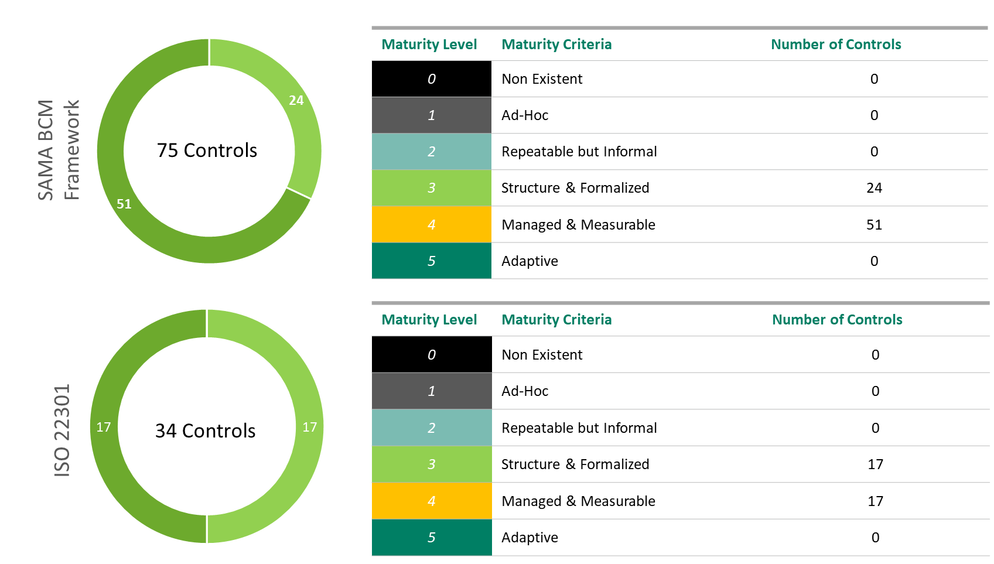
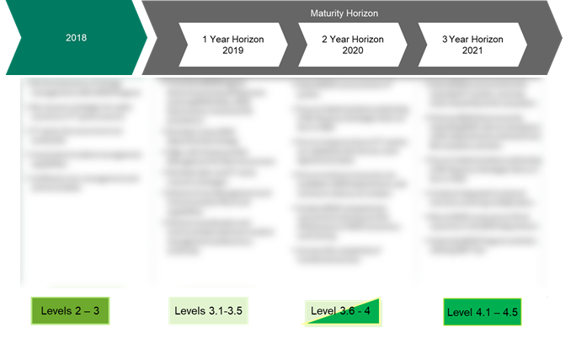
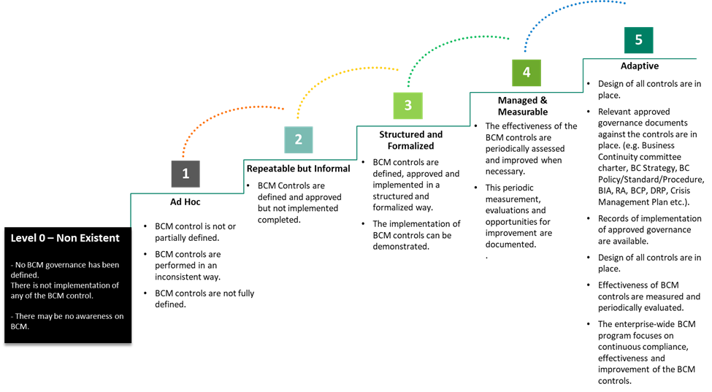
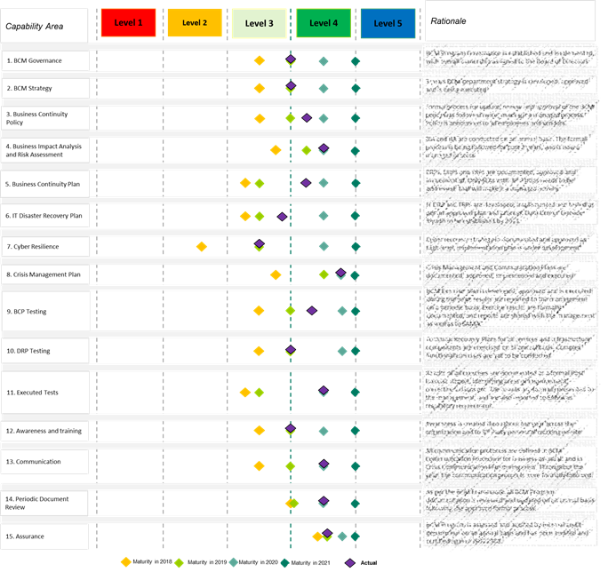
Approach & Methodology
Phase 2: BCM Strategy and Roadmap (1/2)
Key Activities
Methodologies / Sample Deliverables
Current State Assessment
A current state assessment will be carried out using Deloitte’s proprietary Capabilities Assessment of Resilience and Recoverability (CARR) methodology, which is aligned to ISO 22301:2019, ISO 22361:2022 and industry best practices and will enable a comprehensive approach to understanding stc’s current business continuity, disaster recovery, incident management and crisis management capabilities and BCMS maturity.
Key activities include:
Collaborate with stc teams to seek existing documentation relevant to services restoration, BCM and Crisis Management such as (BCM Policy, BCM Plan high level summary of key functional processes, etc.)
Evaluate and assess key criteria of the business continuity capabilities, including but not limited to buildings, equipment, technology, third parties and vendors, vital records, structures and processes, plans and procedures, capabilities of response teams, communication channels and protocols
Conduct interviews with key stc stakeholders from a range of key functions (such as IT Operations, Cybersecurity, Business Operations, Communications, Legal and HR, etc.) to develop an understanding of the current practices
Review output of any resilience exercises and Internal Audits.
BCM Strategy and Roadmap
Define Vision, Mission and objectives for stc BCMS
Identify gaps between the current BCM maturity and target maturity state over a period of 3 years
Identify initiatives and activities required to achieve the target BCM maturity state
Develop 3-year roadmap for implementation of the identified initiatives and activities with high-level timelines.
For Illustration Purposes Only
Deliverables
Strategy Gap Report
BCM Strategy and 3-Year Roadmap

Slide 26



Approach & Methodology
Phase 2: BCM Strategy and Roadmap (2/2)
Key Activities
Methodologies / Sample Deliverables
BCM Recovery Strategy Updates
Based on the outcomes of BIA already conducted by stc and BC Risk assessment as part of phase 1, we will review the existing BCM recovery strategies and evaluate whether they are viable or not.
For every process enabler that a recovery strategy is required to be developed or updated, we will do the following:
Review the current recovery strategies and identify any gaps based on the outcome of latest BIA exercise (in terms of recovery of BETH3V enablers);
Evaluate the recovery options to ensure they provide the minimum acceptable level of service for key BCM Program metrics – such as within the defined maximum tolerable period of disruption (MTPD) and recovery time objective (RTO) timeframe as well as recovery point objective (RPO);
Present the recovery strategy options for the time-critical processes to the BCM Steering Committee / Management; and
Recommend, based on hierarchical tiers, the most cost-effective strategy option for each time-critical service and process and obtain management approval of the selected options.
Drivers:
An understanding of core functions and current operating environment, as well as the exposures that may impact the continuity of operations
Design:
Solutions proposed to enable continuity in line with prioritization and resources required for resuming time-critical departments
Requirements
Obtained from BIA as well as management requirements for incident response
Requirements
Solutions
Proposed strategy options
Deliverables
Exposures
Updated Recovery Strategies
Exposures
Obtained through the BC Risk Assessment

Slide 27
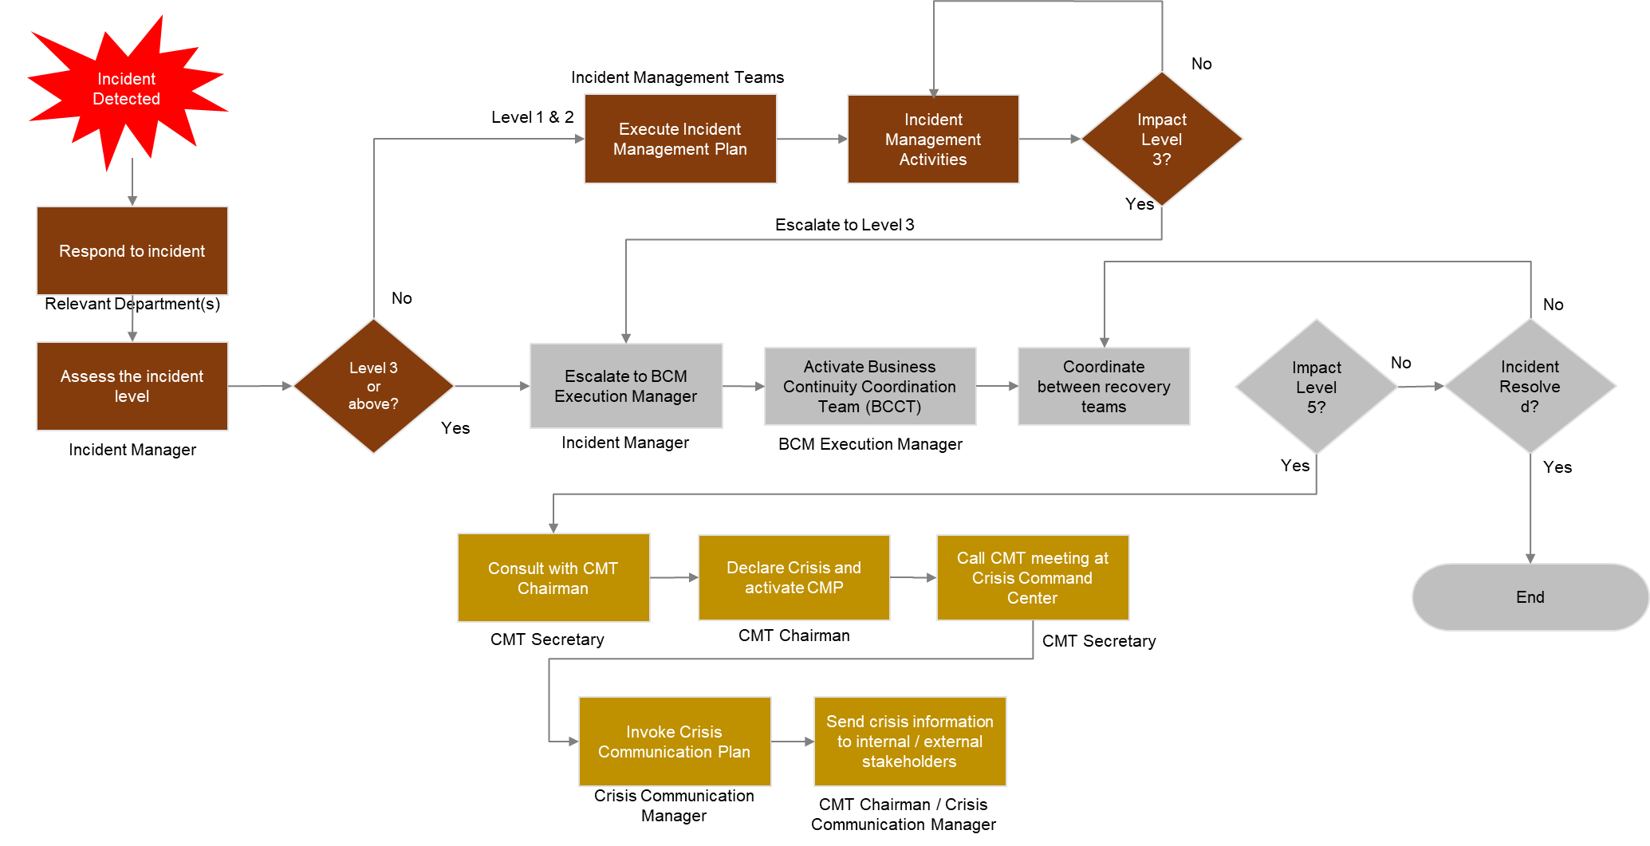
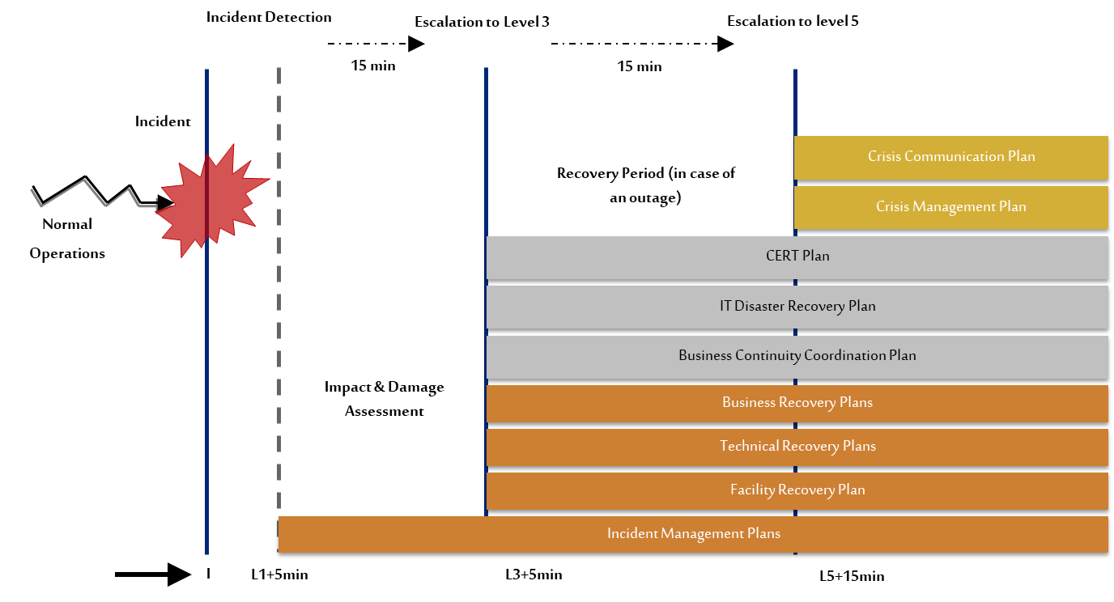
Approach & Methodology
Phase 3: Plans Review and Enhancement (1/3)
Key Activities
Methodologies / Sample Deliverables
Incident Management, Crisis Management and Communication
Review and update incident management plans and crisis management plan to ensure a structured and systematic process for responding to incidents of different severity that may significantly or strategically impact stc. We will do the following activities:
Review and update the overall emergency response, incident management and crisis management structure.
Specify process and criteria for activation of different teams, escalation criteria and deactivation mechanisms.
Identify protocols of crisis command center and relationship between the departmental emergency response / incident management teams, centralized incident management team and crisis management team.
Contain procedures to mobilize and deploy internal and external resources.
Oversee execution of response activities and provide guidance as appropriate.
Outline the approval process for sending messages to external parties concerning the crisis.
Document internal and external communication procedures and protocols.
Identify appropriate channels for communication.
Document procedures for determining and communicating that the crisis is over.
Update Crisis Communication Plan that will provide directives and instructions on how to manage communications internally and externally in the event of disasters and crises.
Review documents and communication policies at the time of current crises and disasters (if any).
Define the roles and responsibilities of communication teams, the mechanism, communication structure, and possible internal and external communication message models.
Documenting procedures and protocols for internal and external communication, and defining appropriate channels for communication.
For Illustration Purposes Only
Deliverables
Incident Management Plans
Crisis Management Plan
Crisis Communication Plan
Emergency Response Plan template

Slide 28
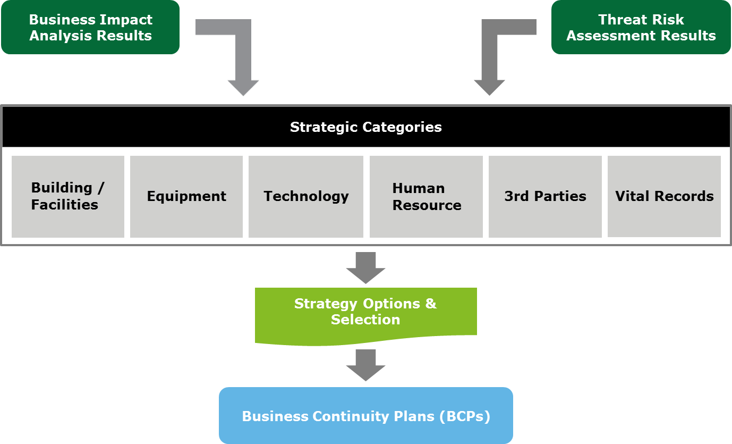
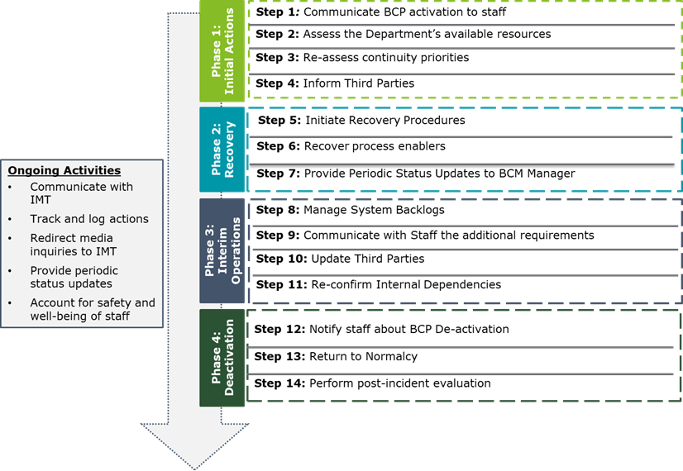
Approach & Methodology
Phase 3: Plans Review and Enhancement (2/3)
Key Activities
Methodologies / Sample Deliverables
Business Continuity Plan Updates
Deloitte will review and enhance the existing BCPs to make them consistent, easy-to-use yet complete to be used in case of activation.
Based on the updated BIAs for the in-scope sub-departments, Deloitte will develop BCPs covering the following:
Update the BCP template by simplifying and restructuring the document to make it user-friendly, easy-to-navigate, etc.
Provide a Quick Guide at the start of every plan to enable rapid use by end users in the case of a BCP invocation.
Provide detailed guidance on required actions during and following a disruption.
Specify the resources and personnel required to recover time-critical business processes as part of the overall response to a disruptive event.
Outline the sequence of recovery of services and processes.
Involve relevant leadership and key personnel in recovery of operations.
Include clear tasks with clear beginnings and end points to report to management for managing recovery-effort progress, including:
identifying tasks to be undertaken,
teams to complete them,
team assignments and
identifying the key contacts, suppliers and resources necessary to support the recovery.
For Illustration Purposes Only
Deliverables
Updated BCP Template
Business Continuity Plans for time critical departments

Slide 29
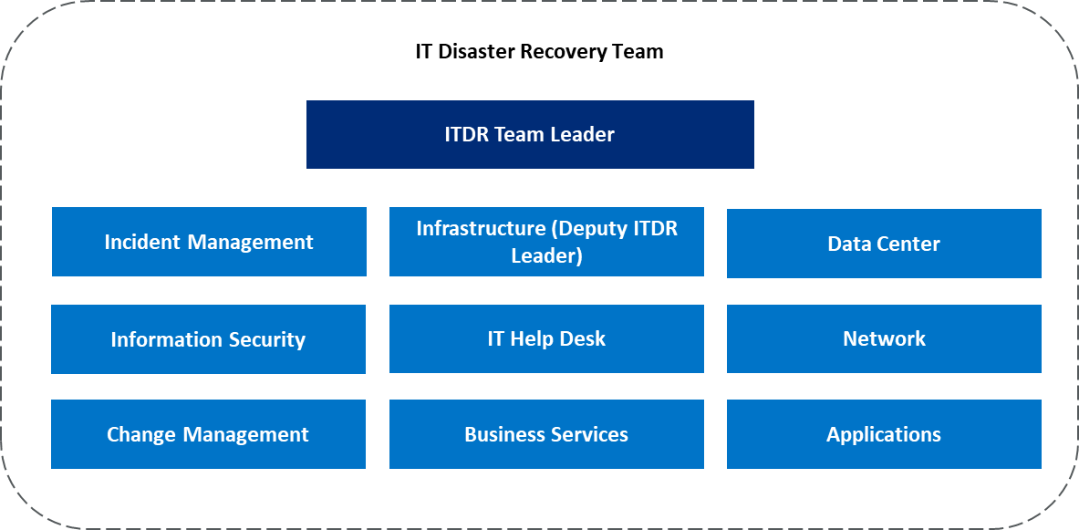
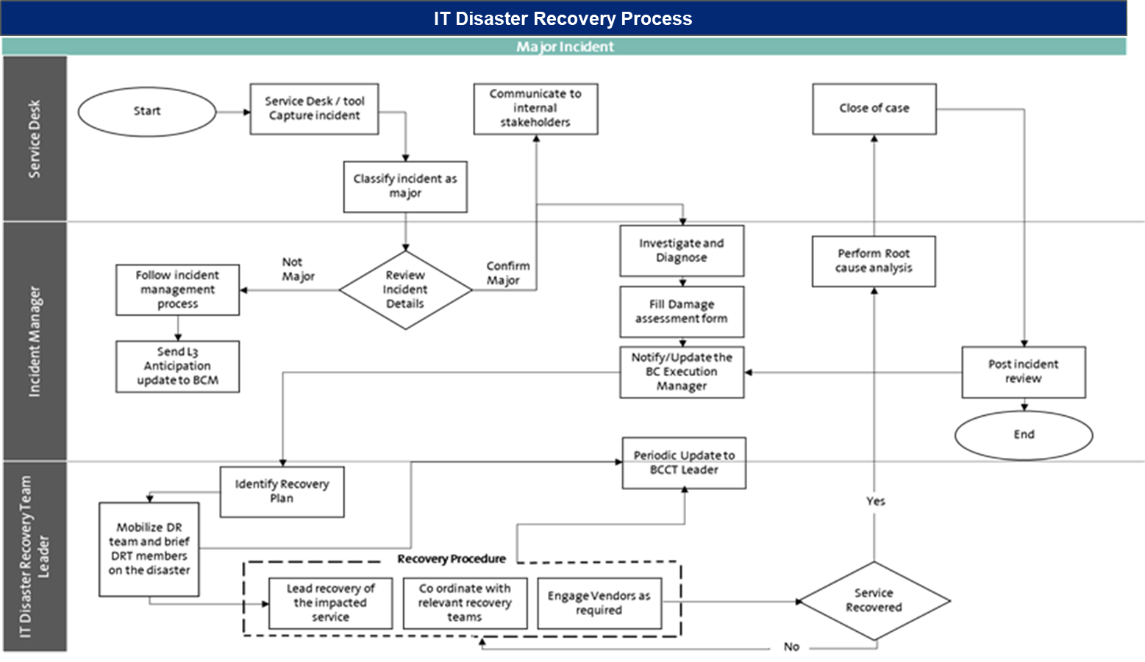
Approach & Methodology
Phase 3: Plans Review and Enhancement (3/3)
Key Activities
Methodologies / Sample Deliverables
Our ITDR philosophy is to identify and evaluate the most cost effective and appropriate strategies of Information Technology (IT) Recovery based on the outcomes of the BIA and the risk assessment.
The following activities will be conducted as part of enhancing and updating the IT DR Plan:​
Establish an stc-wide centralized IT DR governance covering the different roles across different technology teams. ​
Define detailed responsibilities for each member of the IT DR team as part of IT DR governance.​
Develop IT DR activation criteria and escalation protocols between centralized IT DR and technical recovery teams.
Define general IT DR stages and clarify their relationship with potential scenarios that may lead to the activation of IT DR.​
Develop recovery phases to be executed in operational disaster or cybersecurity incident scenarios to achieve targeted RTOs and RPOs.​
Develop Technical Recovery Plan template to be utilized by stc to add the technical procedures.
Submit the IT DR Plan and recovery arrangements to management for review and approval.
For Illustration Purposes Only
Deliverables
Centralized IT Disaster Recovery Plan
Technology Recovery Plans template
Technology Recovery Plans

Slide 30
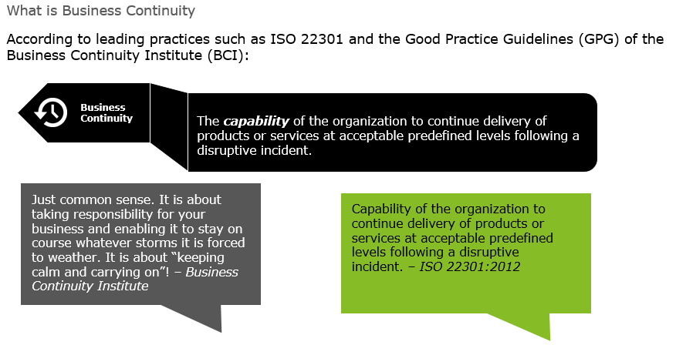
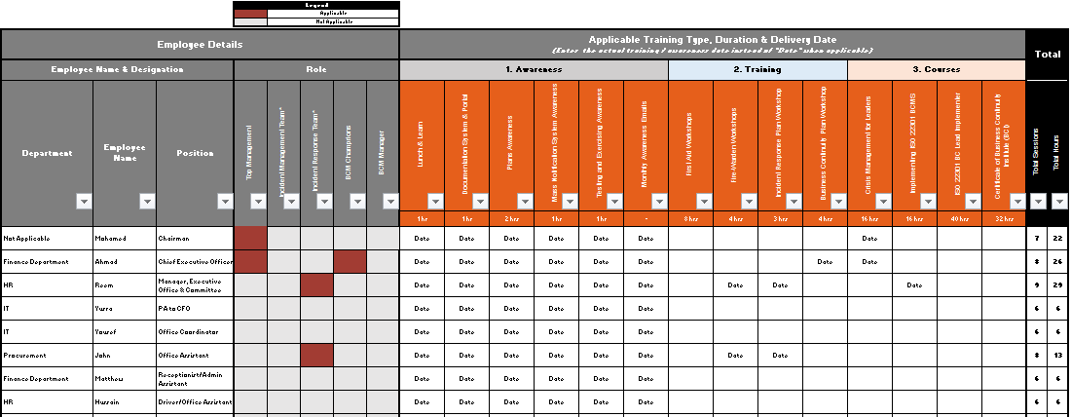
Approach & Methodology
Phase 4: BCM Exercising (1/4)
Key Activities
Methodologies / Sample Deliverables
BCM Awareness & Training
The aim of this phase is to promote the vision and purpose of stc’s BCMS and its benefits to various stakeholder groups. We will do this through the following:
Propose a BCM Awareness and Training Program covering methodologies and approach, subjects and areas, types and channels, criteria / maturity measurements and levels, objectives, target audiences, RACI with HR and corporate & communication.
Review and enhance BCM awareness and training presentations.
Conduct awareness session for senior management on BC&DR Governance and management’s roles & responsibilities.
Conduct BCM awareness session for general stc staff.
Conduct one (01) training session for IMPs and BCPs, one (01) training session for CMP and CCP and one (01) training session for IT DRP.
For Illustration Purposes Only
Deliverables
BCM Awareness and Training Program
One (01) BCM Awareness Presentation and One (01) BCM Training Deck
One (01) BCM awareness session for senior and middle management
One (01) BCM awareness session for general employees
Three (03) training sessions for IMPs and BCPs, CMP / CCP and IT DRP

Slide 31
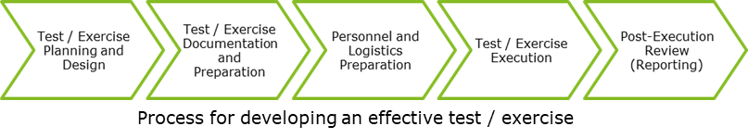
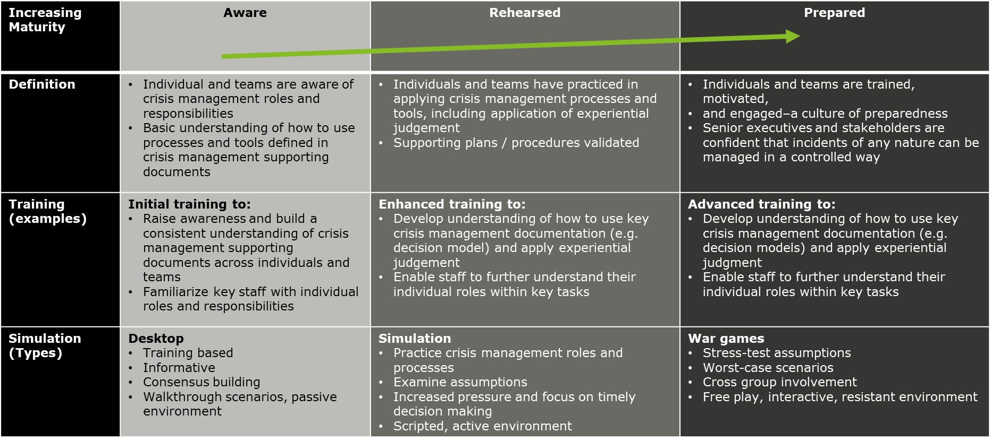
Approach & Methodology
Phase 4: BCM Exercising (2/4)
Key Activities
Methodologies / Sample Deliverables
BCM Exercising
Develop a BCM Exercising Program for stc that defines a progressive model for increasing the maturity of exercising conducted on a periodic basis. The program will include a definition of the exercise types, recommended execution frequency, objectives, plan(s) to be exercised, location(s) to be covered, as well a definition of the relevant roles and responsibilities required for designing and executing test(s) / exercise(s).
In line with the progressive maturity model defined in the Exercising Schedule, we will design different test scenarios covering key threats and risks identified during the risk assessment phase.
We will conduct a maximum of seven (07) tabletop exercises for selected IMPs, BCPs, IT DRP, TRPs, CMP and CCP developed in phase 3.
We will conduct a maximum of three (03) crisis simulations covering CMP and CCP.
Provide post-exercise report for documenting observations during the exercises and highlighting strength and opportunities to improve.
Deloitte will conduct an IT DR drill for selected systems where Deloitte will propose a scenario and act as independent observer during the exercise. Deloitte will not be responsible for success or failure of the failover exercise, and will not be responsible for conducting the exercise itself.
For Illustration Purposes Only
Deliverables
BCM Exercising Program
Ten (10) test scenarios
Four (04) tabletop exercises covering selected IMPs and BCPs
One (01) tabletop exercise covering CMP and CCP
One (02) tabletop exercise covering ITDRP and selected TRPs
IT DR Failover Drill scenario and independent observation
Post Exercise Reports for exercises

Slide 32
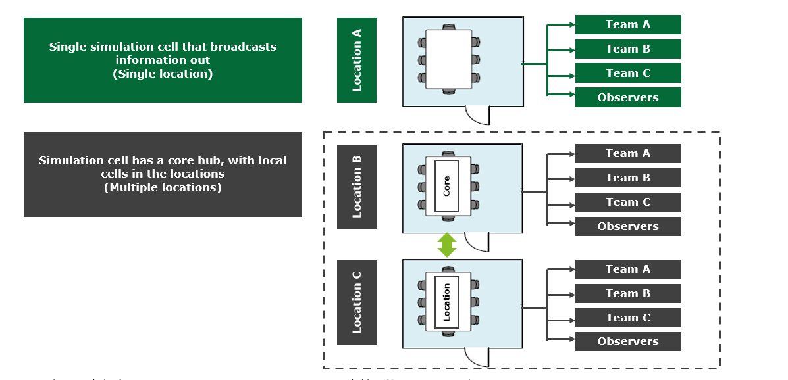
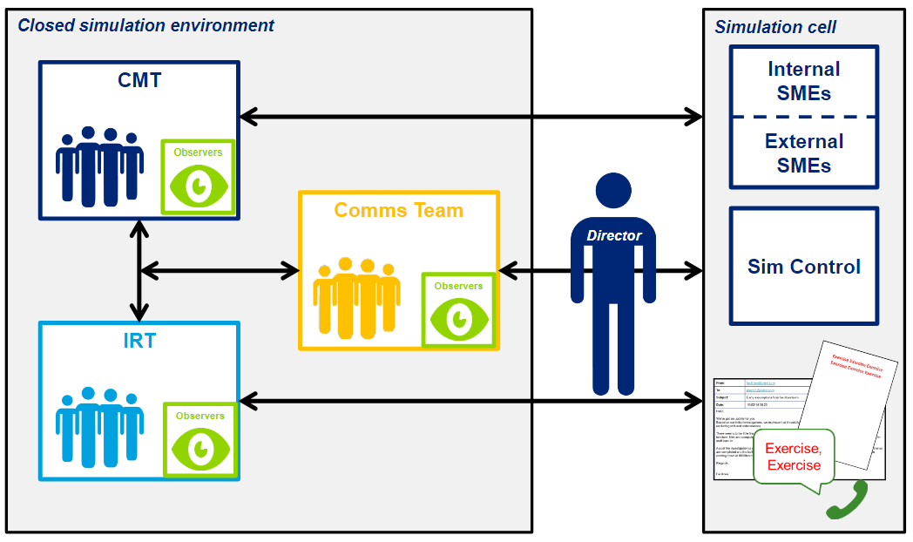
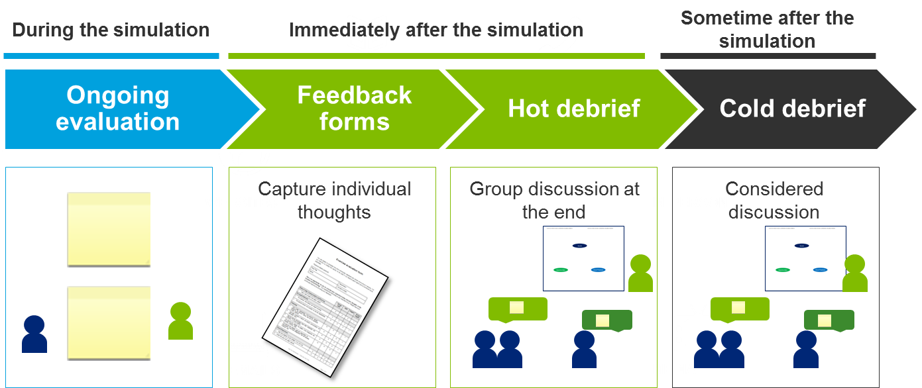
Approach & Methodology
Phase 4: BCM Exercising (3/4)
Key Activities
Methodologies / Sample Deliverables
Crisis Simulations
Deloitte will conduct three (03) crisis simulations covering three different scenarios. Each simulation would be a 2-3 hours exercise simulation a real-life scenario, triggering incidents through different channels and monitoring the actions, reactions and activities performed by different teams following their plans.
Key activities for each simulation will include:
Develop the Master Events List i.e., exercise structure and script defining both how the exercise will run, and how the scenario itself will develop.
Develop injects which will drive the scenario throughout the exercise. Each inject drives the scenario forward with a specific purpose, and an expected action, discussion or decision for participating teams.
A Simulation Playbook will be developed identifying the instructions, guidelines, roles and responsibilities for different stakeholders participating in the simulation.
Conduct dry-run for the simulation using all exercise materials prepared, ensuring the exercise flows smoothly, all injects work with the flow of information. Any gaps identified would be resolved and materials would be updated.
Conduct full rehearsal at the designated location using all tools and equipment to ensure any issues are identified and rectified.
Deloitte’s exercise delivery team will oversee the delivery of injects, working with the responding teams throughout to ensure objectives are met.
Conduct de-brief session with all participants providing them instant feedback, key observations and issues noted during the simulation, and brief them on the next actions.
For Illustration Purposes Only
Example data capture and evaluation process
Deliverables
Three (03) Crisis Simulations
Post Exercise Reports for exercises

Slide 33
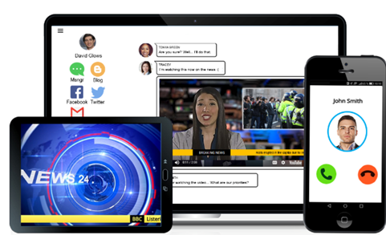
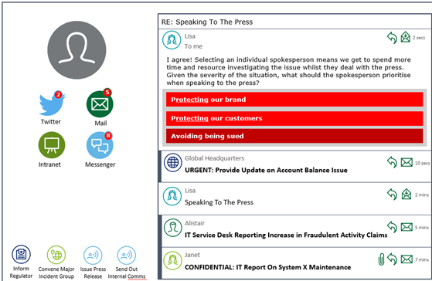
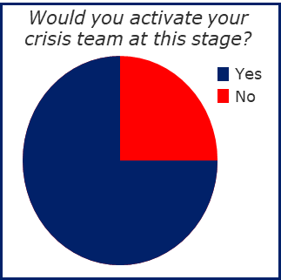
Approach & Methodology
Phase 4: BCM Exercising (4/4)
CrisisConductor
Immersive, interactive and engaging crisis decision-making tool.
Ability to inject simulated, realistic multimedia content, including news reports, social media posts, phone-calls and emails.
Ability to capture quantitative and qualitative data on individual performance in real-time.
Ability to create a highly bespoke, specific and path-dependent scenario, where decisions taken by participants informs the direction of the activity.
Highly interactive, safe and secure sandbox environment.
Ability to provide tailored injects to specific participants to review and evaluate processes for information sharing.
For Illustrative Purpose Only
Key attributes:
Password-protected platform: secure and safe web application.
Immersive experience: narrative-based, sandbox style scenario requiring decisions to be made in real-time.
Realistic: ability to create a bespoke scenario based on real events relevant to your organisation.
Enhanced feedback: personalised feedback for individual participants based on in game decisions and interactions.

Slide 34

Timeline and Assumptions
Deloitte has developed a streamlined approach to assist stc in addressing its requirements. We expect to mobilize our team of consultants upon signing the engagement letter and anticipate that it will require 6 – 8 months to execute the project, based on the delivery model selected by stc.

Slide 35
Project Timeline

Slide 36
Project Timeline
Delivery Model Option 1 – Value-based, Cost-effective Scope Delivery
Engagement Phase | Month 1 |  |  |  | Month 2 |  |  |  | Month 3 |  |  |  | Month 4 |  |  |  | Month 5 |  |  |  | Month 6
Project Planning and Initiation
Phase 1: BC Risk Assessment
Risk Assessment for Locations in Riyadh
Risk Assessment for Locations outside Riyadh
Phase 2: BCM Strategy and Roadmap
BCM Current State Assessment and Roadmap
BCM Recovery Strategy
Phase 3: Plans Review and Enhancement
IMP, CMP and CCP
BCPs, IT DRP and TRPs
Phase 4: BCM Exercising
BCM Exercising Program and Scenarios
Crisis Simulations (CMP and CCP)
Tabletop Exercises (IMP, BCP, IT DRP, TRP)

Slide 37
Project Timeline
Delivery Model Option 2 – Full-scope Delivery
Engagement Phase | Month 1 |  |  |  | Month 2 |  |  |  | Month 3 |  |  |  | Month 4 |  |  |  | Month 5 |  |  |  | Month 6 |  |  |  | Month 7 |  |  |  | Month 8
Project Planning and Initiation
Phase 1: BC Risk Assessment
Risk Assessment for Locations in Riyadh
Risk Assessment for Locations outside Riyadh
Phase 2: BCM Strategy and Roadmap
BCM Current State Assessment and Roadmap
BCM Recovery Strategy
Phase 3: Plans Review and Enhancement
IMP, CMP and CCP
BCPs, IT DRP and TRPs
Phase 4: BCM Exercising
BCM Exercising Program and Scenarios
Crisis Simulations (CMP and CCP)
Tabletop Exercises (IMP, BCP, IT DRP, TRP)

Slide 38
Project Assumptions

Slide 39
Project Assumptions
General Assumptions (1/3)
The proposal is valid for 90 days from the date of submission.
Deloitte proposal submission is conditional without any liability, upon the parties agreeing mutual favorable terms and conditions within 30 days upon Deloitte being awarded the project
The engagement will be performed from stc Head office with a hybrid model, where teams will have the flexibility of working remotely if there are no onsite meetings / visits required. For any work to be performed in locations outside Riyadh, stc shall make all necessary arrangements to ensure health & safety of all team members and follow all COVID-19 related protocols, provide flights, hotels, transportation and other logistic arrangements.
Representatives from stc will be dedicated to the project and have sufficient authority to manage and approve systems / information access, and access to personnel.
Deloitte will assume that all information and documentation provided by stc will accurately represent the existing infrastructures / environment.
stc will make the necessary interviewees available. Deloitte is aware of the constraints on stc resources and will make every effort to optimize the efficiency of the information gathering process.
Deloitte will not be responsible for the security capability evaluation of the IT products deployed in the stc technology Infrastructure environment.
Our deliverables will be in English and solely addressed to stc. We do not hold responsibility if your organization wishes under any circumstances to share our deliverables with external parties.
Our ability to complete the work within the timelines indicated and issue our report by the agreed upon dates will depend on the timeliness and extent of cooperation, participation and assistance provided to us by stc personnel.
Provision of any procurement of resources (hardware / IT infrastructure / equipment) for plan implementation is excluded from the scope of this project.
Availability of specific named resources, in our proposed team, is dependent on timing of contract signature. If specific named resource is not available, alternative resource will be substituted.
Notwithstanding anything contained in stc Request for information or any form of contract terms incorporated therein to the contrary, Deloitte is submitting this proposal subject to the express condition that it and stc negotiate and execute a contract containing terms and conditions mutually acceptable to both Deloitte and stc. This proposal does not constitute an offer and is subject to our discharging our professional, legal, regulatory and internal take-on procedure requirements; including conflict and independence checks and client acceptance and identification requirements.
All amounts payable exclude Value Added Taxes “VAT” and the Client, at its sole expense, shall be responsible for all taxes, such as VAT, sales and use tax, gross receipts tax, withholding tax, and any similar tax, imposed or applicable, at date of this agreement or introduced and made applicable by legislation thereafter, whether in retrospect or not, on the Client or on Deloitte in connection with the Services, other than Deloitte’s corporate income and property taxes.

Slide 40
Project Assumptions
General Assumptions (2/3)
Due to the latest travel restrictions applied to flights and passengers departing from certain destinations and considering rapid and unexpected changes in the application of these travel restrictions, Deloitte cannot guarantee that any of resources and team members will be available on the ground at the project start date or at any date thereafter.
If these risks materialize to any of the Deloitte project team members (and our experts, as applicable) before and/or during project implementation, both Parties will collaborate to redesign the project delivery model while taking advantage of digital methods of team communication and cross-border cooperation to reduce the impact on the project where possible. Deloitte will continue to monitor the situation across the region and will keep an open channel of communication with you in order to deploy the most effective methods of delivery, where possible, and while taking into consideration the challenges we encounter regarding the Epidemics or Pandemics, whilst ensuring that the safety and health of both your and our personnel is our priority
Deloitte Touche Tohmatsu Limited (“DTTL”), is a UK private company limited by guarantee. DTTL and each of the DTTL member firms, their subsidiaries, predecessors, successors, assignees and subcontractors and all partners, associate partners, members, owners, directors, employees and agents of all such entities (hereinafter collectively “D&T Parties”) are separate and independent legal entities, which cannot obligate, bind or act on behalf of each other. Each DTTL member firm renders services in a particular geographic area and jurisdiction and is subject to the laws and professional regulations of the particular country or countries in which it operates. DTTL itself does not render services to clients. DTTL and each DTTL member firm are liable only for their own acts or omissions and not those of each other. This Agreement is solely between the Client and Deloitte & Touche Advisory Saudi Limited (“Deloitte”).
Services may include advice and recommendations provided by Deloitte, but all decisions in connection with the implementation of such advice and recommendations shall be the responsibility of, and made by, stc. Deliverables are supplied on the basis that they are for the sole internal use of the Client and for the exclusive purpose set out therein. Deloitte shall not be liable for any loss, damages, costs or expenses directly or indirectly incurred by any party other than the Client who may rely upon the Deliverables for whatsoever reason. Any advice, recommendation, report, certificate, schedule or other Deliverable arising from or in connection with the Services under this Agreement will be for the sole use of the Client. No person other than the Client shall be entitled to make use of any Deliverable, unless this has been agreed to in writing between the Parties, in advance, and subject to terms agreed between the Parties. Any such advice, recommendation, report, certificate, schedule or other Deliverable is based on the particular facts and circumstances of the Client at a particular point in time. Consequently, such advice, recommendation, report, certificate, schedule or other Deliverable may not be relevant to another Party or at a different time and under different circumstances.
The Client and related parties, e.g., hardware/software providers or Internet Service Providers, shall cooperate with Deloitte in the performance by Deloitte of the Services, including, without limitation, providing Deloitte with reasonable facilities and timely access to data, information and personnel of the Client. The Client shall be responsible for the performance of its personnel and agents and for the accuracy and completeness of all data and information provided to Deloitte for purposes of the performance by Deloitte of the Services. The Client acknowledges and agrees that Deloitte’s performance is dependent upon the timely and effective satisfaction of the Client’s responsibilities hereunder and timely decisions and approvals of the Client in connection with the Services. Deloitte shall be entitled to rely on all decisions and approvals of the Client. The Client shall be solely responsible for, among other things:
making all management decisions and performing all management functions.
designating a competent management member to oversee the Services.
evaluating the adequacy and results of the Services.
accepting responsibility for the results of the Services.
establishing and maintaining internal controls, including, without limitation, monitoring ongoing activities; and
providing Deloitte with correct and accurate information, data, form or any other required to complete its Services, as Deloitte will carry no liability for any incorrect information provided by the Client

Slide 41
Project Assumptions
General Assumptions (3/3)
Deloitte may, from time to time in its sole discretion, subcontract external companies to provide resources to Deloitte, to enable Deloitte to fulfill its obligations under this engagement. For purposes of this engagement, Personnel of such a subcontractor would be included in the Personnel of Deloitte. In the event of another D&T Party providing resources to Deloitte for the Project, such D&T Party would, for the purposes of this engagement, be considered a subcontractor to Deloitte without a need for the Client prior written consent. Notwithstanding the fact that certain Services under the engagement may be carried out by Personnel provided to Deloitte from other D&T Parties through service or other internal agreements, the Client agrees that none of the D&T Parties (except Deloitte Contracting Party) will have any liability to the Client and that the Client will not bring any claim or proceedings of any nature (whether in contract, delict, breach of statutory duty or otherwise and including, but not limited to, a claim for negligence) in any way in respect of or in connection with this engagement against any of the D&T Parties (except Deloitte contracting party) nor against any subcontractors that Deloitte may use to render the Services.
Notwithstanding any other term in the Client Request for Proposal, the Client Group’s management acting on behalf of its shareholders provide their consent ,by issuance of the Request for Proposal, for Deloitte to transfer the Group’s information to other members of the Deloitte Network, third parties or contractors providing administrative, infrastructure and other support services for the needs of our completion and submission of the Request for Proposal, and to store and process any information received, wherever located within or outside of the Kingdom of Saudi Arabia. In this respect, members of the Deloitte Network and third parties are bound by similar confidentiality, privacy and data security obligations (“Confidentiality and Privacy Obligations”) to those contained in this Request for Proposal. In addition, such members of the Deloitte Network and third parties will keep all data confidential and private and will be shared with their employees/ management/ partners/ agents/ officers/ members strictly on a need-to-know basis (“Authorized Recipient”). The Authorized Recipients are also bound by similar Confidentiality and Privacy Obligations. The Client and Deloitte shall both be solely responsible for its own breach of Confidentiality and Privacy obligations including that of its Authorized Recipient. The above provision constitutes an express written consent from the Group’s management acting on behalf of its shareholders regarding the transfer of the Group’s information to the abovementioned third parties.
Deloitte is required to maintain, and to be seen to maintain, its independence as auditors when rendering non-audit services to, and forming business relationships with, audit clients. Deloitte is therefore prohibited from rendering certain consulting services or forming business relationships which may result in a Conflict of Interest or a lack of Independence for Deloitte. Please note that Deloitte will not perform any professional services until the results of any internal Client and Engagement Acceptance procedures have been completed, including Conflict and Background Checks and approval from the audit committee. Deloitte reserves the right, without any liability, to withdraw from this opportunity in the event that any conflict of interest or independence issues arise as a result of the Client and Engagement Acceptance procedures.
Deloitte may terminate this Agreement or any impacted part of the Services due to Auditor Independence, without incurring any penalty. Deloitte’s right to terminate: Where a governmental, regulatory or professional body, or a relevant authority having the force of law, has introduced a new, or modified an existing, law, rule, regulation, interpretation or decision, the result of which would render the provision of, or any part of the services provided by the Deloitte illegal or otherwise unlawful, or in conflict with independence or professional rules.
The Client agrees to provide Deloitte with at least 2 weeks’ notice prior to the carrying out of an audit for this engagement. Any request for an audit shall be limited in scope to the people, process and technologies involved in the engagement and with Client data. The payment for any audit will be borne by the Client requesting the audit, and any request for an audit will be limited to a maximum of once per calendar year. The Client agrees that if any audit is to be carried out by a client appointed vendor/ third party or external auditor, that Deloitte will be provided with notice of this appointed vendor to allow Deloitte to carry out its internal compliance and conflict check procedures to approve the appointed vendor or not. Deloitte may not be audited by a competitor.

Slide 42
Project Assumptions
Project-specific Assumptions
Delivery Model Option 1 – Value-based, Cost-effective Scope Delivery
Project Initiation Activities
Time taken during the contract preparation and signing process is not part of this phase and is considered as pre-project activity. Project duration calculation will start two weeks after contract signing date to allow team mobilization.
Any changes to the scope, project plan and the deliverables shall be discussed and agreed between Deloitte and stc. Deloitte will assess the impact of change and discuss additional efforts and fees.
Stc shall provide templates for project charter, status reports etc. to Deloitte to be used throughout the project. In case there is no official format, Deloitte will propose its templates for approval of stc.
Phase 1 – BCM Risk Assessment
Risk assessment activities in stc Head Office and other locations in Riyadh will be performed onsite where possible.
All risk assessment activities outside Riyadh will be performed remotely. The assessment will be limited to interviews and review of documentations. However, no control verification will be performed, and risk mitigation plan will be proposed based on the design of control provided during workshops.
Phase 2 – BCM Strategy and Roadmap
Current state assessment will be performed against GSNRC Framework, ISO 22301, ISO 22361, and ISO 22320.
Deloitte will neither conduct any business impact analysis (BIA) activities or review any existing BIAs. All BIA outputs will be taken as-is for identifying the recovery strategies.
Deloitte will not be responsible for any manpower analysis or cost / budget estimation for the initiatives identified in 3-year roadmap.
Phase 3 - Plans Review and Enhancement
Business continuity plans will be developed using the recovery requirements identified during BIA already performed by stc.
Review and enhancement of incident management plans will be limited to ten (10) plans
Review and enhancement of IT DR plan will be limited to one (01) centralized IT DRP, while review and enhancement of technical recovery plans will be limited to twenty (20) plans.
Our scope is limited to development of emergency response plan (ERP) template. However, the ERPs will be developed by relevant departments of stc. to be used by stc departments
Phase 4 – BCM Exercising
Deloitte will identify a maximum of ten (10) different test scenarios
Our scope is limited to conducting a maximum of seven (07) tabletop exercises covering IMPs, BCPs, IT DRP, TRP, CMP and CCP
Deloitte will conduct three (03) crisis simulations covering CMP and CCP
The scope does not cover performing any IT DR failover exercise.
The scope does not cover performing any integrated exercise covering functional execution of any plans.

Slide 43
Project Assumptions
Project-specific Assumptions
Delivery Model Option 2 – Full-scope Delivery
Project Initiation Activities
Time taken during the contract preparation and signing process is not part of this phase and is considered as pre-project activity. Project duration calculation will start two weeks after contract signing date to allow team mobilization.
Any changes to the scope, project plan and the deliverables shall be discussed and agreed between Deloitte and stc. Deloitte will assess the impact of change and discuss additional efforts and fees.
Stc shall provide templates for project charter, status reports etc. to Deloitte to be used throughout the project. In case there is no official format, Deloitte will propose its templates for approval of stc.
Phase 1 – BCM Risk Assessment
Risk assessment activities will be performed onsite for all in-scope locations, where possible.
Phase 2 – BCM Strategy and Roadmap
Current state assessment will be performed against GSNRC Framework, ISO 22301, ISO 22361, and ISO 22320.
Deloitte will neither conduct any business impact analysis (BIA) activities or review any existing BIAs. All BIA outputs will be taken as-is for identifying the recovery strategies.
Deloitte will not be responsible for any manpower analysis or cost / budget estimation for the initiatives identified in 3-year roadmap.
Phase 3 - Plans Review and Enhancement
Business continuity plans will be developed using the recovery requirements identified during BIA already performed by stc.
Review and enhancement of incident management plans will be performed for all IMPs in stc (a maximum of 100).
Review and enhancement of IT DR plan will be limited to one (01) centralized IT DRP, while review and enhancement of technical recovery plans will be limited to a maximum of three-hundred (300) plans.
Our scope is limited to development of emergency response plan (ERP) template and a maximum of ten (10) emergency response plans for stc Head Office.
Phase 4 – BCM Exercising
Deloitte will identify a maximum of ten (10) different test scenarios
Our scope is limited to conducting a maximum of seven (07) tabletop exercises covering IMPs, BCPs, IT DRP, TRP, CMP and CCP
Deloitte will conduct two (02) crisis simulations covering CMP and CCP
Deloitte will conduct one (01) integrated simulation covering selected IMPs, BCPs, IT DRP, TRPs, CMP and CCP
The scope does not cover performing any IT DR failover exercise.
The scope does not cover performing any integrated exercise covering functional execution of any plans.

Slide 44

Our Team
Members of our core team have prior experience with similar organizations and have relevant certifications.
We believe it is all about people who make the difference. Therefore, we have carefully structured a multidisciplinary team which has the required technical skills, industry knowledge and previous experience of working on similar projects.

Slide 45
Our Team
Tariq Ajmal Engagement Partner
Engagement Leadership
Nader Farid Partner, QA
Ensure objectives are met within timing and scope outlined
Provide overall guidance and technical expertise
Ensure project runs smoothly and in accordance with approved delivery framework.
Review Deliverables and work progress throughout the life of the project
Engagement Advisors
Arsalan Yousuf Engagement Leader
Project Management
Katie Diacon
Crisis Management SME
Project managers will be responsible for delivering the overall scope and objectives of the engagement in accordance with quality expectations Responsible for ongoing status reporting and issue escalation and resolution
Maarten Smulders
IT Disaster Recovery SME
Syed Waqi Hasan Engagement Manager
Project Team
Chirag Kothari
IT Disaster Recovery SME
Schedule, conduct, and document interviews and workshops
Prepare deliverables and drafts
Conduct fieldwork and delivery activities
Execute project activities
Deepak Sinha Deputy Manager
Tanzeel Afzal Assistant Manager
Nitesh Naik Assistant Manager
Esam Shana’a
Business Continuity SME
Engagement Advisors
Suprotim Ghosh Assistant Manager
Jason Massaad Consultant
Lujain Alfawzan Business Analyst
Provide insight into industry risks and trends
Provide insights into technical areas of expertise
The safety of both our and your personnel is of top priority to us. In light of the evolving global activities that have been, and continue to be, introduced to alleviate the impact of Corona Virus/COVID-19 we may face travel restrictions prior to and during delivery of this engagement. Should this be the case we will work with you to minimize disruption as much as possible, including the deployment of technology solutions to allow our people to work from our offices or remotely.
We will continue to monitor the situation across the region and will keep an open channel of communication with you in order to deploy the most effective methods of delivery whilst ensuring the safety and health of both your and our personnel.

Slide 46
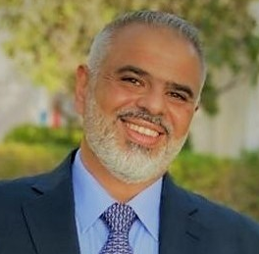
Engagement Partner
Nader is a Partner in Risk Advisory leading Cyber and Technology Risk practice in KSA. Nader has more than 20 years of experience in the field of Information Security & Technology Risk covering IT Governance, IT Risk Management, Information Security Management, Infrastructure & Operations Security, Business Continuity and ERP Process Controls.
Nader has led and managed a wide range of Information Technology and Security Risk Management engagements for a number of iconic clients in the ME across various industries including; Financial Services, Manufacturing, Utilities, Telecoms and the Public Sector.
Nader Farid
Partner
Key Relevant Engagements – Outline
Nader has been involved in various engagements related to end to end information security programme covering current state assessment; strategic and technical risk assessment; strategy and roadmap; governance; policies and procedures, business continuity management; training & awareness; and testing. Some of his relevant project experience includes:
Project Manager for the Business Continuity and Disaster Recovery assessment and documentation for one of the world’s largest National Oil Companies.
Led the SAP Post implementation and Cyber security review for a leading chemicals manufacturing client in KSA. The areas in scope included, IT Governance, IT Operations, ERP automated controls, user access and IT Security (vulnerability assessment and attack & penetration).
Led the IT Internal Audit and Applications Controls review for a leading utilities company based out of AL-Jubail Industrial City, KSA. The scope encompassed review of IT Governance, IT Security as well as ERP functional and user security Controls.
Led an IT internal audit co-sourcing engagement for a leading telecom service provider in the Kingdom Bahrain covering IT, Networks and ERP systems Audits.
Led several internal audit outsourcing engagements for a number of leading clients in KSA. Some of the key areas covered during these engagements include; Finance & Accounts, Revenue & expenditures, HR & Admin, Procurement, Patient Services, as well as IT and Cyber Security.
Project Manager for a large transformation engagement for a leading Paper Manufacturing client in Saudi Arabia. The scope encompassed Strategy Articulation, Organization restructuring as well as development of the client’s Process, Policies & procedures, and Compensation schemes.
Professional and Technical Qualification
Bachelor of Science Degree in Computer Information Systems from California State University of Fresno, USA.
Certified Information System Auditor [CISA].
Certified in Risk and Information Systems Control [CRISC]
Member of the Information Systems Audit and Control Association (ISACA)
Key Clients SAMBA – KSA Bank AlBilad – KSA NCB - KSA AlAwal Bank – KSA Saudi Aramco – KSA | ELM – KSA NADEC – KSA STC -KSA Bupa Arabia – KSA Al-Jazira Takaful - KSA

Slide 47
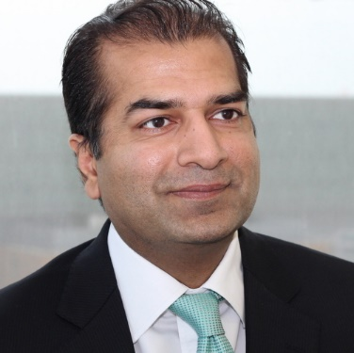
Engagement QA Partner
Tariq has more than 20 years of experience in the field of Information & Technology Risk covering IT Governance, Project Risk, Cyber Security, Resiliency & Crisis Management, IT and Business Process Controls as well as helping organization comply with requirements such as Sarbanes Oxley, ISO, CobiT, ITIL, ADSIC, etc. Tariq’s experience spans various industries and clients in Middle East and North America.
Key Relevant Engagements – Outline
Tariq has performed, managed and directed engagements in a wide range of data processing environments, ranging from highly complex mainframe systems to stand alone PC and LAN based systems. His project experience includes:
IT Governance assessments and implementations (including IT Risk Management, Project and Portfolio Management, IT and Business Alignment, IT Compliance Management).
IT control design and risk identification / mitigation reviews.
Business process reviews covering both operational and support processes.
Third party reviews and reporting (such as SAS 70 / SSEA16, CICA Sec. 5900, ISAE 3402 / ISAE 3000 / WebTrust etc.) for outsourced business processes and infrastructure.
Application (SAP, Oracle, JD Edwards, Great Plains, People Soft, Baan, Maximo, Banking, Insurance, Telecom etc.) pre and post implementation reviews covering application functionality controls, security controls (technical and segregation of duties) and implementation project reviews.
Database (Oracle, SQL), operating systems / platforms (IBM Mainframe, RACF, Top Secret, AS400, Windows, UNIX, etc.) and network configuration and security reviews.
Data conversion reviews including data quality and integrity reviews.
Development and implementation of Integrated Management System (IMS) based on PAS99 covering various ISO standards such as ISO14000 (Environment), OHSAS18000 (Health & Safety), ISO20000 (IT Service), ISO27001 (Information Security) and ISO22301 (Business Continuity Management).
Key Clients
Tariq M. Ajmal Partner
Professional and Technical Qualification
CISA - Certified Information Systems Auditor, Member Information Systems Audit and Control Association (ISACA), USA
CGEIT - Certified in the Governance of Enterprise IT, ISACA
CA - Chartered Accountant (Canada), Member Canadian Institute of Chartered Accountants (CICA), Canada
MMPA - Master of Management & Professional Accounting, Rotman School of Management University of Toronto, Toronto
B. Com. Joint Honours in Economics and Accounting, McGill University, Montreal
Abu Dhabi Investment Authority - UAE Abu Dhabi National Oil Company (ADNOC) ADGAS GASCO Dubai Financial Services Authority (DFSA) – UAE | Emirates NBD National Bank of Abu Dhabi – UAE Mubadala – UAE Qatargas RasGas

Slide 48
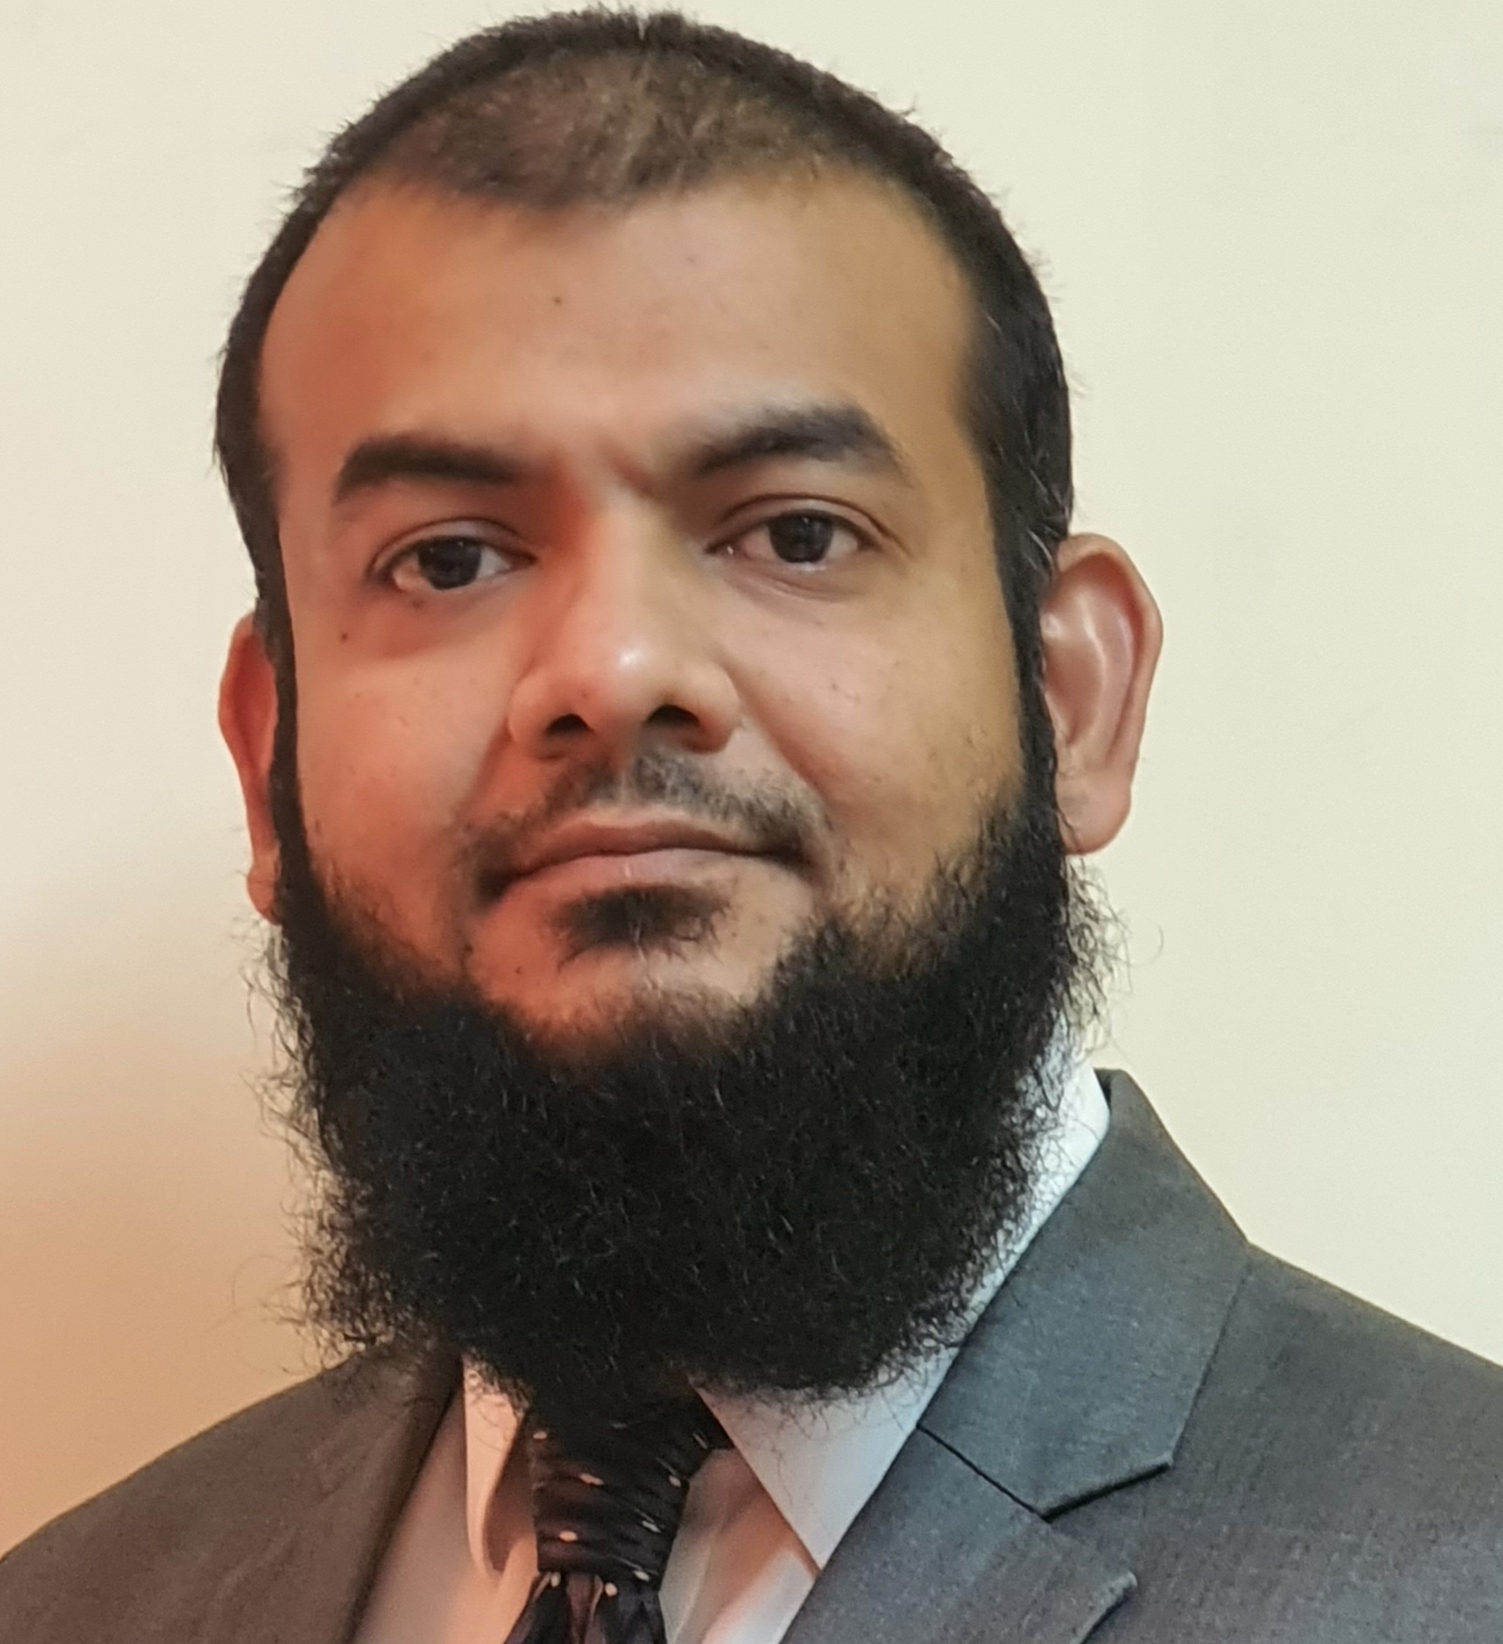
Engagement Leader
Arsalan is Director in Deloitte’s Cyber and Strategic Risk Advisory Services practice based in Riyadh. With an overall experience of 18+ years, he has in-depth knowledge & experience in the field of Crisis Management, Resiliency and Business Continuity, working on several different engagements for development, implementation and assessment of BCM based on ISO 22301, ISO 22361, BS 67000, SAMA BCM Framework and industry best practices. Arsalan holds a Masters’ Degree in Computer Science, and industry recognized certifications like Certificate of the BCI (CBCI), Certified Information Security Manager (CISM) and Certified Information Systems Auditor (CISA).
Key Relevant Engagements – Outline
Arsalan has led several key business continuity engagements in different sectors including Banking, Financial market, Oil & Gas, etc. Key experience includes:
Engagement Leader for Business Continuity Management Program at one of the largest payment infrastructure provider in Middle East
Engagement Leader for BCM & DR Development at the leading digital wallet payments in KSA
Engagement Leader for an end-to-end BCMS development project for technology service provider in KSA
Engagement Manager for enhancement of BCM Program for the largest stock exchange in the middle east
Engagement Manager for development and implementation of end-to-end Business Continuity Management Program for one o the G20 central bank
Subject Matter Expert for the development of IT BCM Program for a large commercial bank in KSA
Engagement Manager for Development and implementation of end-to-end Business Continuity Management Program for a government authority in Bahrain
Subject Matter Expert for Development of end-to-end BCM Program at the largest insurance organization in KSA
Core team member for Business Continuity Enhancement Project (BCEP) at leading LNG company in Qatar assisting the organization in revamping its BCM Program
Arsalan Yousuf
Director
Professional and Technical Qualification
MS Computer Science & Networks – National University of Computers & Emerging Sciences, Islamabad, Pakistan
BS Computer Science – Department of Computer Science, University of Karachi, Pakistan
Certified ISO 22301:2019 Lead Implementer
Certificate of the BCI (CBCI) with Merit
Certified Information Security Manager (CISM)
Certified Information Systems Auditor (CISA)
Key Clients Royal Commission for AlUla Uptown Jeddah Company Stc Bank (stc Pay) Solutions by stc Saudi Payments Saudi Arabian Monetary Authority (SAMA) Saudi Stock Exchange (Tadawul) Bupa Insurance National Commercial Bank (NCB) Central Informatics Organization (Bahrain) | RasGas – Qatar Supreme Council of IT Qatar (ictQatar) Channels by stc Pakistan Petroleum Limited - Pakistan Karachi Stock Exchange - Pakistan Pakistan State Oil - Pakistan Pakistan Steel Mills Limited - Pakistan Pakistan International Airlines - Pakistan Sui Southern Gas Company – Pakistan Gulf Drilling International – Qatar

Slide 49

Subject Matter Expert
Katie is a Partner in Risk Advisory and the Middle East Leader for the Cyber consumer markets team. She has more than 20 years of experience serving large and complex global organizations around strategic & reputation risk, cyber and business resilience, technology & digital risk, cyber risk, IT and process controls as well as helping organizations with regulatory compliance.
Katie has led the cyber resilience team of over 30 people in the UK for other Big 4 organizations and served many consumer and TMT clients across the globe. Her SME is in cyber and enterprise resilience where she has led multiple engagements including some of the largest testing programs globally for consumer organizations. She recently won an industry award for the resilience transformation she led with a major global consumer company and was recognized as a top 30 women in cyber in the UK in 2022.
Katie Diacon
Partner, Cyber Risk
Key Relevant Engagements – Outline
Katie has been involved in various engagements related to cyber security and resilience covering current state assessment; strategic and technical risk assessment; strategy and roadmap; governance; policies and procedures, business continuity management; training & awareness; and testing. Some of her relevant project experience includes:
Global FMCG - Led a multi million $ resilience testing and transformation program across Europe and Asia involving everything from governance, policies and procedures to scenario design, manufacturing site testing, Executive Leadership Team ransomware testing, learning and development program design and roll out across multiple sites.
Global FMCG – Led multiple engagements including a zero-trust strategy and roadmap engagement to move the organization closer to a zero-trust environment, training and awareness program and OT specific security awareness design and roll out, cyber risk insights program and multiple penetration tests.
Global Telco – Led a maturity assessment and target operating model redesign for the security and resilience team.
Global Media/Telco – Led an end-to-end enterprise resilience assessment on a new product to come to market.
Global FMCG – Led the IT disaster recovery work.
Professional and Technical Qualification
Bachelor of Engineering, Aerospace Engineering, University of Southampton
Master of Science in Advanced Systems Engineering, Loughborough University
Key Clients Served
Technology, Media & Telecommunications
Consumer
Pharmaceutical

Slide 50

Subject Matter Expert
Maarten is an experienced consulting leader in a multidisciplinary, international firm with a track record of the successful management of large and complex engagements, live incident, and crisis situations. He is a subject matter expert in crisis management & operational resilience with 20+ years experience. As a Director of the Deloitte Middle East Risk Advisory Practice Maarten is leading our crisis and resilience services in the region. With a specific focus on our emerging business in KSA and wider region. In times of ongoing geopolitical situations, supply chain challenges, climate change and increasing incidents his mission is to build trust and create space to think. He has extensive experience with IT and technology resilience through supporting clients with disaster recovery planning, third party risk management and cyber incident response. He manages a diverse client portfolio mainly in government & public sector, manufacturing and financial services.
.
Maarten Smulders
Director, Cyber Resilience
Key Relevant Engagements – Outline
Business Continuity for a global industrial products manufacturer: Lead the design and implementation of a global BCM program. Steer and oversee BCP development in +300 entities worldwide. Support senior and executive management with the response to few major disruptive incidents.
Crisis management assessment for a global consumer brand: Lead a mission to identify and evaluate the global and local crisis management capabilities and overall readiness. Benchmark against peer organizations. Design a roadmap for crisis readiness enhancements. • IT Disaster Recovery for a local life insurer: Lead the design and implementation of Disaster Recovery capabilities for core IT infrastructure, applications and data. Identify business requirements and align DR needs with the technology roadmap. Steer and oversee the DR test program, training of key stakeholders and supplier engagement.
Business Continuity and Cyber Crisis Management for a global consumer brand: Lead the design and implementation of a BCM program for strategic production and logistics facilities. Lead the development of tactical and strategic playbooks for the response to major cyber incidents. Design and facilitate a cyber crisis exercise for senior and executive management.
Business Continuity and Crisis Management for a European Institution: Design, implement and continuously improve departmental business continuity plans and the corporate crisis management plan. Design and facilitate annual simulation exercises, BCP tests, training and awareness. Design and deliver an inter-agency CERT simulation exercise to enhance ransomware response capabilities.
Professional and Technical Qualification
Badmin Facility Management (2006), Netherlands
BCI CBCI (2009)
IRM CIRM (2011)
BS25999 (2008); ITIL (2012)
Key Clients Served
Technology, Media & Telecommunications
Government & Public Sector
Financial Services
Consumer & Industrial Products
Energy & Resources

Slide 51

Engagement Manager
Syed Waqi Hasan is a Senior Manager at Deloitte’s Cyber Risk Advisory Practice. Waqi holds a Bachelor’s degree in Business Computing from University of Surrey, United Kingdom with more than 18 years of experience in Big Four Advisory, Telecommunications, Banks, Oil & Gas, Manufacturing and Fintech sectors. Waqi has led teams in various projects including IT SOX 404 & ISO 27001 Implementation and Compliance, Cyber & Information Security Risk Management, IT Internal Audits, Business Continuity and IT Risk Management.
Key Relevant Engagements – Outline
Syed Waqi Hasan has led several key business continuity engagements in different sectors including Banking, Telecom, Manufacturing, etc. Key experience includes:
Engagement Leader for Business Continuity Management Maturity Assessment at stc head office and its 13 subsidiaries , the largest telco service in the kingdom.
Waqi has served as member of Business Continuity Steering Committee for the Telenor Pakistan and has led Business Continuity and Disaster Recovery initiatives for IT and Technology divisions.
Led the development of Business Continuity Plan and conducted Business Impact Analysis for Faysal Bank.
Waqi served as the member of Steering Committee for the launch of Easy Paisa ensuring that the first Mobile Banking platform in Pakistan is compliant with the Information Security, Disaster Recovery and Business Continuity requirements of Telenor Group and the State Bank of Pakistan.
Waqi worked closely with State Bank of Pakistan to develop Branchless Banking Guidelines and achieved the first ISO27001 certification for Mobile Banking in Pakistan.
Core team member for Business Continuity Enhancement Project (BCEP) at leading LNG company in Qatar assisting the organization in revamping its BCM Program.
Syed Waqi Hasan
Senior Manager
Professional and Technical Qualification
BSc Business Computing
University of Surrey
Diploma Core Leadership-Stockholm School of Economics Oslo, Bangkok, Dubai
Certified ISO/IEC 27001 LA
SAP Certified Consultant (FICO)
Key Clients stc (KSA) Solutions (KSA) Telenor Stc Channels Stc Specialized GSK Pakistan Petroleum Limited Faysal Bank Bank Alfalah | ICI Pakistan Limited Abbot Laboratories Public Procurement Authority Pakistan Stock Exchange

Slide 52

Subject Matter Expert
Chirag Kothari is a Manager with Risk Advisory - Cyber Risk and Crisis & Resilience practice at Deloitte.
He holds extensive experience in IT Disaster recovery, Cyber Resiliency, BCP and IT strategy planning with IT- BFSI, Telecom and ITeS.
Key Relevant Engagements – Outline
Led multiple engagement on IT DR , Cyber resilience and BCP assessments for leading banks, telecom and technology companies in India and Middle East Asia
Develop cyber resilience, IT DR and Cloud recovery framework, plan for leading private banks in India
Design strategic plan on data center migration ensuring continuity of services, cloud recovery optimizing resources and cost for private sector banks
Setup and operationalized end to end IT DR program for leading bank in India
Led in defining robust & optimized DR recovery procedure by building different DR scenarios, suite of business application and prioritization to fail-over in case of data center/ city level disaster for private banks
Designed disaster recovery maturity matrix to project DR capability and DR process re-engineering model with a 360-degree view to cover DR landscape across different industries
Develop and conduct cyber simulation for senior leadership to gauge their and organizations response capabilities
Developed crisis management framework and plans for organizations
He has designed, automated and tested complete recovery procedure for several critical banking services such Core Banking System , Customer facings channels like ATMs, Internet Banking and Digital Platform Services like Mobile Banking ,Payment Wallets ,UPI ,IMPS etc.
Optimize Recovery Time Objective by implementing best DR implementation practice, understand of system architecture, automation and DR operating model
Implemented banking solutions like Bancs@24,Bancs@Treasury,Bancs@AML for various co-operative and International Banks
Focused on automation and optimization of resources
Chirag Kothari
Manager, Cyber Risk Services
Professional and Technical Qualification
MBA - IT
BSC.IT
Certified Google cloud digital leader
ISO22301 BCMS Lead implementor
Certified Scrum Master
ITIL V3
Oracle OCA & OCP
Key Clients Served
Banking
Insurance
Brokerage & Securities
Telecom
ITeS

Slide 53
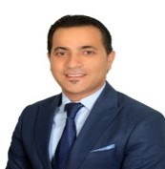
Subject Matter Expert
Esam is a Senior Manager in Risk Advisory - Cyber & Technology Risk - based in Riyadh with over than 19 years of experience in the field of Business Continuity Management, Risk Management and BCM software implementation.
Prior to joining Deloitte, Esam has held several positions with multiple Consulting and Information Technology firms as a Business Continuity Manager.
Esam has also worked as an Assistant Risk Manager for one of the leading Banks in Jordan where he was supporting Operational Risk ,Business Continuity and Information Security.
Esam Shana’a
Senior Manager
Key Relevant Engagements – Outline
Esam has performed and managed engagements in a wide range of environments, including:
Managed and performed Business Impact Analysis (BIA) exercise that included identifying the urgency of each of the in scope business activities undertaken by the organization by assessing the impact of interrupting those activates over a defined timeframe.
Design/Manage/conduct BCM Awareness and training for Staff.
Development/Review/Update of Business Continuity Plans & Crisis Management Plan (in line with ISO 22301/BS2599 & regulatory guidelines/circulars /regulations).
Executed and managed self assessment exercises that covered Policies, BCPs, BCP testing to ensure alignment with ISO 22301.
Participated in Implementing Disaster Recovery centers, and developing DRPs.
Participated in Implementing Business Alternative sites.
Executed and Managed Implementations of Business continuity Tools.
Conduct BCM Audit against ISO 22301 , SAMA Framework
Managed Risk and Compliance related IT projects.
Professional and Technical Qualification
Bachelors of Science (BSc) in Accounting Sciences from Al Mustansiryah University – Iraq
Certified ISO 22301 Business Continuity Management System Lead Implementer.
Certified ISO 27001 Information Security Management Systems Lead Implementer and Lead Auditor.
Certified by Business Continuity Institute (CBCI)
Member of the Business Continuity Institute (MBCI)
Certified ISO 27001 Information Security Management Systems Lead Implementer and Lead Auditor.
Key Clients Stc Solutions in Saudi Arabia Royal Commission for AlUla Government Agency in Saudi Arabia Leading Commercial and Islamic Banks in ME | Uptown Jeddah Company Thiqah Business Services Leading Insurance Company in Jordan E-Government Program - Yesser Saudi Railway Company – SAR

Slide 54
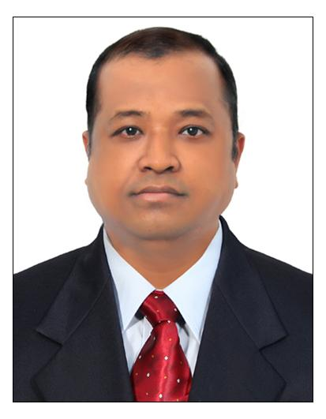
Deputy Manager Risk Advisory
Deepak is a Deputy Manager in Risk Advisory team of Deloitte Touche Tohmatsu India LLP with overall 13 years of expertise. He manages the delivery of engagements in Chennai location and supporting other locations as and when needed. He is a risk professional and ISO 9000-27001 (LA), ISO 22301:2019 (LA), HIPPA certified Professional. His core areas of specialization lies in Risk Management, Compliances, Business continuity management, Crisis Management, IT Disaster Recovery and Information Security Management System.
Key Relevant Engagements – Outline
Involved in creating, implementing and testing Business Continuity Management System (BCMS), IT Disaster Recovery Plan for India, Middle East and European countries at Account and location level
Performed Risk Assessments, Risk Causal Self-Assessment Audits, Infosec Audits, identifying potential risk and developing/updating the Risk Register.
Worked on end to end ITDR Project in one of the Govt. client in Kuwait
Profound knowledge of Business Impact Analysis (BIA), designing Business Continuity strategies and provided suitable BCP guidance to clients based on the requirement.
Involved in designing Business continuity plans, Pandemic response plans, Crisis Management plans .and other mandatory procedures at organization level.
Completely involved in managing the overall BCMS activities that includes performing BCP tests (Desktop Audit, Table top , Call tree tests, etc. ) and conducted several BCP webinars , workshops etc.
At Deloitte, Deepak is collaborating with different business verticals to build resiliency in their operations.
Previously he has organized and conducted workshops, training, mentoring and crisis management. Deepak is specialized in his team-building and collaboration strategies
Deepak Sinha
Deputy Manager Risk Advisory
Professional and Technical Qualification
PGDBA (Marketing Management)
B.Sc (Electronics)
Key Clients Central Agency for Information Technology (Kuwait US Mortgage Project Internal Wipro Projects Internal Projects

Slide 55
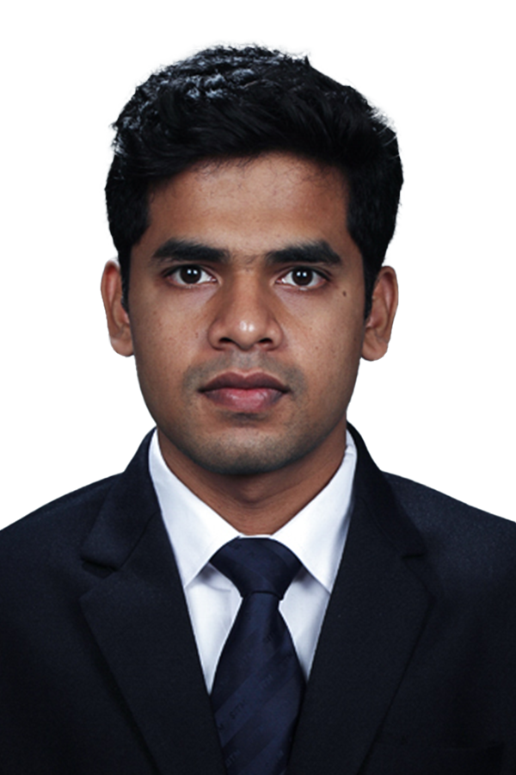
Assistant Manager, Crisis & Resilience
Nitesh Naik is working as an Assistant Manager in Deloitte has over 5 years of experience in cybersecurity consulting in domains such as networking, telecommunication and cloud infrastructure. He has served various clients across various domains such as BFSI, telecommunications, IT shared service and media.
Key Relevant Engagements – Outline
Drafted 40+ standards/procedures for a banking client located in Riyadh (Saudi Arabia)
Has a deep understanding of SAMA CSF/NCA and helped client to increase cyber maturity level
He has drafted cloud security policy and cloud security control framework for hybrid cloud environment
He has drafted security over 40 security standards and procedures for BFSI client
He has assessed and identified gaps in procedures for IT shared service client
He has assisted client for data classification activities
He has assisted for implementing information security policy across cloud environment for the leading OTT client. He has closely work with client infosec team for gap assessment and implementing solutions for identified gaps.
He has captured processes for shared service provider which provides cloud services to its businesses.
He has conducted SOX audit and assisted for creating BCP documentation for a leading OTT client.
He has earned EY cloud bronze badge by understanding and demonstrating cloud knowledge to the engagement team.
He has worked on performance management for major telecom client which included assessing KPI dashboards and presenting performances to senior management
He has performed ITGC Statutory audit for the leading telecom client in Africa. He was able to highlight major gaps in the processes. Also, he tracked end to end implementation of those gaps
He has conducted audit for a leading telecommunication client against regulatory requirements. He identified major gaps in the regulatory compliance which helped client to reduce penalties for regulatory. He was awarded by the organization for the same.
He has assessed BSS application stack for leading telecom client which helped client to ensure security of BSS applications.
He has performed network resiliency audit for a telecom client.
Nitesh Naik
Assistant Manager, Crisis & Resilience
Professional and Technical Qualification
MBA (Digital and Telecommunication Management)
B.E. (Electronics and Telecommunications)
Certified ISO 27001:2013 Lead Implementer
Certified ISO 27701:2019 Lead Implementer
Google Cloud Platform-Professional Security Engineer
Google Cloud Platform-Associate Cloud Engineer
Google Cloud Platform-Cloud Digital Leader
Azure Fundamentals (Az-900)
Key Clients Served
BFSI
Shared Service
IT services
Telecommunication
Healthcare

Slide 56

Assistant Manager
Suprotim is an Assistant Manager in the Risk Advisory – Crisis and Resilience practice at Deloitte India with overall 6 years of expertise. He has done B.Tech in Information and Telecommunication Engineering. He is Proficient in completing risk and impact assessments. Competent in readying employees with use of exercises and training programs. He has documented feedbacks and adjusted plans to account for changing conditions. He is a dedicated professional with history of meeting company goals utilizing consistent and organized practices. Skilled in working under pressure and adapting to new situations and challenges to best enhance the organizational brand.
Key Relevant Engagements – Outline
Supported the Business Continuity Management (BCM) program across business and functions(Europe, India and North America Region) as per the BCM policy and methodology. Having an understanding on IT Disaster Recovery Program.
Supported the alignment of new clients(Europe/North America/India) and services to the business continuity program.
Liaised with business projects / functions to provide guidance on the development of business continuity plans
Provided input or guidance to the business projects / functions to maintain all business continuity documentation and processes required
Provided support to required assessments and tests related to the business continuity.
Supported communication and training programs for the business projects / functions to provide effective management of the business continuity program
Provided guidance to Business in development of business continuity plans
Tracked compliance to the agreed business continuity controls through ongoing reviews
Contributed towards the development of tools, processes, methodology and standardization for the business continuity program so it remains relevant and compliant with industry standards. Actively worked on Fusion Framework tool for Business Continuity.
Having an experience on assisting ISO22301 certification conducted by BCI(Business Continuity Institute).
Conducted Business Continuity Management Maturity Assessment for one of the largest telecom company in Middle-East Region.
Suprotim Ghosh
Assistant Manager
Professional and Technical Qualification
B.Tech in Information and Telecommunications Engineering
ISO 22301 Internal Auditor
ISO 27001 Foundation
AWS Cloud Practitioner Essentials
Key Clients Served
IT
Healthcare
Banking
Manufacturing Industries

Slide 57
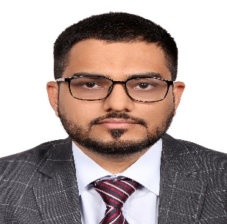
Core Team Member
Tanzeel is an Assistant Manager in Deloitte’s Cyber services. He has gained 10+ years of experience in various areas related to business continuity, disaster recovery and IT risk in a multitude of disciplines and industries.
Tanzeel has been part of multiple teams performing end to end business continuity implementations and disaster recovery reviews based on ISO 22301. Tanzeel was involved in various advisory engagements based on ISO 27001, ISO 20000 COBIT, ITIL and more.
Tanzeel Afzal
Assistant Manager
Key Relevant Engagements – Outline
Led End-to-End implementations of Business Continuity Management Systems as per the requirements of international standards such as ISO22301 covering current state assessment; business impact analysis; threat risk assessment; business continuity and disaster recovery strategies; crisis management plans, business continuity plans, IT DR plans; training & awareness; and testing. ​
Worked on the development of IT DR plan for multiple organizations. This involved identifying critical IT systems and development of measures to ensure services are available when required by the organization.
Performed and managed the review of the IT General Controls with respect to the business continuity, disaster recovery planning, backups and service management and other areas for more than 15 Abu Dhabi entities.
Performed and managed multiple end to end IT Risk Assessments based on security best practices such as NIST, ISO and COBIT.
Professional and Technical Qualification
B.Sc. – Applied Auditing – Oxford Brookes University, UK
Fellow Chartered and Certified Accountant (FCCA) ACCA-UK
Certified Internal Auditor (CIA), Institute of Internal Auditors (IIA), USA
Certified Information System Auditor (CISA), ISACA-USA
Certified Information System Security Professional (CISSP), ISC2-USA
Certified ISO 27001 Lead Auditor
Certified ISO 20000 Lead Implementer
Key Clients Public Investment Fund – KSA BMW Abu Dhabi Motors – UAE Abu Dhabi Cooperative Society – UAE Ministry of Finance – UAE SHUROOQ – UAE Al Ansari Exchange – UAE Al Jaleel Trading-UAE Grand Millennium- UAE Rabdan Academy- UAE Abu Dhabi Municipality- UAE Abu Dhabi Statistics Department- UAE | Abu Dhabi Accountability Authority – UAE Abu Dhabi Government Media Office – UAE Abu Dhabi Department of Economic Development – UAE Abu Dhabi Digital Authority - UAE ADNOC Distribution – UAE Abu Dhabi Investment Office - UAE King Abdullah Economic City – Saudi Pakistan Telecommunication Company Limited – Pak Telenor – Pak PMCL and Warid now Jazz – Pak

Slide 58
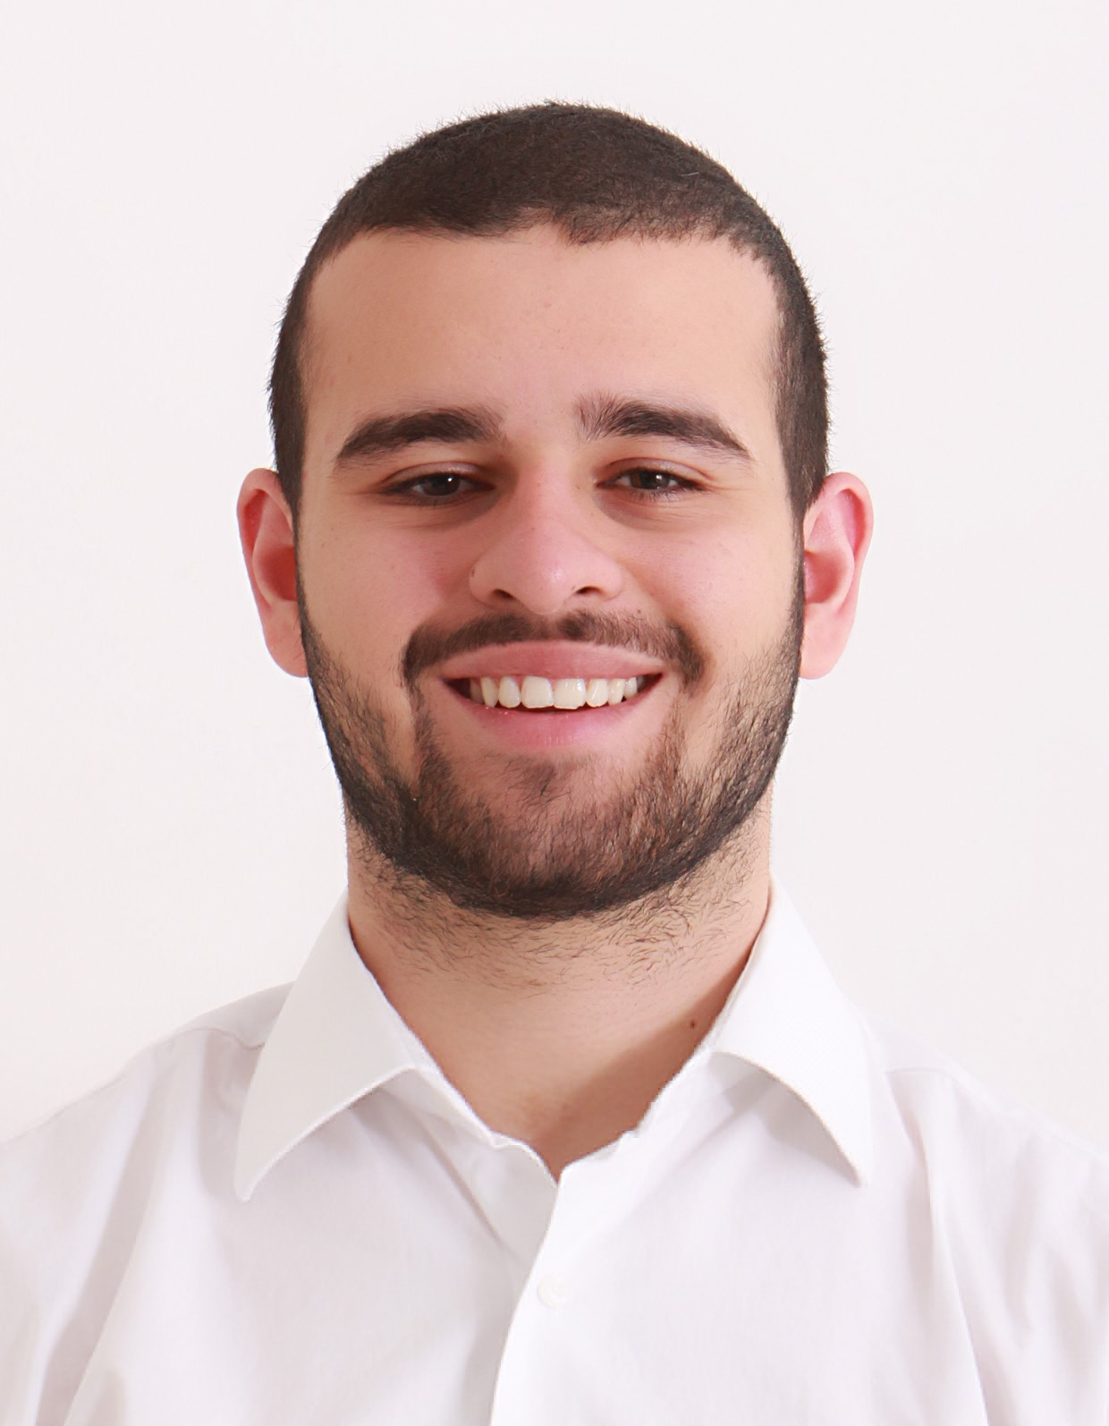
Core Team Member
Jason is a Consultant in Deloitte Risk Advisory practice working with the Crisis & Resilience Team. He has been trained to work on Business Continuity International Standard ISO 22301:2019 and UAE national standard NCEMA AE/SCNS/NCEMA 7000:2021.
Jason has been involved in multiple engagements working on end-to-end business continuity implementation, maintenance of the business continuity management system, current state assessment and enhancement of crisis management framework and testing and exercising.
Key Relevant Engagements – Outline
Business Continuity Governance Framework: Jason developed documentation requirements based on NCEMA 7000:2021 and ISO 22301 requirements. That includes but not limited to: Business Continuity policies, Technical procedures such as Business Impact Analysis procedure, Threat Risk Assessment procedure, Testing and Exercising procedure and Supporting Documents.
Business Continuity Design: End-to-End implementation of Business Continuity Management Systems as per the requirements of international standards such as ISO22301, as well as local UAE Standard issued by NCMEA AE/HSC 7000:2021. The activities include but are not limited to:
Business Impact Analysis: Jason conducted Business Impact Analysis for corporate departments in the public sector as well as private sector. In this exercise, Jason identified organization critical processes, recovery requirements and critical dependencies.
Threat Risk Assessment: Jason conducted Threat Risk Assessment exercise including Threat identification, Threat analysis and evaluation, and high-level assessment of threat treatment options.
Involved in developing Crisis Management Plans, Recovery strategies, Business Continuity Plans, Testing and Exercising.
Jason Massaad
Consultant
Professional and Technical Qualification
Bachelor of Science in Business Administration from Boston University Questrom School of Business, Boston, MA
Certified ISO 22301 Business Continuity Management System Lead Implementer and Lead Auditor.
Certified ISO 27001 Information Security Management Systems Lead Implementer and Lead Auditor
Certificate of the BCI (CBCI)
Key Clients NEOM ROSHN Real Estate Company Solutions by stc Public Investment Fund The Olayan Group

Slide 59
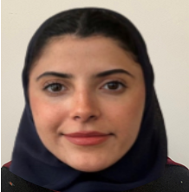
Core Team Member
Lujain is a Business Analyst in Deloitte’s Cyber services in Riyadh, KSA with experience in business continuity management and project management. She holds a Bachelor Degree in Computer Science from Al-imam Mohammed bin Saud University and is CBCI certified. She did her COOP training with Sahab National Company for 6 months.
Key Relevant Engagements – Outline
Core team member as part of BCM project in NEOM working on multiple business units
Core team member for delivery of crisis simulation at Alinma Bank
Published book chapter entitled “Security Challenges for UAV Systems Communications: Potential Attacks and Countermeasures” in the book series: Synthesis Lectures on Intelligent Technologies (SLIT), specifically as a part of "Unmanned Aerial Vehicles Applications: Challenges and Trends" book, Springer, 2023.
Her Graduation Project “Detecting Cyber-Attacks Against Unmanned Aerial Vehicles Using Machine Learning Model” was chosen as one of the outstanding projects to represent Al-Imam Mohammed bin Saud University at the Sustainable Partnerships Conference entitled "Research and Innovation to Build a Prosperous Economy”.
Worked in Sahab National Company as project management Intern for 6 months.
During her time at Sahab National Company, she managed the “Digital Inspection” project by creating a solid project plan, risk assessment reports, and leading the technical team.
Lujain Alfawzan
Business Analyst
Professional and Technical Qualification
Bachelor’s degree in Computer Science from Al-imam Mohammed bin Saud University
Certificate of the BCI (CBCI)
Key Clients NEOM Alinma Bank

Slide 60

Appendices
Why Deloitte?
Our Credentials
Deloitte’s Official Documents
General Business Terms

Slide 61
Why Deloitte?

Slide 62
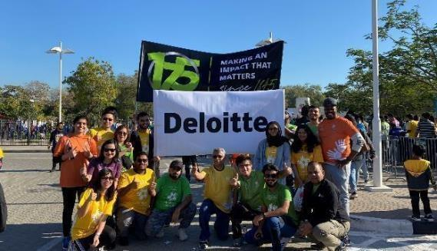
About Deloitte – Deloitte 175
2020 marked 175 years of Deloitte people making an impact that matters.
It is an enduring story that began in 1845 with William Welch Deloitte. An individual with an ideal, integrity and incentive to build something that would last.
He was someone who understood the power of connection as a way to grow. It was the start of a thriving global organization, which has grown to more than 300,000 people proudly carrying forth a legacy of connection and collaboration.
Ideals that remain the bedrock of today’s Deloitte—an organization with the multidimensional perspectives necessary to solve the world’s greatest challenges— in business and society.
It’s in our DNA.

Slide 63
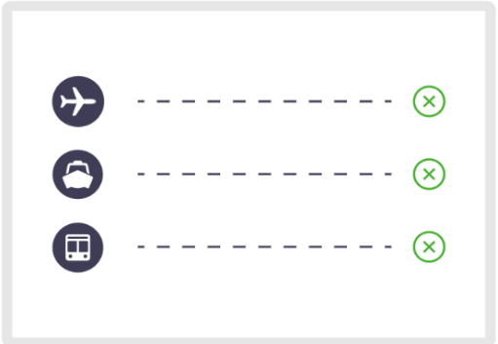
About Deloitte Global professional services firm
A multi-billion-dollar company
2022
Revenue US$59.3B
Headcount 411,951
Countries & territories
More than 150
New hires 156,430
Societal investment US$284M

Slide 64
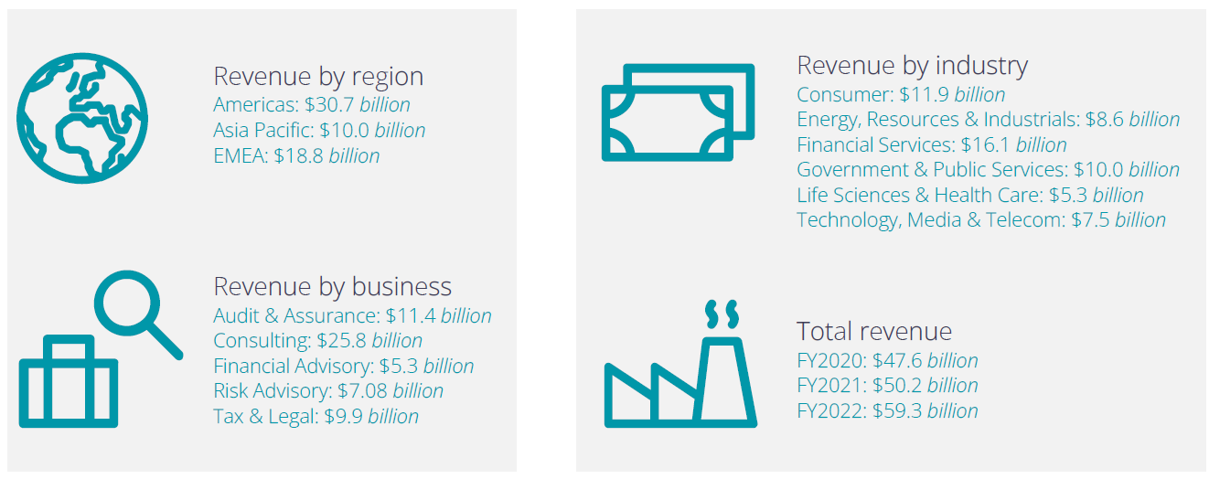
About Deloitte Global professional services firm
The Largest Professional Services Firm Globally

Slide 65

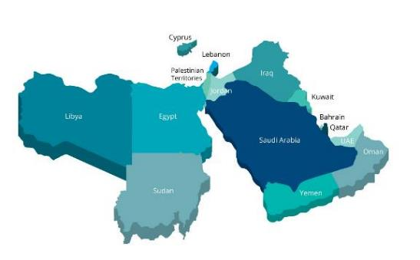
About Deloitte Global professional services firm
Deloitte Middle East
We have served as trusted advisors for clients for the past 96 years
Deloitte is the world’s largest leading professional services firm, providing audit and assurance, tax, consulting, financial advisory and risk advisory services to public and private clients spanning multiple industries.
Deloitte’s presence in the Middle East has contributed to the advancements and growth of the professional services industry in the region.
Deloitte clients are able to benefit from experts that are well-aware of the environment, culture, and specific industry that they are operating in.
Deloitte's professionals are dedicated to strengthening corporate responsibility, building public trust, and making a positive impact in their communities.
5,900 +
Professionals
39%
Women
105
Nationalities
15
Countries
29
Offices

Slide 66
















About Deloitte Global professional services firm
Our Middle East Presence
Our 5,900 + professionals serve the Levant region and the wider GCC across 15 countries
Cyprus
Nicosia
Limassol
Iraq
Erbil
Baghdad
Lebanon Beirut
Palestinian Territories
Ramallah
Kuwait Revitalize City
Jordan Amman
Qatar Doha
United Arab Emirates Dubai
Abu Dhabi
Fujairah
Ras Al-Khaimah
Sharjah
Bahrain Manama
Libya
Tripoli
Oman Muscat
Sudan Khartoum
Kingdom of Saudi Arabia
Riyadh Jeddah
Al Khobar
Egypt Cairo
Alexandria
105
nationalities
Yemen
Sanaa

Slide 67

About Deloitte Global professional services firm
Deloitte Middle East - Our Regional Presence
Deloitte at a Glance
Deloitte is established in the Middle East region with uninterrupted presence since 1926 and is present across 29 offices in 15 countries with more than 5,900 partners, directors and staff.
Awards
Deloitte Middle East has received numerous awards in the last few years such as Brand Finance’s strongest and most valuable “commercial services” brand in the world (2022), the Great Place to Work® and Best Workplaces ™in the UAE 2022 ), Great Place to Work® and Best Workplaces ™in the KSA ( 2022 ) and World s Most Attractive Employers ” 2022.
Internal Impact
Deloitte makes an impact that matters to its clients, talent and society. Our practices around the Middle East support clients become leaders wherever they choose to compete. We invest in outstanding people of diverse talents and backgrounds and empower them to achieve more than they could elsewhere. Our work combines advice with action and integrity. We believe that when our clients and society are stronger, so are we.
External Impact
Our organization has grown in scale and diversity providing services across the region— with our shared culture remaining the same. We aim to help clients realize their ambitions; make a positive difference in society; and maximize the success of our people. This drive fuels the commitment and humanity that run deep through our every action.

Slide 68


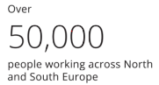
About Deloitte Global professional services firm
About Deloitte North and South Europe
28
countries all part
of one firm
Deloitte Middle East is part of NSE
Deloitte North and South Europe (NSE) is the second largest member firm in the Deloitte network. Deloitte NSE combines our unmatched breadth and depth of capabilities in audit & assurance, consulting, financial advisory, risk advisory, and tax & legal. As our clients operate in a more globally connected way than ever before, Deloitte NSE helps us provide a seamless cross-border service. Deloitte NSE brings together 3,000 partners and over 100,000 people, providing us with the scale, and the means, to increase our investment in the innovation our clients need.
It is also creating more opportunity and growth for our people, and playing an important part in helping us to embed quality consistently in all we do. Central to our firm is our commitment to our global purpose: to make an impact that matters for our clients, our people and society.
100,000
Deloitte NSE is the second largest member firm in the Deloitte network.
Deloitte Middle East comprises Bahrain, Cyprus, Egypt, Iraq, Jordan, Kuwait, Lebanon, Libya, Oman, Palestinian Ruled Territories, Qatar, Saudi Arabia, Republic of the Sudan, United Arab Emirates and Yemen.
Read more about how Deloitte NSE makes an impact that matters to clients, people and society.

Slide 69
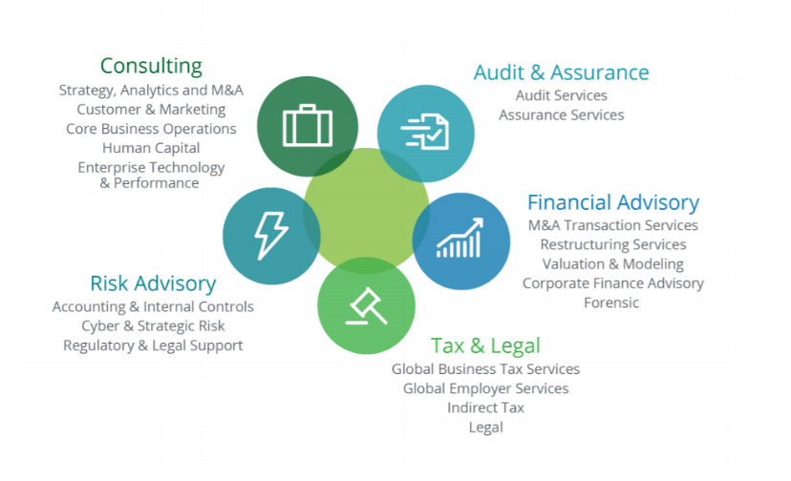

About Deloitte Global professional services firm
Our Core Services (1/2)
Delivering Excellence

Slide 70
About Deloitte Global professional services firm
Our Core Services (2/2)
Solving complex problems is our passion. We’ve built our world-class businesses to affect change that matters and deliver transformational impact for clients and the communities in which we work. Our operating model allows our businesses to work better together and enables sustained enhancement and innovations to service capability and cross-border delivery as well as talent development and deployment.
Audit & Assurance
Consulting
Tax & Legal
Audit & Assurance is about much more than just the numbers. It’s about attesting to accomplishments and challenges, and helping to assure strong foundations for future aspirations. Deloitte illuminates the what, how, and why of change so you’re always ready to act ahead.
Innovation, transformation and leadership occur in many ways. Deloitte helps solve clients’ most complex issues is distinct. The team delivers strategy and implementation, from a business and technology view, to help clients lead in the markets where they compete.
Today’s rapidly shifting global Tax environment is creating unprecedented change in the market. In the midst of uncertainty, Deloitte helps clients see opportunities and lead with confidence.
Business Tax
Global Family Solutions
Indirect Tax
International and M&A Tax
Transfer Pricing
Global Employer Services
Business Process Solutions
Tax Management Consulting
Financial statements Audit
Accounting Advisory
Assurance Services
Integrated Services
Strategy, Analytics and Mergers & Acquisitions
Customer & Marketing
Business Operations
Human Capital
Enterprise Technology & Performance
Risk Advisory
Financial Advisory
Leading organizations understand that risk is a source of competitive advantage. By managing risk more effectively these organizations unleash their full potential, creating and protecting value for all of their stakeholders.
Deloitte provides services around M&A, restructurings, raising capital, and forensic investigations. Multi-situational capabilities are offered and those include business modeling, public private partnerships, and infrastructure advisory and valuations.
Accounting and Internal Controls
Cyber Risk
Financial and Regulatory Risk
Mergers & Acquisitions
Forensics
Real Estate
Restructuring Services

Slide 71
About Deloitte Global professional services firm
Our Industries
Deloitte focuses on six core industries and 21 sectors in the global marketplace
Consumer
Energy, Resources and Industrials
Automotive
Consumer Products
Retail, Wholesale & Distribution
Transportation, Hospitality, and Services
Industrial Products & Construction
Mining & Metals
Oil, Gas & Chemicals
Power, Utilities & Renewables
Government and Public Services
Financial Services
Civil Government
Defense, Security & Justice
Health & Social Care
International Donor Organizations
Transport
Banking & Capital Markets
Insurance
Investment Management
Real Estate
Life Sciences and Health Care
Technology, Media and Telecom
Health Care
Life Sciences
Technology
Telecom, Media & Entertainment

Slide 72
About Deloitte Global professional services firm
Our Awards and Capabilities – Global Recognition
What the Analysts say about Deloitte
A
global leader
in Business Transformation consulting based on strategy and current offering” by Forrester ⁵
A leader
in Global Risk Management Consulting Services, based on completeness of vision and ability to execute” by Gartner ^{3a}
Deloitte is recognized as a global leader in capabilities, vision and execution
For several consecutive years, industry analysts have maintained their perspective on Deloitte Consulting practices globally.
As the world's largest management consulting business, Deloitte is distinct in its ability to help clients solve their most complex problems, from strategy to implementation.
We are differentiated by our capability to execute the advice we provide to help clients in the markets where they operate today and where they want to be in the future. Delivering this kind of value requires the skills to integrate a broad range of talent and skills – across human capital, strategy & operations, and technology – aligned to the unique needs of our clients’ industry sectors, businesses, and organisations.
A
global
Leader
in IT Consulting to the Energy & Utilities Industries based on capabilities” by Kennedy ²
A global
leader in Forensics & Dispute Advisory services based on breadth and depth capabilities” by Kennedy ¹
#1
globally in
Consulting based
on revenue by
Gartner¹
A
worldwide leader in Business Consulting Services based on capability and strategy by IDC MarketScape²
#1
globally in Consulting based on revenue and market share by Kennedy³
#1
Professional services firm for four consecutive years by Brand Finance (2021)
A
worldwide leader
in organizational Consulting Services based on capability and strategy” by IDC ⁴
1 Source: Gartner, Market Share Analysis: Consulting Services Worldwide, 2014, Jacqueline Heng, Dean Blackmore, Julie Short, April 22, 2015
2 Source: IDC MarketScape: Worldwide Business Consulting Services 2015Vendor Assessment by Cushing Anderson, February 2015, IDC #254320
3 Source: Kennedy Consulting Research & Advisory; Global Consulting Market Index 2013; Kennedy Consulting Research & Advisory estimates © 2014 Kennedy Information, LLC. Rreproduced under license
¹ Kennedy Consulting Research & Advisory; Forensic and Dispute Advisory Financial Consulting 2014; Kennedy Consulting Research & Advisory estimate © 2014 ALM Media Properties, LLC. Reproduced under license
² Kennedy Consulting Research & Advisory; Information Technology Consulting to the Energy and Utilities Industry; © 2014 Kennedy Information, LLC. Reproduced under license
³ Gartner, Magic Quadrant for Global Risk Management Consulting Services, Jacqueline Heng, John A. Wheeler, 7 October, 2014
⁴IDC Markets cape: Worldwide Organisational Consulting Services 2015 Vendor Assessment by Cushing Anderson,2015, IDC #258551
⁵Forrester Research, Forrester WaveTM: Business Transformation Consultancies Q3 2015”, Marc Cecere, July 21, 2015

Slide 73
About Deloitte Global professional services firm
Our Awards and Capabilities – Awards and Recognition
Best Employer in the Middle East by Hewitt
Most attractive employer in multiple ME countries by Universum
Deloitte EMEA HR Award for Business Partnering
Best professional services firm by Brand Finance
“Best CSR Integrated Organisation” in Levant
Deloitte Best in Class award for “Outstanding brand building performance”
Judges Award for Distinction for the Brand and Communications team
Best Consulting Firm of the Year Award
Citi Performance Excellence Award
World Tax results: Deloitte tax practice maintains tier one ranking in the GCC
Middle East’s best Continuity and Resilience provider
World Tax awards Deloitte more tier one ratings than ever before
Deloitte Middle East partner named at top of Financial Times and HERoes global champions of women in business
Central Banking Awards - Saudi Arabia (with Deloitte Canada and Hong Kong)

Slide 74














About Deloitte Global professional services firm
Thought leadership and innovation are core elements to service delivery
Our Awards and Capabilities – Capabilities
Books & Magazines
Publications
Research
Assets & Capabilities
Client Labs
Media
Innovation Centers:
Dbriefs Webcasts
Deloitte Insights Podcasts
Deloitte Perspectives Blog
Deloitte TV
Corporate Governance
Cyber Innovation
Doblin
Federal Innovation
Health Solutions
Center for the Edge
Energy Solutions
Monitor Institute
Middle East Islamic Finance Knowledge Center
ARIS - A Really Inspiring Space (Cyprus)
Center for Collective Leadership (UK)
Deloitte Innovation Center (Belgium)
Center for Government Insights (US)
Center for Financial Services (US)
Center for Talent Innovation (US)
Deloitte Institute of Innovation & Entrepreneurship (UK)
Deloitte Client Experience Labs
Deloitte Analytics
InsightStudio

Slide 75
Our Credentials

Slide 76







Our Credentials
Our Middle East BCM practice has experienced practitioners and consultants certified in the business continuity field. We have successfully developed and evolved BCMS, implemented end-to-end projects, assessed readiness and maturity, and advised on BCM best practices.

Slide 77

Our Credentials
Royal Commission for Al Ula
Uptown Jeddah Company
ROSHN Real Estate Company
Ministry of Commerce
Project Details
Project Details
Project Details
Project Details
Establishment and operation of Governance, Risk and Compliance (GRC). Due to its vast experience in GRC, its qualified team and strong relationships, Deloitte has recently completed a mega project for the Royal Commission for AlUla (RCU). Deloitte is responsible for the establishment of the GRC function based on the build-operate-transfer model over an 18-month period. The scope of work covered the development of the enterprise risk, enterprise resilience, governance, ethics and compliance departments part of the GRC division.
Uptown Jeddah Company engaged Deloitte & Touche Advisory Saudi Limited to Establish the Business Continuity Management Function and implement an end-to-end Business Continuity Management System for the Company. The project had a timeline of 10 Months.
The scope of work covered the establishment of the function develop the policy and operating model, in addition to BCM Framework and manual procedures. Also as part of the scope performing Threat Risk Assessment and Business Impact Analysis for the whole entity. As a result of this analysis, Deloitte has delivered an updated Business Continuity Plans and Recovery Strategies that are will support Uptown Jeddah Company in recovering their time critical services and operations in a timely manner.
As part of the scope Deloitte developed the Incident Response and Crisis Management framework and related plans.
ROSHN is a real estate entity established under the Public Investment Fund (PIF).
ROSH partnered with Deloitte to implement a robust BCMS in light of ROSHN’s mission and vision to make long term investments in the future of cities across Saudi Arabia by developing great communities with best-in-class homes and to be the most trusted community developer in Saudi Arabia. The engagement was completed over a period of 8 months, with below key outcomes:
A Business Continuity Management System which is aligned with the ISO 22301:2019 standards and is reflective of ROSHN’s culture and operations.
Trained, skilled professionals who understand the importance of resilience, and are confident and competent to complete their assigned roles in the BCMS.
Deloitte & Touche Advisory Saudi Limited led the development and implementation efforts for a comprehensive Business Continuity Management program for MC for a period of 10 Months. The project comprised of establishing BCM Governance Policies and Procedures as well as conducting organization-wide Business Impact Analysis, IT Disaster Recovery Assessment and Threat Risk Assessment outlining the recovery time and recovery point objectives for the MCs critical services and processes. Moreover, a number of exercises (Tabletop and Simulation) have been conducted to evaluate MC’s crisis preparedness.

Slide 78

Our Credentials
Saudi Arabian Monetary Authority (SAMA)
Saudi Payments (SADAD)
Bupa Arabia
Tadawul
Project Details
Project Details
Project Details
Project Details
Deloitte was engaged to develop Business Continuity Development Program for SAMA Head Office, all branches and Committees across the Kingdom. In line with the understanding of the vision and requirements of SAMA, Deloitte built on its realization of the scale and criticality of such an important initiative by investing 24 months of extensive efforts of hands-on involvement to develop an end-to-end BCM program. The dedicated team steered the development of the program in its initial stages by assessing and understanding existing resilience capabilities of the organization, only to be followed with a multi-month in-depth BIA of the entire organization (including the Headquarters in Riyadh as well as the authority’s ten branches across the kingdom) to derive the authority’s time-critical processes and identify recovery requirements needed to support the recovery of such processes.
Saudi Payments (ex. SADAD Payment System) was established by the Saudi Arabian Monetary Authority (SAMA) to be the national Electronic Bill Presentment and Payment (EBPP) service provider for the Kingdom of Saudi Arabia (KSA). The core mandate for SADAD is to facilitate and streamline bill payment transactions of end consumers through all channels of the Kingdom’s Banks. SADAD was launched on October 3, 2004. SADAD links the commercial sector and local banks, offering the ability to collect customer payments electronically through all the banking channels in the kingdom 24 hours a day.
Deloitte has been appointed by SAMA to manage the Governance, Risk and Compliance function of SADAD for 2 years. This includes management and maintenance of Business Continuity Management, Enterprise Risk Management, Information Security Governance, Fraud Risk Management and Compliance Management.
Bupa Arabia, a leading insurer in Saudi Arabia, engaged Deloitte to develop and implement an end-to-end BCM Program covering their Head Office and other locations.
Deloitte & Touche M.E is working with Bupa Arabia to deliver an end-to-end BCM Program, focusing on developing a well prepared framework to minimize the impacts due to business disruption, provision to protect the interests of key stakeholders, and establish a process for internal communication, decision making and priority setting during incidents.
Our team is working closely with Bupa to build a culture of resilience to protect its mission, vision, and goals, and to mitigate risks. Deloitte has successfully developed a BCM Framework and Governance structure for Bupa and is currently delivering key assessments and strategies, that will be followed by a comprehensive Incident Response and Crisis Management framework.
Tadawul has Business Continuity (BC) arrangements in place and was striving to ensure its BC program is enhanced and up to date.
To achieve this, Tadawul sought the services of Deloitte to provide expert advice and assistance to enable the Risk Management Division (RMD) undertake an update cycle of Tadawul’s BC program with the aim of raising the quality and maturity to the program further (including initiation of expanding the scope of the program to the Subsidiary), and also focusing on building exercising and testing capability.

Slide 79



Our Credentials
Saudi National Bank
SEDCO
Ma’aden
OSN
Project Details
Project Details
Project Details
Project Details
Deloitte’s BCM team assisted SNB for a compressive Disaster Recovery (DR) Assessment and helped them to developed an IT Business Continuity Management Program in line with the SAMA BCM Requirements and ISO 22301 Standard requirements.
Deloitte’s BCM team led the development and implementation efforts for a comprehensive business continuity management system for SEDCO Holding. The project includes the development of main strategies and plans for critical departments within SEDCO Holding.
Deloitte & Touche M.E. has been awarded the contract to implement end-to-end Business Continuity Management System for Ma’aden Corporate and all of its business units and affiliate companies including a review of its emergency response procedures for its mines and sites. MA’ADEN has engaged Deloitte to assist in the development of the enterprise wide Enterprise Risk Management (ERM) Program and the BCM Program concurrently. The Project is expected to last 2 years at the initial onset and to cover the entire units and sites in scope.
Deloitte & Touche M.E. led the development and implementation efforts for a comprehensive Business Continuity Management program for OSN’s operations. We conducted organization-wide business impact analysis outlining the recovery time and recovery point objectives for the organization’s critical business processes. Each technology application supporting the various processes has been identified, along with its corresponding recovery objectives.

Slide 80




Our Credentials
Dubai Airports
TECOM Group
Dubai International Financial Center
Aramex
Project Details
Project Details
Project Details
Project Details
Deloitte was engaged to conduct a Technology Resilience Assessment at Dubai Airports, where key activities included:
Performing a complete end-to-end Business Impact Analysis (BIA) for the Business Technology department for the following areas:
Data Centers which are on premise at Dubai Airports (DA) and Dubai World Central (DWC)
IT infrastructure which is on premise at DA and DWC
Network infrastructure
All IT services
Technology touch points within Dubai Airports Operations
Identifying the gaps between the recovery requirements outlined in the BIA against DA’s existing recovery capabilities in order to identify a comprehensive set of additional recovery requirements.
Developing a recommendation report and roadmap to achieve the recovery objectives identified during the BIA report.
Deloitte was engaged to assist in the enhancement of TECOM’s pre-existing Business Continuity Management (BCM) framework. The overall objectives of this engagement aim to focus on the below items:
Review of existing BCM framework documentation and propose enhancements (if required) to existing framework
Review and update existing Business Impact Analysis, associated Business Continuity strategies and plans for significant functions and business processes
Proposal for and execution of appropriately sized BCM tests and future testing schedule
Provide guidance for assisting TECOM with certification
The project was executed over a period of 6 months.
Deloitte was engaged to conduct a refresh of the existing Business Continuity Management (BCM) frameworks within DIFC. The project duration was 6 months, and the scope of work included:
Establishing a revamped BCMS Governance Framework
Conducting BIA and TRA workshops
Identifying recovery strategies and accordingly establishing Business Continuity Plans
Developing a Crisis Management Framework and plan for DIFC management
Conducting BCM training and exercising sessions for selected stakeholders
Deloitte & Touche M.E. led the development and implementation efforts for a comprehensive Business Continuity Management program for Aramex operations. We conducted organization-wide business impact analysis outlining the recovery time and recovery point objectives for the organization’s critical business processes. Each application supporting the various processes has been identified, along with its corresponding recovery objectives. Using the requirements identified, we are developing recovery and resiliency strategies, design documentation, and business continuity plans for each of Aramex’s critical processes.

Slide 81



Our Credentials
Dubai Silicon Oasis Authority
Abu Dhabi Police GHQ
Mubadala
Central Bank of Kuwait
Project Details
Project Details
Project Details
Project Details
Deloitte & Touche M.E. was engaged to implement an end-to-end Enterprise Risk Management & Business Continuity Management system for a key governmental entity in Dubai, a municipal body of the free zone. The project aims at achieving compliance with ISO22301 for Business Continuity Management Program.
The project aims to establish the BCM governance framework, perform a Business Impact Analysis and Threat Assessment workshops to prioritize critical processes, develop BC strategy & plan & conduct BCM exercising as part of the implementation support. The total project duration is 12 months covering 20 departments.
Deloitte & Touche M.E. is implementing a BCM program with Abu Dhabi Police (ADP). The project aims at achieving compliance with ISO22301 Business Continuity Management program and National Crisis and NCEMA 7000 standards. We are engaged to:
Perform Current State Assessment
Create BCM Governance Framework
Perform a Business Impact Analysis and Threat Assessment
Business Continuity Strategy Development & Implementation
BCM Training and Exercising
Critical design considerations like alignment with the requirements of NCEMA; integration with Enterprise Risk Management System, Crisis Management System, IT Disaster Recovery Planning & Procedures, Health, Safety & Environment System, ADP’s Quality Management System; and abiding by the Sheikh Khalifa Excellence Award have been incorporated within our approach to ensure successful implementation.
Deloitte & Touche M.E. was requested to perform a Business Impact Analysis for all Business and Support functions of Mubadala (the investment arm of the Government of the State of Abu Dhabi) in order to drive the next steps in the implementation of the Business Continuity and Disaster Recovery initiatives
Deloitte & Touche M.E. led the development and implementation efforts for a comprehensive business continuity management program for the Central Bank of Kuwait. We began our efforts with a bank-wide business impact analysis, resulting in a detailed, requirements report, outlining the recovery time and recovery point objectives for the bank’s critical business processes. Each application supporting the various processes was also identified, along with its corresponding recovery objectives. Using the requirements identified, we developed strategies, designed and documented, business continuity plans for each of the central bank’s critical processes. We documented recovery plan covering the BETH3 asset mix outlined in Deloitte’s recommended BCM methodology.

Slide 82



Our Credentials
STC Solutions
STC Channels
General Organization for Social Insurance
Project Details
Project Details
Project Details
Deloitte & Touche Advisory Saudi Limited was engaged by solutions to implement a holistic BCM Program and integrating it with the existing Enterprise Risk Management framework. The project was executed in a timeline of 6 Months and comprised of establishing BCM governance policy and procedures as well as performing Threat Risk Assessment and Business Impact Analysis for the whole entity. As a result of this analysis, Deloitte has developed Business Continuity Plans and Recovery Strategies that will support solutions in recovering their time critical services and operations in a timely manner.
STC Channels engaged Deloitte to review and update channels‘ existing BCM program. The project had a timeline of 6 Months and comprised of reviewing and updating the overall BCM framework as well as performing Threat Risk Assessment and Business Impact Analysis for the whole entity. As a result of this analysis, Deloitte has delivered an updated Business Continuity Plans and Recovery Strategies that are will support channels in recovering their time critical services and operations in a timely manner.
Deloitte’s BCM team led the development and implementation efforts for compressive Disaster Recovery (DR) Assessment for the General Organization for Social Insurance (GOSI).

Slide 83
Deloitte’s Official Documents

Slide 84
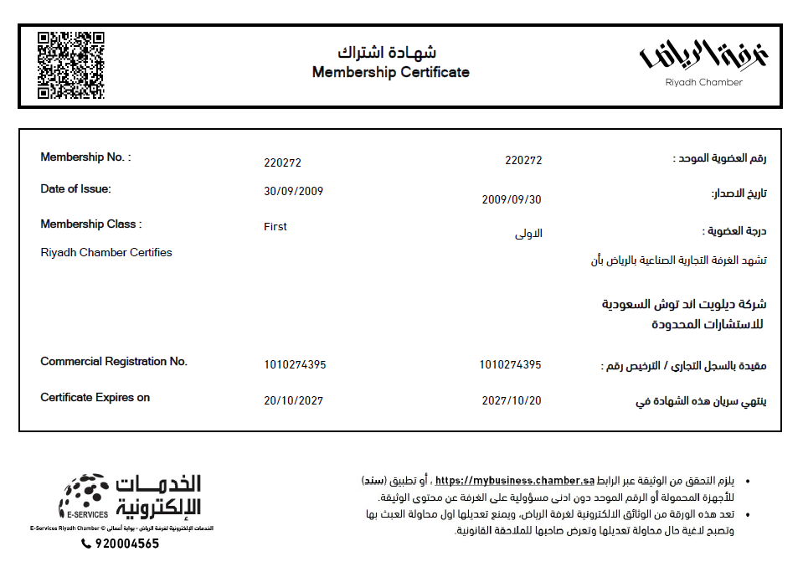
Membership Certificate

Slide 85
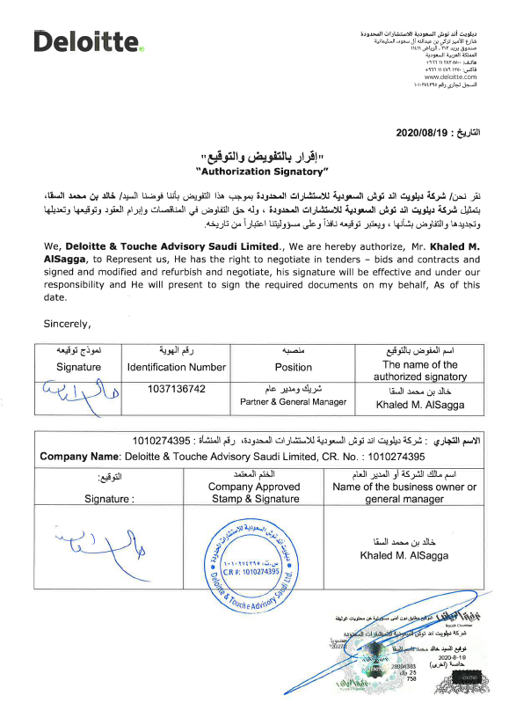
Authorization Signatory

Slide 86

Commercial Registration (1/3):

Slide 87
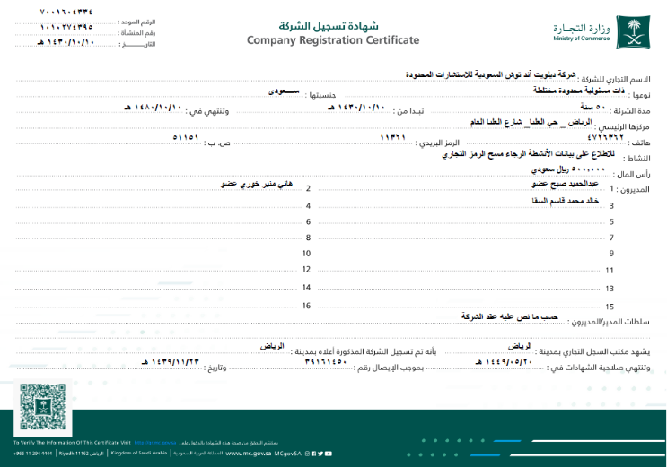
Commercial Registration (2/3):

Slide 88
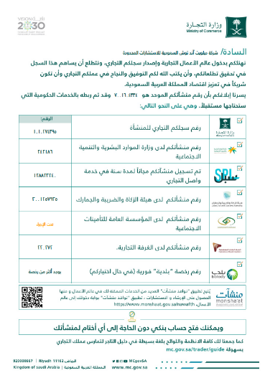
Commercial Registration (3/3):

Slide 89


Value Added Tax Registration:

Slide 90
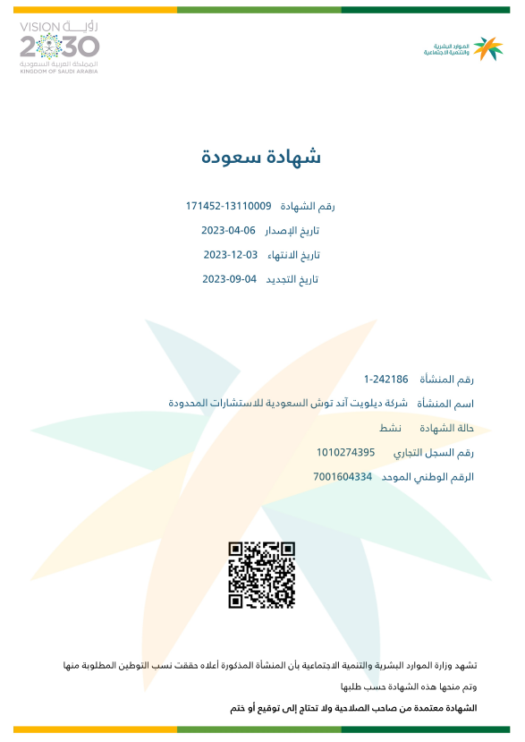
Saudization Certificate:

Slide 91
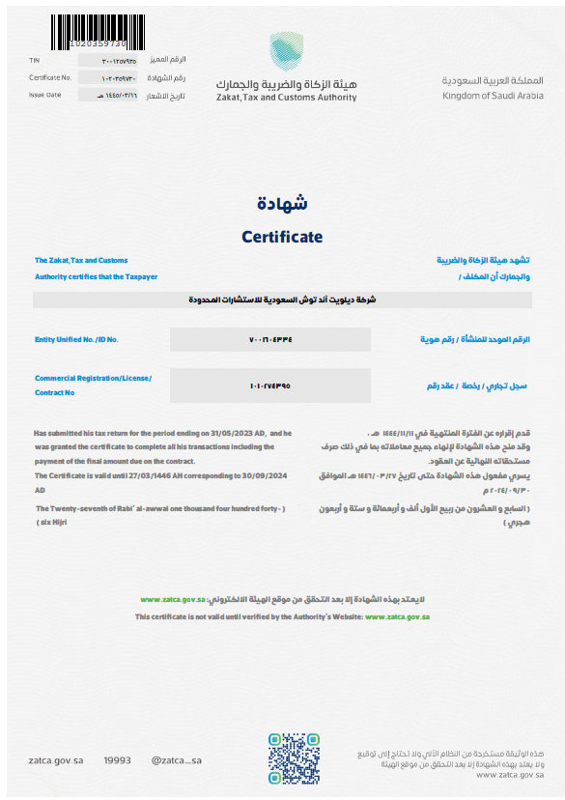
Zakat and Income Department Certificate:

Slide 92
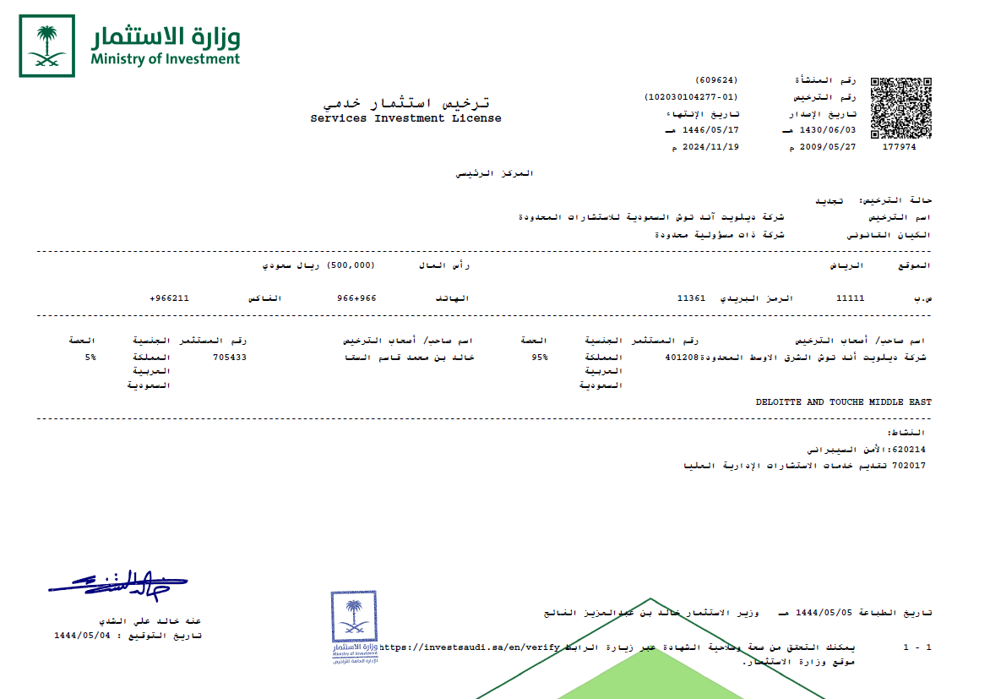
Service Investment License:

Slide 93
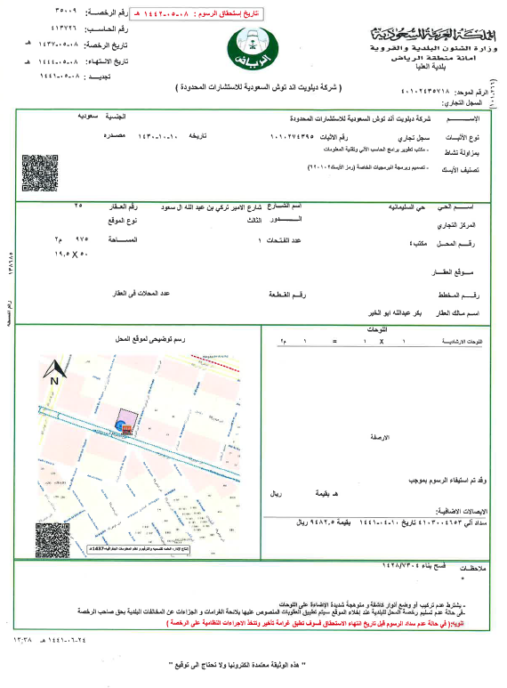
Official Address

Slide 94
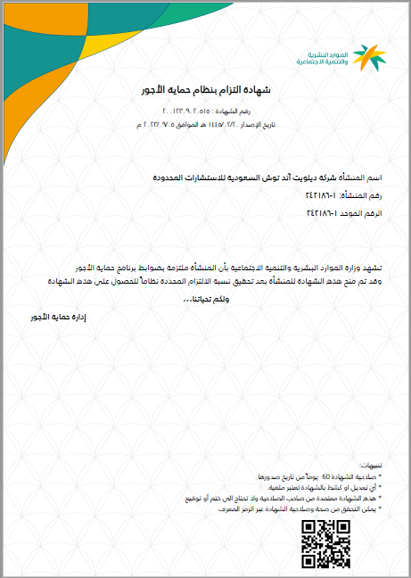
Wage Protection Certificate:

Slide 95


ISO Certificates

Slide 96
General Business Terms and Conditions

Slide 97
General Business Terms and Conditions (1 of 18)
Master General Business Terms and Conditions
1 Terms of Reference.
1.1 Deloitte hereby agrees to render Services to the Client, as set out in the General Business Terms and Conditions read together with the Proposal (hereinafter collectively referred to as the “Agreement”). Deloitte accepts the appointment to render the Services to the Client on the terms and conditions set out in this General Business Terms and Conditions. All Services rendered by Deloitte for the Client will be in accordance with the agreed terms of reference for the Project as contained in this Agreement unless both Parties in writing agree upon a revision.
1.1.1 It is specifically recorded that a number of assumptions have been made by the Parties around the rendering of Services, and these are as described in the Proposal.
1.1.2 It is agreed that should any of these assumptions be proven to be incorrect (by either Party), this will be treated as a change of scope to the Agreement, and will be dealt with accordingly by the Parties.
1.2 In the event of Services already being delivered, Client agrees that these terms shall apply to the Engagement retrospectively. In the event that any of the General Business Terms and Conditions in whole or in part are found to be illegal, void or unenforceable, the remainder of the terms shall not be impacted and will remain in force.
2 Interpretation.
2.1 The headings to the clauses in this Agreement are for convenient reference purposes only, shall not be used in the interpretation of this Agreement and shall not limit or extend the language of the clauses to which they refer.
2.2 Unless the context otherwise requires:
2.2.1 The singular shall import and include the plural and vice versa;
2.2.2 Words indicating a gender shall import and include other genders;
2.2.3 Words indicating natural persons shall include juristic persons;
2.3 The Gregorian calendar shall be the basis for any years, quarters, months or dates expressed in this Agreement; and
2.4 References to clauses, parts and sections are, unless otherwise provided, references to clauses, parts and sections of this Agreement.
2.5 Order of Precedence:
2.5.1 Proposal;
2.5.2 Letter of Engagement;
2.5.3 Change Order (if applicable, the Change Order would supersede the Proposal and be followed by the General Business Terms and Conditions).

Slide 98
General Business Terms and Conditions (2 of 18)
3 Services.
Shall mean the Services to be rendered by Deloitte to the Client as described in the Proposal (“Services"). The Services could include the production and delivery of Deliverables (“Deliverables”), as described in the Proposal. It is understood and agreed that Deloitte’s Services may include advice and recommendations, but all decisions in connection with the Services of such advice and recommendations shall be the responsibility of, and made by the Client. In connection with its Services hereunder, Deloitte shall be entitled to unequivocally rely on all decisions and approvals of the Client.
4 Change Order.
4.1 If applicable, any amendments to this agreement, including but not limited to new or additional Services to be rendered by Deloitte to the Client outside of the scope of Services included in this Agreement shall be detailed in a (“Change Order”), signed by both parties. Except as expressly modified in the Change Order, all other terms and conditions of the Proposal and General Business Terms and Conditions remain unchanged.
4.2 Unless stated otherwise in a Change Order, each Change Order, as read together with this Agreement, shall form the sole basis of the agreement between the Parties as to its subject matter. Where there is a conflict between the terms of this Agreement and the terms of a Change Order, the Change Order will take precedence.
5 Acceptance and Testing.
5.1 “Acceptance” or “Accepted” or “Accept” means, in respect of any Service or Deliverable, confirmation in writing by the Client that the agreed Acceptance Testing criteria or agreed alternative acceptance formalities have been satisfied in respect of the Service or Deliverable as commercially agreed between the Parties.
5.2 Unless the Letter of Engagement specifies other arrangements, you agree that each Deliverable will be deemed accepted by you (and our Services, or the relevant part of them, completed) when it is in its final form or when you first make use of the Deliverable, whichever first occurs.
5.3 “Deliverable/Service Defect” means:
5.3.1 A material deviation from the Specifications for a Deliverable or Service agreed to in writing between the Parties; and/or,
5.3.2 Non-compliance of a Deliverable or Service with the standards agreed to in writing between the Parties for such Deliverable or Service; and/or,
5.3.3 An error that materially impacts the Client’s ability to use any specific component of a Deliverable; and/or,
5.3.4 An error that materially reduces the effectiveness of a Service rendered; and/or,
5.3.5 An error in a Deliverable or Service that materially negatively impacts the technical performance of the Client’s systems; and/or,
5.3.6 Non-compliance with the scope of work as agreed for a Deliverable or Service, but excluding errors which are minor or cosmetic in nature.

Slide 99
General Business Terms and Conditions (3 of 18)
5.4 “Specifications” means the technical or descriptive specifications of functional, operational, performance or other characteristics required of a Service or Deliverable, as agreed between the Parties from time to time;
5.4.1 It is specifically recorded that the Parties Intend for each Service and Deliverable to undergo Acceptance Testing relevant to such Service or Deliverable, based on Acceptance Testing criteria agreed (or to be agreed) in writing between the Parties, and based on the Acceptance Testing procedure for the Service or Deliverable agreed (or to be agreed) in writing between the Parties.
5.4.2 Each Deliverable shall be considered Accepted by the Client when the Acceptance Testing procedure agreed in writing between the relevant Parties for such a Deliverable, if any, have been completed for such Deliverable.
5.4.3 Acceptance constitutes an acknowledgment, in writing, that the Agreement’s requirements in respect of the tested Service and/or Deliverable have been satisfied as at the date of Acceptance.
5.4.4 The Acceptance Testing procedures for the Services and Deliverables will be described in the Proposal or in the relevant Change Order.
5.5 Disputes related to Acceptance.
5.5.1 In the event that Deloitte considers a Deliverable or Service ready to be Accepted by the Client, and the Client unreasonably withholds or delays such Acceptance, Deloitte shall be entitled to initiate a Dispute.
5.5.2 Test Procedures:
5.5.2.1 The Parties will conduct the Acceptance Testing, and discharge their respective responsibilities, in the manner specified.
5.5.2.2 The Client may appoint any third party, at its sole expense and risk, to assist them with, or to conduct on behalf of the Client, any Acceptance Testing and quality assurance activities, as specified.
5.5.3 Failure of Acceptance Testing:
Following the completion of the Acceptance Testing, or within the 5 (Five) Business Days of formal submission by Deloitte, if the Client considers a Service and/or Deliverable to have failed an Acceptance Test, or considers the Service or Deliverable to contain a Deliverable and/or Service Defect, the Client must set out the basis of this conclusion in writing to Deloitte with the acceptable reasonable period of remedy.

Slide 100
General Business Terms and Conditions (4 of 18)
6 Deloitte Touche Tohmatsu Limited.
6.1 Deloitte Touche Tohmatsu Limited (“DTTL”), is a UK private company limited by guarantee. DTTL and each of the DTTL member firms, their subsidiaries, predecessors, successors, assignees and subcontractors and all partners, associate partners, members, owners, directors, employees and agents of all such entities (hereinafter collectively “D&T Parties”) are separate and independent legal entities, which cannot obligate, bind or act on behalf of each other. Each DTTL member firm renders services in a particular geographic area and jurisdiction and is subject to the laws and professional regulations of the particular country or countries in which it operates. DTTL itself does not render services to clients. DTTL and each DTTL member firm are liable only for their own acts or omissions and not those of each other. This Agreement is solely between the Client and Deloitte.
6.2 The Client agrees that its relationship with DTTL and the D&T Parties is solely with Deloitte as the cited contracting entity herein, contracting with the Client under this Agreement. Notwithstanding the fact that certain Services under the Agreement may be carried out by Personnel provided to Deloitte from other D&T Parties through service or other internal agreements, the Client agrees that none of the D&T Parties (except Deloitte as referenced in this Agreement) will have any liability to the Client and that the Client will not bring any claim or proceedings of any nature (whether in contract, breach of statutory duty or otherwise and including, but not limited to, a claim for negligence) in any way in respect of or in connection with this Agreement against any of the D&T Parties (except Deloitte) nor against any subcontractors that Deloitte may use to render the Services.
7 Payment of Invoices.
7.1 Invoices: Deloitte’s invoices are due per the terms and conditions set forth in the Proposal.
7.1.1 Properly submitted invoices upon which payment is not received within 30 (Thirty) calendar days of the invoice date shall accrue a late charge of the lesser of (i) 1½% (One and a half percent) per month or (ii) the highest rate allowable by law, in each case compounded monthly to the extent allowable by law.
7.1.2 Without limiting its other rights or remedies, Deloitte shall have the right to suspend or terminate the Services entirely or in part if payment is not received within 30 (Thirty) calendar days of the invoice date.
7.1.3 All amounts payable excludes Value Added Taxes “VAT” and the Client, at its sole expense, shall be responsible for all taxes, such as VAT, sales and use tax, gross receipts tax, withholding tax, and any similar tax, imposed or applicable, at date of this agreement or introduced and made applicable by legislation thereafter, whether in retrospect or not, on the Client or on Deloitte in connection with the Services, other than Deloitte’s corporate income and property taxes.
7.2 “Escalation Date” means the anniversary date of the Effective Date.
7.3 “Annual Percentage Change” means, with reference to the most recent statistics available at the Escalation Date, the headline Consumer Price Index annual inflation rate at the Escalation Date, expressed as a percentage for the month in which the Escalation Date occurs.
7.4 Deloitte may, at its discretion, on each Escalation Date, increase or decrease the rates applicable to this Agreement by the Annual Percentage Change.
7.5 Such rate increases, or decreases are to be communicated by Deloitte to the Client 30 (Thirty) calendar days in advance of them becoming effective, providing all relevant documentary evidence as reasonably required by the Client.

Slide 101
General Business Terms and Conditions (5 of 18)
7.6 Disputed Invoices. Should a dispute arise relating to any Project Fees or Reimbursable Expenses due to Deloitte:
7.6.1 The Client must notify Deloitte of the disputed amount(s) in writing, specifying the affected amount(s), and the alleged reasons for such dispute, within 30 (Thirty) calendar days of receipt of the invoice containing the disputed amount(s), failing which the Client shall be deemed to have accepted the invoice as correct, due and payable;
7.6.2 Any notification, as contemplated in the clause above, shall detail the amount(s) disputed and the reason(s) therefore;
7.6.3 The undisputed portion(s) of the invoice shall be payable on the terms defined above;
7.6.4 The Client shall be entitled to withhold payment of the disputed portion(s) of any amount(s) payable until the dispute is resolved;
7.6.5 If the Client disputes, and withholds, an amount in excess of 50 % (Fifty percent) of the relevant invoice total, Deloitte shall be entitled to suspend the rendering of the Services until the dispute is resolved and any amount payable to Deloitte pursuant to the resolved dispute is paid.
8 Charges.
8.1 All fees and charges for the services and applicable expenses and taxes (“Charges”) are set out in the Proposal (“Fee and Payment Schedule”).
8.2 Project Fees and Expenses:
8.2.1 “Project Fees” charged by Deloitte on the Project can include either or both of the following:
8.2.1.1 “Time and Material Fees”, which are based on the actual time spent by Deloitte Personnel on the Project at the rates which are agreed between the Parties, taking into account the experience and seniority of Personnel, and the complexity of work undertaken unless otherwise agreed; and,
8.2.1.2 “Fixed Price Fees”, which are based on the amounts agreed to in writing by the Parties, regardless of the actual time spent by Deloitte Personnel.
8.3 Unless agreed otherwise between the Parties in writing for the Project, out of pocket expenses incurred directly on a Project by Deloitte and its Personnel (“Reimbursable Expenses”) will be charged to the Client at actual cost.
8.4 Reimbursable Expenses include all reasonable costs necessary for the successful completion of the Project including but not limited to travelling, subsistence, goods and services purchased on the Client's behalf, communications, stationery, administration charges, report and presentation material, secretarial time and computer charges.
9 Termination.
9.1 Unless terminated sooner in accordance with its terms, this engagement shall terminate on the completion of the Services.
9.2 This engagement may be terminated by either Party at any time by giving written notice to the other Party not less than 30 (Thirty) calendar days before the effective date of termination.
9.3 Upon termination of the engagement, the Client will compensate Deloitte for all hours and expenses incurred for Services performed through to the effective date of termination. Deloitte reserves the right to waive any discounts provided to clients due to early termination.

Slide 102
General Business Terms and Conditions (6 of 18)
10 Intellectual Property.
10.1 Own Technology: Each Party has created, acquired or otherwise obtained rights in, and may, in connection with the Project, employ, provide, modify, create, acquire or otherwise obtain rights in various concepts, ideas, methods, methodologies, procedures, processes, know-how, techniques, models, templates, generalized features of the structure, sequence and organization of software, user interfaces and screen designs; general purpose consulting and software tools, utilities and routines; and logic, coherence and methods of operation systems (collectively known as the “Own Technology” of each Party).
10.2 To the extent that either Party utilizes any of its property (including intellectual property and its Own Technology) in connection with the Project, such property shall remain the property of that Party. Except for cases where a license is expressly granted in writing, the other Party shall acquire no right or interest in such property. Any improvements or enhancements to a Party’s Own Technology resulting from a Project will remain the property of that Party.
10.3 Notwithstanding anything in this Agreement, each Party will exclusively own all right, title and interest, including but not limited to all rights under all copyright, patent and other intellectual property laws, in and to its Own Technology.
10.4 In the event of either Party requesting the use of the other Party’s Own Technology, outside the scope of the Project, this would be subject to the Parties agreeing to a written license agreement for such use.
10.5 Client Data:
10.5.1 “Client Data” means information of the Client including information relating to subsidiaries or associated companies of the Client and its business, as well as personal data of its employees and of customers, provided by the Client to Deloitte pursuant to Deloitte rendering the Services.
10.5.2 Ownership in all the Client Data belonging to the Client whether under its control or not shall continue to vest in the Client, and Deloitte shall not obtain any proprietary rights in such data. Any improvements or enhancements to the Client Data resulting from a Project will remain the property of the Client.
10.5.3 The Client Data in the possession of Deloitte, or to which Deloitte may have access during the currency of this Agreement, may not be used by Deloitte for any purposes whatsoever other than as may be specifically required to enable Deloitte to fulfil its obligations in terms of this Agreement.
10.5.4 The Client Data is and shall remain the property of the Client and shall be deemed Confidential Information of the Client in terms of this Agreement.
10.6 Deliverables under this Agreement:
10.6.1 Except as otherwise provided in this Agreement, and upon full and final payment to Deloitte of all amounts owing to Deloitte in terms of this Agreement, all Deliverables shall become the property of the Client.
10.7 Intellectual Property Rights of Third Parties:
10.7.1 Deloitte warrants to the Client that the Deliverables or any part thereof do not infringe the intellectual property rights of any third party.
10.7.2 Deloitte undertakes to defend the Client from and against any claim or action that the use or possession of the Deliverables or any part of them infringes the Intellectual Property Rights of a third party (“IPR Claim”), and shall indemnify the Client against all liabilities, costs, expenses, damages and losses (including any direct, indirect or consequential losses, loss of profit, loss of reputation and all interest, penalties and legal and other reasonable professional costs and expenses) suffered or incurred by the Client arising out of or in connection with that IPR Claim.

Slide 103
General Business Terms and Conditions (7 of 18)
11 Limitation on Warranties.
This is a professional services engagement. Deloitte warrants that it shall perform the Services in good faith and in a professional manner. Deloitte disclaims all other warranties, either express or implied, including, without limitation, warranties of merchantability and fitness for a particular purpose. The client’s exclusive remedy for any breach of this warranty shall be for Deloitte, upon receipt of written notice, to use diligent efforts to cure such breach, or, failing any cure in a reasonable period of time (up to a maximum of 1 (One) ) year, the return of professional fees paid to Deloitte hereunder with respect to the services giving rise to such breach.
12 Limitation on Damages and Indemnification.
12.1 The Client agrees that Deloitte, and its personnel shall not be liable to the Client for any claims, liabilities, or expenses relating to this engagement (“Claims”) for an aggregate amount in excess of the fees paid by the Client to Deloitte pursuant to this engagement, except to the extent finally judicially determined to have resulted primarily from the bad faith or intentional misconduct of Deloitte. In no event shall Deloitte or its personnel be liable for consequential, special, indirect, incidental, punitive or exemplary loss, damage, or expense relating to this engagement.
12.2 The Client shall indemnify and hold harmless Deloitte and its personnel from all claims, liabilities, and expenses relating to this engagement, except to the extent finally judicially determined to have resulted primarily from the bad faith or intentional misconduct of Deloitte.
12.3 The provisions of this Clause and Clause 18 shall apply to the fullest extent of the law, whether in contract, statute, tort (such as negligence), or otherwise. In circumstances where all or any portion of the provisions of this Clause are finally judicially determined to be unavailable, Deloitte’s aggregate liability for any claims, liabilities, or expenses relating to this engagement shall not exceed an amount which is proportional to the relative fault that Deloitte’s conduct bears to all other conduct giving rise to such Claims, liabilities, or expenses and on no account shall exceed Deloitte paid fees.
12.4 Deloitte indemnifies the Client against any claim by a subcontractor to Deloitte, arising from payment obligations between Deloitte and the relevant subcontractor, provided that the Client gives prompt notice to Deloitte of any such claim and Deloitte controls the defence thereof.
12.5 The Client indemnifies Deloitte against any loss, damages, costs or expenses directly or indirectly incurred by Deloitte as a result of inaccurate or incomplete information supplied by, or misrepresentations, fraudulent acts or wilful Default on the part of the Client, the Client’s Personnel, or any third party under the control of the Client.
12.6 Deloitte indemnifies the Client against any loss, damages, costs or expenses directly or indirectly incurred by the Client as a result of misrepresentation, fraudulent acts or wilful default on the part of Deloitte, the Personnel of Deloitte, or any third party under the control of Deloitte. Deloitte shall accept liability to the client, only to the extent of its portion of the Services, as agreed.
12.7 The Client indemnifies Deloitte and D&T Parties against any Claim by any third party arising from a copy of any report, certificate, schedule or other Deliverable which the third party received from the Client, its Personnel, or its advisors.
12.8 In the event of the Client not being the final consumer of the Services under this Agreement (the “Consumer”), the client indemnifies Deloitte and D&T Parties against any Claims by the Consumer.

Slide 104
General Business Terms and Conditions (8 of 18)
13 Client Responsibilities.
13.1 The Client and related parties, e.g., hardware/software providers or Internet Service Providers, shall cooperate with Deloitte in the performance by Deloitte of the Services, including, without limitation, providing Deloitte with reasonable facilities and timely access to data, information and personnel of the Client. The Client shall be responsible for the performance of its personnel and agents and for the accuracy and completeness of all data and information provided to Deloitte for purposes of the performance by Deloitte of the Services. The Client acknowledges and agrees that Deloitte’s performance is dependent upon the timely and effective satisfaction of the Client’s responsibilities hereunder and timely decisions and approvals of the Client in connection with the Services. Deloitte shall be entitled to rely on all decisions and approvals of the Client.
13.2 The Client shall be solely responsible for, among other things:
13.2.1 making all management decisions and performing all management functions;
13.2.2 designating a competent management member to oversee the Services;
13.2.3 evaluating the adequacy and results of the Services;
13.2.4 accepting responsibility for the results of the Services;
13.2.5 establishing and maintaining internal controls, including, without limitation, monitoring ongoing activities; and,
13.2.6 providing Deloitte with correct and accurate information, data, form or any other required to complete its Services, as Deloitte will carry no liability for any incorrect information provided by the Client.
14 Non-Solicitation.
The Client, its subsidiaries, parent company or any other of its affiliates undertake that, for the duration of the engagement and for 1 (One) year thereafter, it shall not solicit for employment, nor offer employment directly or indirectly, nor enter into any contract for services, nor engage the services of any team member assigned to this Project by Deloitte. In the event the Client breaches this provision, it shall be liable to the aggrieved party for an amount equal to 30% (Thirty percent) of the higher of either the annual base compensation of the relevant personnel in his/her new position or the annual base compensation of the relevant personnel in his/her last position with Deloitte. Although such payment shall be the Deloitte’s exclusive means of monetary recovery from the Client for any breach of this provision, Deloitte shall be entitled to seek injunctive or other equitable relief, as may be applicable.

Slide 105
General Business Terms and Conditions (9 of 18)
15 Force Majeure.
15.1 Except for the payment of money, neither Party shall be liable for any delays or non-performance resulting from circumstances or causes beyond its reasonable control, including, without limitation, acts or omissions or the failure to cooperate by the Client (including, without limitation, entities or individuals under its control, or any of their respective officers, directors, employees, other personnel and agents), acts or omissions or the failure to cooperate by any third party, fire or other casualty, act of God, strike or labor dispute, war or other violence, or any law, order or requirement of any governmental agency or authority.
15.2 Both Parties agree to reasonably mitigate costs associated with such events, where possible. If the anticipated or actual delay or non-performance exceeds thirty (30) calendar days, the other Party may immediately terminate the Agreement by giving notice of termination. The Client agrees to pay Deloitte for all amounts owed in terms of this Agreement for Services rendered by Deloitte up until the Force Majeure event.
15.3 Additional restrictions and conditions imposed due to epidemics and/or pandemics:
15.3.1 The Parties acknowledge the threat posed by the spread of diseases classified by the World Health Organization as epidemics (“Epidemics”) or pandemics (“Pandemics”), including but not limited to Covid-19 (“Coronavirus”) and the associated impact this might have on the delivery of the Services. The Parties personnel will comply with any restrictions or conditions imposed by their respective organizations on working practices as the threat of Epidemics or Pandemics continues.
15.3.2 Whilst the Parties will seek to continue to comply with their respective obligations in accordance with the timeframes and approach set out in the Letter of Engagement, the Parties accept that they may be required to adopt alternative working practices and put in place safeguards during this period, including but not limited to working remotely, restrictions on travel to and from particular locations and the quarantining of individuals. These working practices and safeguards may impact or prevent the delivery of various activities or deliverables, for example, workshops or other face to face meetings.
15.3.3 Without prejudice to this clause 15 (Force Majeure), the Parties will work collaboratively and in good faith to agree a Change Order to mitigate the adverse impact resulting from the effects of Epidemics or Pandemics on the Services, including the timetable for delivery of the Services, the approach, methods and working practices for delivering the Services, and any additional associated costs.
15.3.4 In any event, Deloitte shall have no liability for any failure or delay to perform its obligations under this Proposal, to the extent caused and/or contributed to by the spread of Epidemics or Pandemics and its associated impact.
16 Limitation on Actions.
No action, regardless of form, relating to this Engagement, may be brought by either Party more than 1 (One) year after the cause of action has accrued, except that an action for non-payment may be brought by a Party not later than 1 (One) year following the date of the last payment due to such Party bringing such action.
17 Independent Contractor.
It is understood and agreed that each of the Parties hereto is an independent contractor and that neither Party is, nor shall be considered to be, the other’s agent, distributor, partner, fiduciary, joint venturer, co-owner or representative. Neither Party shall act or represent itself, directly or by implication, in any such capacity in respect of the other or in any manner assume or create any obligation on behalf of, or in the name of, the other.

Slide 106
General Business Terms and Conditions (10 of 18)
18 Confidentiality and Internal Use.
18.1 The Client agrees that all Services and Deliverables shall be solely for the Client’s informational purposes and internal use, and are not intended to be, and should not be, used by any person or entity other than the Client except as otherwise specifically agreed in writing. The Client further agrees that such Services or Deliverables shall not be circulated, quoted, disclosed, or distributed to, nor shall reference to such Services or Deliverables be made to, any person or entity other than the Client, except as may be required by law or Agreed by the Parties.
18.2 To the extent that, in connection with this engagement, either Party (each, the “Receiving Party”) comes into possession of any trade secrets or other proprietary or confidential information of the other (the “Disclosing Party”), it will not disclose such information to any third party without the Disclosing Party’s consent, except:
18.2.1 to subcontractors that are providing services in connection with this engagement and that have agreed to be bound by confidentiality obligations similar to those in this Clause;
18.2.2 as may be required by law, regulation, judicial or administrative process, or in accordance with applicable professional standards or rules, or in connection with litigation pertaining hereto; or,
18.2.3 to the extent such information:
18.2.3 (a) shall have otherwise become publicly available (including, without limitation, any information filed with any governmental agency and available to the public) other than as the result of a disclosure in breach hereof,
18.2.3 (b) becomes available to the Receiving Party on a nonconfidential basis from a source other than the Disclosing Party that the Receiving Party believes is not prohibited from disclosing such information to the Receiving Party by obligation to the Disclosing Party,
18.2.3 (c) is known by the Receiving Party prior to its receipt from the Disclosing Party without any obligation of confidentiality with respect thereto, or
18.2.3 (d) is developed by the Receiving Party independently of any disclosures made by the Disclosing Party to the Receiving Party of such information. In addition, the Client acknowledges and agrees that any such information that comes to the attention of Deloitte in the course of performing this engagement may be considered and used by Deloitte in the context of responding to its professional obligations as the independent accountants for the Client.
18.3 Deloitte reports will be for the sole internal use of the Client. Provision of the reports to third parties requires Deloitte’s prior written approval. Third party recipients of the reports will be required to enter into separate arrangements with Deloitte, specifying their intended use of the report(s), or indemnify Deloitte by providing “hold harmless” letters. Deloitte will not unreasonably withhold consent for further distribution of the reports, provided that these terms are adhered to.
18.4 Further, the Client agrees that Deloitte may use the Client’s name as a reference, to be included in proposals to other clients and marketing materials developed by Deloitte unless otherwise indicated in writing by the Client.
18.5 The Client agrees not to reference Deloitte’s name or Deloitte’s reports, analysis or other documents prepared by Deloitte in whole or in part, in any document distributed to third parties other than the intended users without Deloitte’s written consent.
18.6 Neither Deloitte’s name nor the material submitted may be included in any prospectus, newspaper publicity or as a part of any printed material, or used in offerings or representations in connection with the sale of securities or participation interest to the public.

Slide 107
General Business Terms and Conditions (11 of 18)
18.7 In the course of providing the Services, we may make reference to spreadsheets and computer models that Client may provide to Deloitte or ask Deloitte to rely upon (“Client Models”) or that we may have developed or used in connection with the Services (“Deloitte Models”). All models have limits and may not produce valid results for all possible combinations of input data. As such, errors and potential errors may go unnoticed. Unless otherwise expressly agreed in the Proposal:
18.7.1 Deloitte will not be responsible for reviewing, testing or detecting any errors in any of the Client Models; and
18.7.2 Deloitte will not provide Client with a copy of Deloitte Models for Client use.
18.8 Deloitte owes no duty of performance to any party other than the Client.
19 Privacy and Data Protection.
19.1 The Client acknowledges that Personal Data may be processed by Deloitte, either in its capacity as a Controller or as a Processor (as applicable), for the purpose of, or in connection with:
19.1.1 The provision of the Services;
19.1.2 Applicable legal or regulatory requirements;
19.1.3 Requests and communications with competent authorities;
19.1.4 Internal and external audits, and/or
19.1.5 Administrative, financial, accounting, risk analysis, and client relationship purposes (the “Purposes”).
19.2 “Personal Data” means any information relating to an identified or identifiable natural person (“data subject”); an identifiable person is one who can be identified, directly or indirectly, in particular by reference to an identifier such as a name, an identification number, location data, an online identifier or to one or more factors specific to the physical, physiological, genetic, mental, economic, cultural or social identity of that natural person.
19.3 “Data Protection Legislation” means any applicable data protection legislation as amended, replaced or superseded from time to time.
19.4 “Deloitte Personal Data” means any Personal Data of Deloitte employees and or/clients processed by the Client on behalf of Deloitte pursuant to or in connection with the Proposal.
19.5 “Controller” means a legal person which, alone or jointly with others, determines the purposes and means of the processing of Personal Data.
19.6 “Processor” means a natural or legal person which processes Personal Data on behalf of the Controller.
19.6.1 The Client acknowledges that without the provision of the requested Personal Data, Deloitte may not be able to provide the Services to the Client or carry out any of the other Purposes referenced herein. In providing the Services to the Client or otherwise in connection with the Services, Deloitte may also occasionally contact the Client with details of events/seminars Deloitte is holding, Deloitte may send you publications or newsletters which we believe are of interest to the Client, or provide the Client with direct marketing or promotional communication for subjects which may be of interest to the Client.

Slide 108
General Business Terms and Conditions (12 of 18)
19.6.2 Personal Data may be disclosed to, and processed by, other members of the Deloitte Network, Deloitte’s service providers and competent authorities for one or more of the Purposes. The processing and disclosure of Personal Data may involve the transfer of Personal Data to other jurisdictions cross border only insofar as such a transfer is necessary for the performance of the Agreement. In such cases, Deloitte shall take adequate measures to ensure that such transfer is in compliance with applicable Data Protection Legislation or according to Deloitte’s Privacy Policies and Procedures and that direct recipients shall provide the same level of protection. Deloitte has in place appropriate technical and organizational measures to ensure that the Personal Data are secure, having regard to the level of the risk, the state of technological development and the costs of implementation. Deloitte shall ensure that all persons authorized to process the Personal Data for the Purposes (including, without limitation, Deloitte’s employees, agents or contractors) are obliged to keep the Personal Data confidential.
19.6.3 Where Deloitte acts as a Processor, it shall additionally:
19.6.3 (a) Process Personal Data on the lawful written instructions of the Client;
19.6.3 (b) Provide reasonable assistance to the Client, at the Client’s cost, in responding to any data subject request in relation to the data subjects’ rights and in ensuring compliance with its obligations under the applicable Data Protection Legislation and Deloitte’s Privacy Policies and Procedures in relation to security, breach notifications, impact assessments and consultations with supervisory authorities;
19.6.3 (c) Notify the Client without undue delay on becoming aware of a personal data breach where the Personal Data have been, or are likely to have been, compromised;
19.6.3 (d) At the written direction of the Client, delete or return Personal Data and copies thereof on termination of the Agreement, subject to the provisions of any legal and/or regulatory requirements with which Deloitte must comply;
19.6.3 (e) Make available to the Client, upon the Client’s request, all information necessary to demonstrate compliance with this Clause; and
19.6.3 (f) Engage other sub-processors only with the prior notification of the Client and provided Deloitte will enter into a written agreement with such sub-processors, incorporating terms, which are substantially similar to this Clause.
19.6.4 Where Deloitte acts as a Processor, the Client agrees that it shall communicate to Deloitte any rectification or erasure of any Personal Data which Deloitte holds or restriction of processing of such Personal Data to Deloitte unless, in Client’s reasonable opinion, such communication proves impossible or involves disproportionate effort.
19.6.5. The parties acknowledge and agree that this Data Protection Clause forms a summary of the applicable Deloitte privacy policy (the “Privacy Policy”).
19.6.6. Deloitte may retain any Personal Data provided by the Client in connection with the Purposes in accordance with Deloitte’s data retention policy which may be found in the Privacy Statement and which is in compliance with applicable Data Protection Legislation.
19.6.7. The Client shall ensure that it has all necessary consents and notices in place to enable the lawful transfer of the Personal Data to Deloitte for the duration and Purposes of this Agreement. Both parties will comply with all requirements of the applicable Data Protection Legislation and Deloitte’s Privacy Policies and Procedures when processing Personal Data. The Client shall ensure that it does not knowingly or negligently do or omit to do anything which places Deloitte in breach of its obligations under the Data Protection Legislation. The Client shall indemnify Deloitte against all costs, expenses (including legal expenses), damages, loss (including loss of business or loss of profits), liabilities, demands, claims, actions or proceedings, which Deloitte may incur arising out of any breach by the Client of its obligations under these Data Protection Legislation clauses.

Slide 109
General Business Terms and Conditions (13 of 18)
19.6.8. The following two clauses are applicable when Deloitte acts as a Controller and provides services to Individuals ONLY. These clauses will not be applicable in case Deloitte acts as a Controller and provides services to legal entities or in case Deloitte acts as a Processor:
19.6.8 (a) The Client has the right to request from Deloitte at any time access to, rectification or erasure of his/her Personal Data or restriction of processing of his/her Personal Data concerning him/her or to object to processing as well as the right to data portability. The Client can find further details in relation to his rights and the extent to which he can exercise them in Deloitte’s Privacy Policy.
19.6.8 (b) If the Client has a complaint or query with regards to the way his/her Personal Data are handled by Deloitte, the Client can contact the Privacy Office at DMEprivacy@deloitte.com. If the Client is not satisfied with the way Deloitte has handled a complaint regarding his/her Personal Data, the client has the right to lodge a complaint with the Data Protection Authority, where applicable.
19.7 Transfer of Confidential and Personal Information:
Notwithstanding any other term in this Agreement, the Client Group’s management acting on behalf of its shareholders provide their consent by signing this Agreement that, Deloitte may transfer the Group’s information to other members of the Deloitte Network, third parties or contractors providing administrative, infrastructure and other support services such as audit review support and subcontractors providing services as part of the engagement to store and process any information received, wherever located within or outside of the Kingdom of Saudi Arabia. In this respect, third parties are bound by similar Confidentiality, Privacy and Data Security Obligations (“Confidentiality and Privacy Obligations”) to those contained in this Agreement. In addition, such third parties will keep all data confidential and private and will be shared with their employees/ management/ partners/ agents/ officers/ members strictly on a need to know basis (“Authorized Recipient”). The Authorized Recipients are also bound by similar Confidentiality and Privacy Obligations. Each party shall be solely responsible for its own breach of Confidentiality and Privacy obligations including that of its Authorized Recipient. The above provision is as an express written consent from the Client Group’s management acting on behalf of its shareholders regarding the transfer of the Client Group’s information to the abovementioned third parties.

Slide 110
General Business Terms and Conditions (14 of 18)
20 Electronic Communications.
20.1 The Parties agree that we may communicate with each other by way of business e-mail (including the internet). The Client acknowledges that, in order for Deloitte personnel to operate effectively and efficiently from the Client’s premises, Deloitte personnel may require access to the Client’s networks, for example, to enable access to Deloitte applications and systems. If Deloitte personnel need to have access to the Client’s systems in order to perform the Services, the Parties acknowledge that such access may be subject to further terms and conditions that are intended to protect the security and integrity of the Client’s data and systems, provided that the Client informs Deloitte of any such terms and conditions before such access takes place.
20.2 The Parties recognise that e-mail and the internet are inherently insecure and that e-mails and data can become corrupted, communications are not always delivered promptly (or at all) and that other methods of communication may be appropriate. In addition, the internet is prone to malware. Similar hazards apply where Deloitte access its systems via Client networks. The Parties recognise these hazards and therefore each Party will be responsible for protecting their our own systems and interests and neither Deloitte nor the Client will be responsible to the other on any basis (contract, tort or otherwise) for any loss, damage or omission in anyway arising from the use of e-mail (including the internet) as a form of communication or from Deloitte personnel connecting to or accessing your network. The exclusion of liability in this clause shall not apply to any liability which arises out of the negligent incorrect addressing of any electronic communication.
20.3 Deloitte will not initiate communications with the Client via instant messaging channels (such as WhatsApp, WeChat or other social media platforms or personal email addresses (such as Gmail, yahoo mail, Hotmail, etc.) as Deloitte does not have control over these and such use may prejudice the confidentiality of the Client’s information. If the Client communicates with Deloitte via instant messaging or personal email addresses, Deloitte will not be held liable for any data breach which results from transmitting information through these means, nor will Deloitte be liable for any direct or indirect loss resulting from a data breach caused by using instant messaging, personal email addresses or by third parties intercepting Client information.
20.4 Cloud Technology:
Deloitte is committed to implementing new and innovative technologies, advanced analytics and cloud-based solutions (“Cloud Technology”) to better serve our clients through more collaborative ways of working. By signing this Agreement, as the Client management, acting on behalf of its shareholders, you provide us with your consent that Deloitte may transfer, process (including collecting, recording, ordering, accumulating, storing, updating or modifying, extracting, utilizing, redacting, blocking, removing, erasing and transferring) or host your information using such Cloud Technology. In addition, you consent that Deloitte may use such Cloud Technology, which may be located outside of the Country, for the purpose of delivering the Services in this Agreement, on the understanding that Deloitte and any of the Deloitte Parties, or other subcontractors used in delivery of the Services, shall keep your information confidential in line with the provisions of this Agreement and, in the case of Personal Data, in accordance with the requirements and obligations of any applicable data protection law. The above provision refers to an explicit consent from you regarding the transfer, processing or hosting of your information in such Cloud Technology. In addition, you agree that Deloitte shall not be held liable for the transfer, processing or hosting of your information to and by the above-mentioned parties, or for the use of Cloud Technology for this purpose. You confirm that the information is suitable for transfer and is not restricted as per relevant applicable law.

Slide 111
General Business Terms and Conditions (15 of 18)
21 Survival and Interpretation.
The terms of any Clauses which by its nature should survive to give adequate meaning and effect to the provisions of this Agreement and/or Change Order will survive the termination or expiration of the entire or any part of this Agreement and/or Change Order.
22 Assignment and Subcontracting.
22.1 Assignment.
Except as provided below, neither Party may assign, transfer or delegate any of its rights or obligations hereunder (including, without limitation, interests or claims relating to this engagement) without the prior written consent of the other Party. Deloitte may, with written notice, but without the consent of the Client, assign or subcontract its rights and obligations hereunder to (a) any affiliate or related entity or (b) any entity that acquires all or a substantial part of the assets or business of Deloitte.
22.2 Subcontracting.
Deloitte shall have the right to subcontract its obligations under this Agreement, provided that Deloitte shall remain responsible to the Client for the fulfilment of obligations assumed in terms of this Agreement, under the following circumstances:
22.2.1 Subcontracting components of the Services:
22.2.1 (a) Deloitte may not subcontract any or all of the Services to be rendered under the Agreement on its behalf, without the prior written approval of the Client, which approval shall not be unreasonably withheld or delayed. Subcontractors listed in the Agreement, or in a Change Order, will be deemed approved.
22.2.1 (b) Deloitte is responsible for ensuring that any obligations which it subcontracts are fulfilled by any such subcontractor(s) concerned.
22.2.2 Subcontracting for Resources:
22.2.2 (a) Deloitte may, from time to time in its sole discretion, subcontract external companies to provide resources to Deloitte, to enable Deloitte to fulfil its obligations under this Agreement. For purposes of this Agreement, Personnel of such a subcontractor would be included in the Personnel of Deloitte.
22.2.2 (b) In the event of another D&T Party providing resources to Deloitte for the Project, such D&T Party would, for the purposes of this Agreement, be considered a subcontractor to Deloitte.
22.2.2 (c) Deloitte shall not be required to disclose the existence or terms of any other subcontract entered into in such instances, but shall take the Client’s reasonable wishes into account in its choice of such subcontractors.

Slide 112
General Business Terms and Conditions (16 of 18)
23 Dispute Settlement.
In the event of a dispute, Deloitte and the Client agree to work with the other Party to resolve the disputed matters in good faith, including providing the other with written notification of the disputed matters and affording the other reasonable time, not exceeding 1 (one) month (30 days) or a mutually agreed upon time frame, to implement corrective measures to the satisfaction of the Disputing Party and obtain written acknowledgement of the same. Only after exhausting all possible options of dispute resolution may either Party consider legal recourse as the option of last resort in accordance with the Kingdom of Saudi Arabia rules.
24 Governing Law and Severability.
These terms, the Proposal to which these terms are attached, including exhibits, and all matters relating to this engagement whether in contract, statute, tort (such as negligence), or otherwise, shall be governed by, and construed in accordance with, the laws of the Kingdom of Saudi Arabia. If any provision of such terms or Proposal is found by a court of competent jurisdiction in the Kingdom of Saudi Arabia, to be unenforceable, such provision shall not affect the other provisions, but such unenforceable provision shall be deemed modified to the extent necessary to render it enforceable, preserving to the fullest extent permissible the intent of the Parties set forth herein.
25 Disclaimer.
25.1 It is understood and agreed that the Services may include advice and recommendations provided by Deloitte, but all decisions in connection with the implementation of such advice and recommendations shall be the responsibility of, and made by, the Client.
25.2 Deliverables are supplied on the basis that they are for the sole internal use of the Client and for the exclusive purpose set out therein. Deloitte shall not be liable for any loss, damages, costs or expenses directly or indirectly incurred by any party other than the Client as stated above, who may rely upon the Deliverables for whatsoever reason.
25.3 Any advice, recommendation, report, certificate, schedule or other Deliverable arising from or in connection with the Services under this Agreement will be for the sole use of the Client. No person other than the Client shall be entitled to make use of any Deliverable, unless this has been agreed to in writing between the Parties, in advance, and subject to terms agreed between the Parties.
25.4 Any such advice, recommendation, report, certificate, schedule or other Deliverable is based on the particular facts and circumstances of the Client at a particular point in time. Consequently, such advice, recommendation, report, certificate, schedule or other Deliverable may not be relevant to another Party or at a different time and under different circumstances.

Slide 113
General Business Terms and Conditions (17 of 18)
26 Special Terms.
26.1 Deloitte Auditor Independence.
26.1.1 Deloitte is committed to fully complying with the Code of Professional Conduct for Registered Auditors, and the Code of Ethics for Professional Accountants of IFAC (International Federation of Accountants), and the legal requirements of stock exchanges around the world, all as amended from time to time, which require a multidisciplinary firm like Deloitte to maintain, and to be seen to maintain, its independence as auditors when rendering non-audit services to, and forming business relationships with, audit clients.
26.1.2 In the context of the codes referenced above, Deloitte is at times precluded from rendering certain consulting services to, or forming business relationships with, companies that are subsidiaries of, or affiliates of, any company that is listed (or intends listing) on the New York Stock Exchange or the London Stock Exchange, or any other national stock exchange, or which has a subsidiary or affiliate that is listed in the United States or the United Kingdom or elsewhere, for which any D&T Party is an appointed external auditor. The restrictions described in this clause also apply to Deloitte forming business relationships with the management of any such companies in their personal capacities.
26.1.3 Deloitte is also restricted from rendering certain consulting services to, or forming business relationships with, other audit clients of any of the D&T Parties, or their subsidiaries or affiliates, which do not fall into the categories listed in clause 26.1.2 above, including listed and unlisted audit clients unless such services are permissible.
26.1.4 Deloitte and the Client agree to take all reasonable actions to resolve any constraints resulting from this clause 26 without delay. Should it not be possible to resolve any such constraints, Deloitte reserves the right to terminate the Agreement in terms of clause 9 of this Agreement.
26.2 Termination due to Auditor Independence.
Deloitte may, without incurring any penalty, terminate this Agreement in whole or in part, with immediate effect upon written notice to the Client if Deloitte determines that (i) a governmental, regulatory, or professional entity or other entity having the force of law has introduced a new, or modified an existing law, rule, regulation, interpretation, or decision, the result of which would render Deloitte’s performance of any part of this Agreement illegal or otherwise unlawful or in conflict with independence or professional rules or (ii) circumstances change (including, without limitation, changes in ownership of the Client or of its Affiliates, so that Deloitte’s performance of any part of this Agreement would be illegal or otherwise unlawful or in conflict with independence or professional rules.
27 Non-Exclusivity.
The Client acknowledges that the D&T Parties render audit, accounting, financial services, management consulting, consultants, and a variety of other services to a large and diverse range of clients. The rendering of the Services to the Client will not prevent Deloitte or D&T Parties from rendering the same or similar Services to other parties, some of whom could be competitors of the Client or who may be in conflict with the Client. In addition, the existence of this Agreement will not prevent Deloitte or D&T Parties from establishing similar agreements with other parties.

Slide 114
General Business Terms and Conditions (18 of 18)
28 Entire Agreement, Validity and Duration.
28.1 The Agreement, together with all Change Orders, constitutes the entire agreement between Deloitte and the Client as to their respective subject matters, and supersedes all other oral and written representations, understandings or agreements between them as to their respective subject matters. Where there is a conflict between the terms contained in this Agreement and any prior written proposals, quotations or submissions provided by Deloitte to the Client regarding the Services under this Agreement, this Agreement (or the Change Order) will take preference.
28.2 Should either Party wish to make any change to the body of this Agreement, including a Change Order, such change shall only take effect once made in writing and signed by both Parties. The same restriction applies to the waiving of this requirement, which cannot be overridden verbally or by action implying intention.
28.3 This Agreement shall be regarded as commencing on the Effective Date and shall, unless terminated earlier in terms of this Agreement, automatically terminate once the Services under this Agreement have been rendered by Deloitte and all monies related thereto have been paid over by the Client to Deloitte, unless a further agreement, replacing and superseding this Agreement, is established in writing between the Parties.
28.4 All obligations created in this Agreement shall survive change or termination of the business relationship between the Parties, unless such obligations have been expressly terminated in writing by both Parties.
29 Anti-Corruption.
29.1 Each contracting party hereby acknowledges and confirms that each has adopted a policy of zero tolerance to bribery and corruption, implementing a total ban of any corrupt practices and on any facilitation payments. Both parties, in connection to the performance of services, conform and shall continue to abide by the applicable legislation as currently exists or as may be amended from time to time; as well as the internal policies and procedures of each party developed and focused on combating bribery and corruption.
29.2 In connection with its performance of services, each contracting party ensures that the parties and their employees shall be prohibited to offer make, consent to offer or make, any suspicious payment (in cash or valuable gifts) to any persons (including, but not limited to, private individuals, commercial entities and government public officials), and shall not solicit, accept or agree to accept from any person any corruption-related payments (cash or valuable gifts), whether directly or indirectly.
30 Respect and Inclusion Behaviors.
30.1 In relation to the engagement, we each agree to foster a culture and working environment where our people treat each other with respect, courtesy and fairness (“Respect & Inclusion Behaviors”). We are committed to encouraging and enabling conversations to address any behaviors that are not aligned with the Respect & Inclusion Behaviors. If an individual would like to raise a concern, they should discuss the matter within their respective organizations in the first instance, following which a conversation between the Deloitte partner and the Client sponsor will be held to address the matter.
30.2 The parties will communicate the steps taken to resolve the matter and will notify each other of the agreed outcomes in writing.

